Slide 1
XRD Applications

Slide 2
The Scherrer equation
L is the crystal size, K is a “constant” ~ 0.9, and β is the peak breadth in radians
1000Å crystal size yields a peak breadth of ~0.1°
The value of β must be corrected for instrumental broadening:
(assuming Gaussian peaks)
The Scherrer constant K depends on the shape of the crystallites

Slide 5
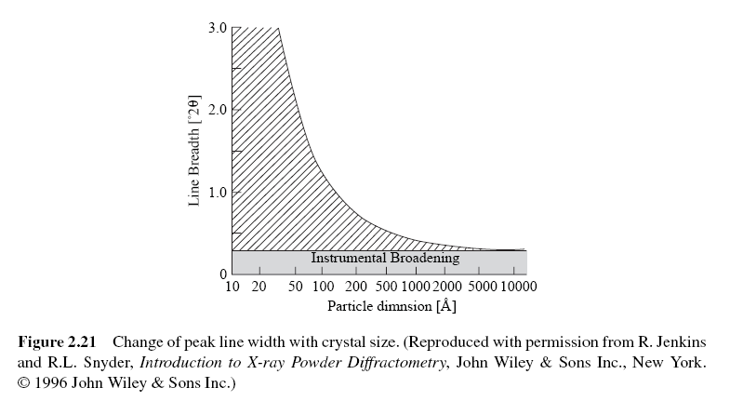

Slide 6
Indexing of cubic patterns
In the cubic system
so Bragg’s law becomes:
so:
because of restrictions on h,k,l different cubic crystal structures will have characteristic sequences of diffracted peak positions
constant for a given crystal
always equal
to an integer

Slide 7
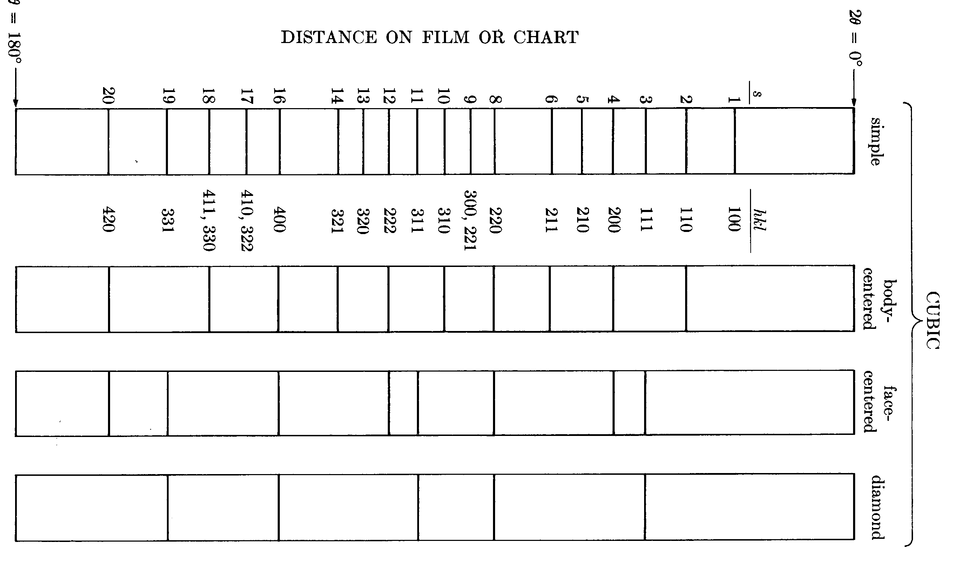
Characteristic line sequences in the cubic system
Simple cubic: 1, 2, 3, 4, 5, 6, 8, 9, 10, 11, …
Body-centered cubic: 2, 4, 6, 8, 10, 12, 14, 16, …
Face-centered cubic: 3, 4, 8, 11, 12, 16, 19, 20, …
Diamond cubic: 3, 8, 11, 16, 19, …

Slide 8
Non-cubic structures -- much more complex!
Cubic:
Tetragonal:
Orthorhombic:
Hexagonal:
Rhombohedral:
Monoclinic:

Slide 9
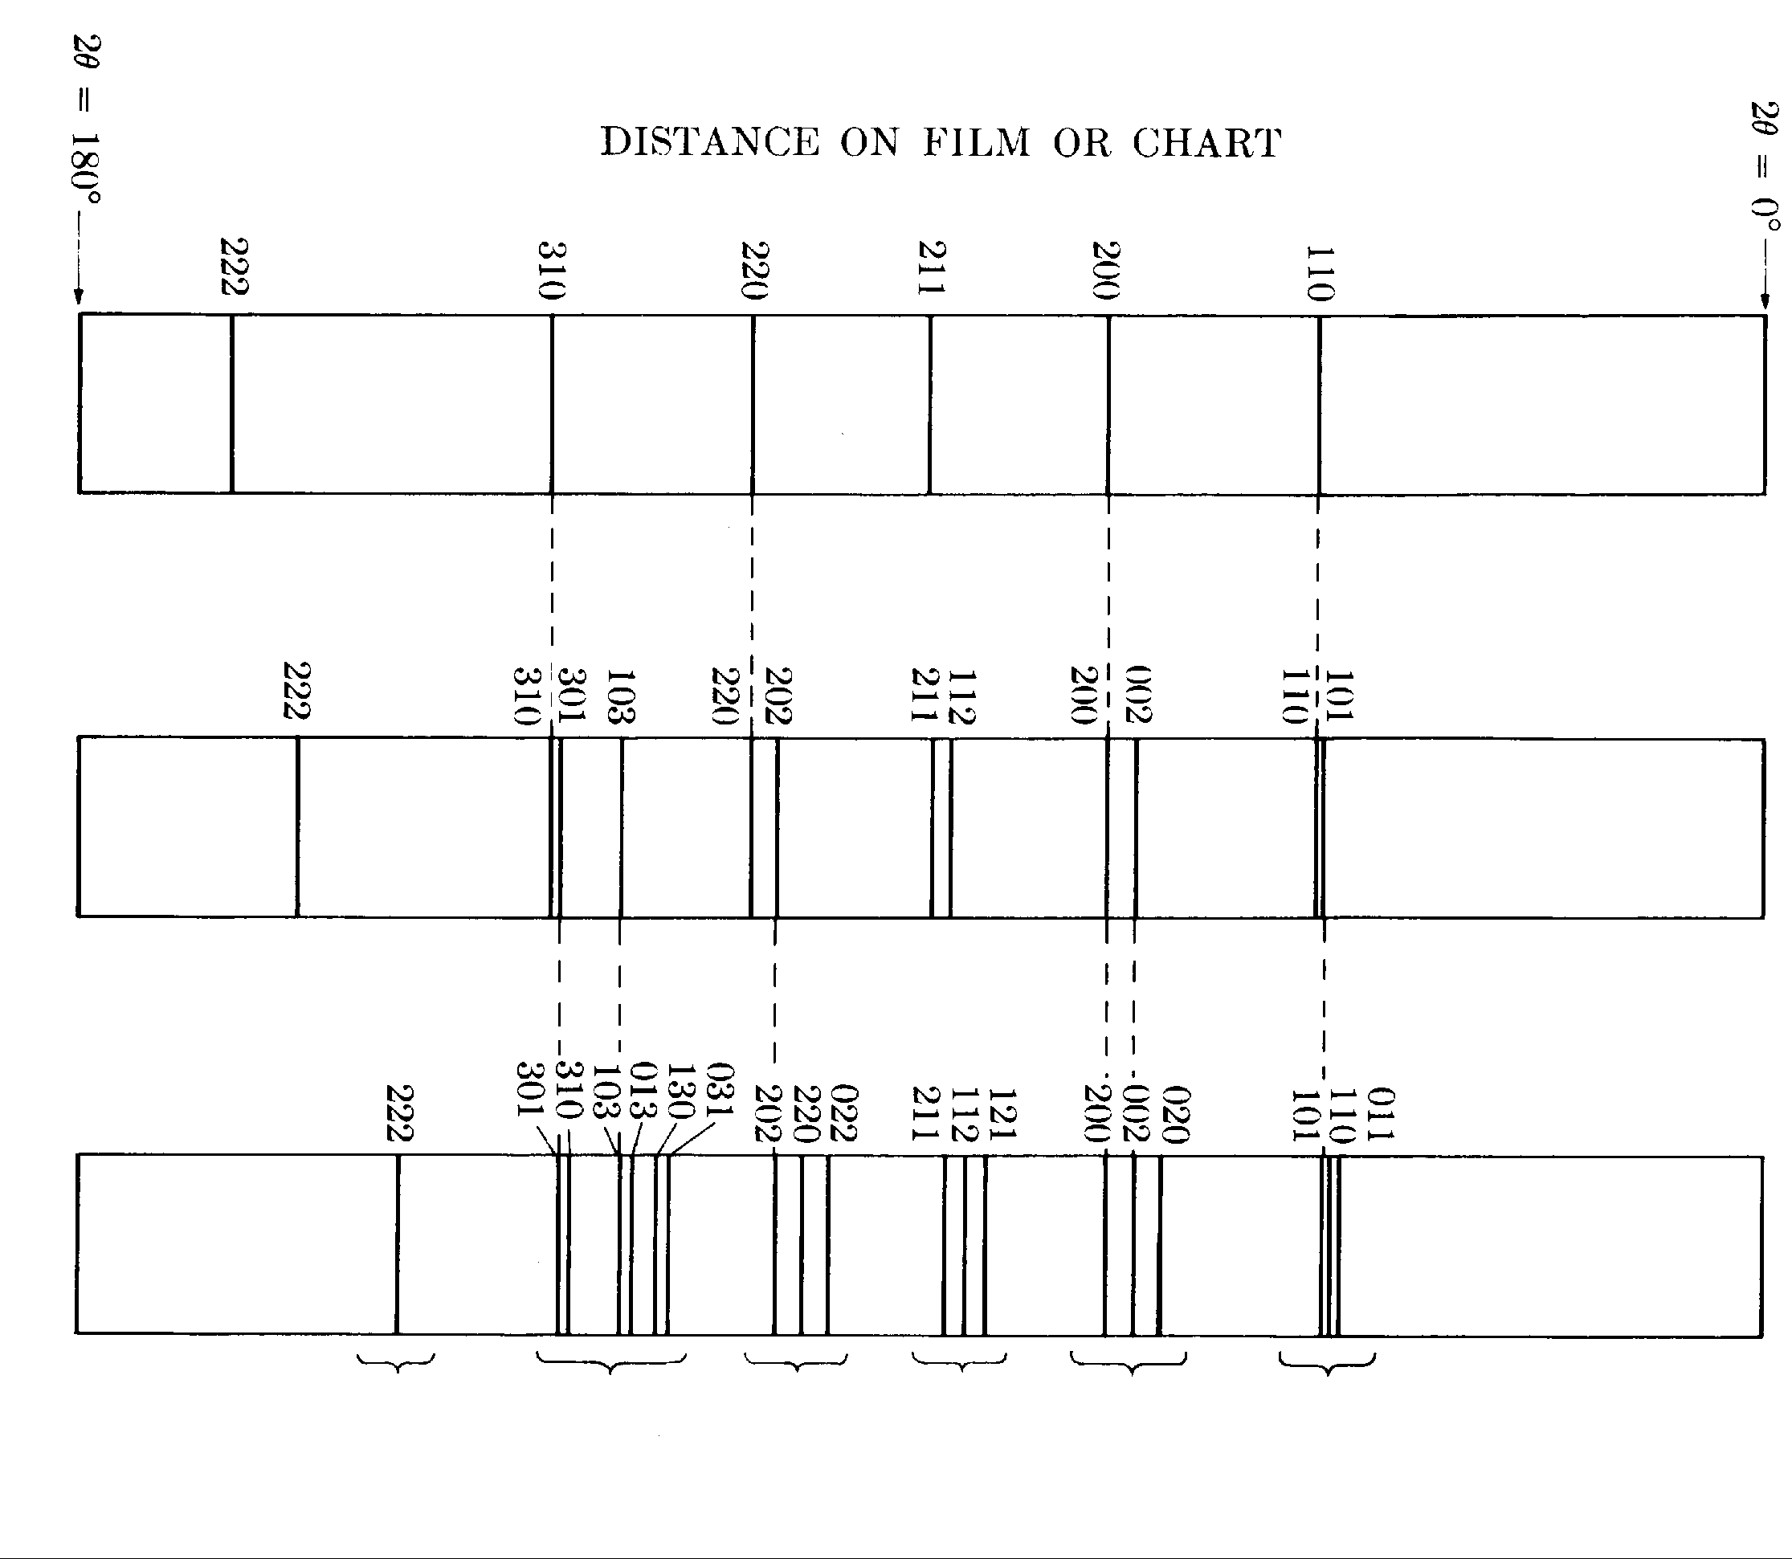
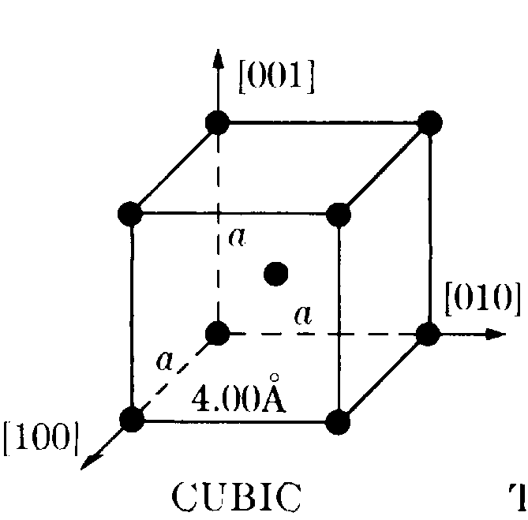
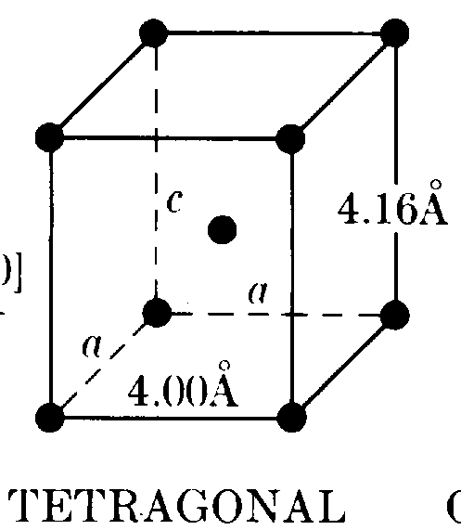
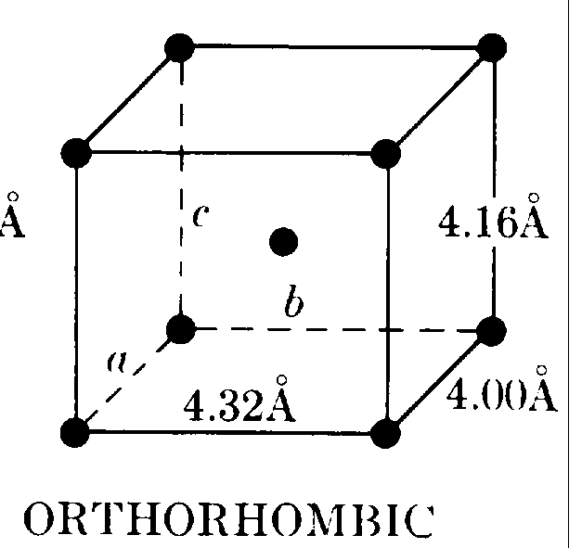
Deviations from cubic

Slide 10
Graphical methods for tetragonal structures
start with the expression for 1/d
consider two lines; take the logs of both sides
the difference:
depends on h,k,l and c/a

Slide 11
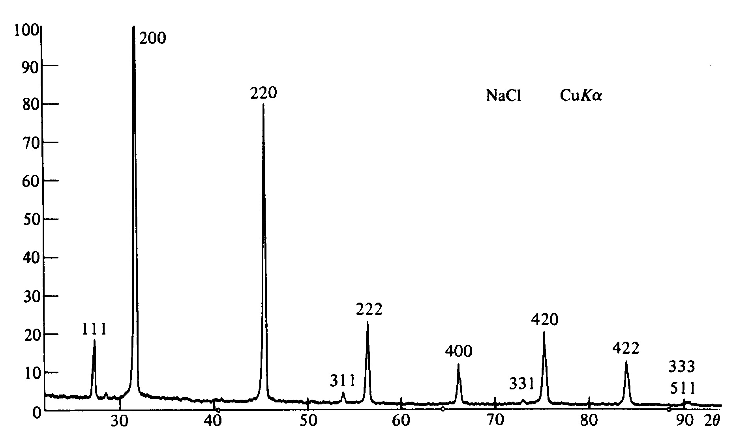
Example #1 -- NaCl
NaCl was the first structure solved by X-ray diffraction

Slide 12
Orientation

Slide 13
Why do we want to make precision lattice parameter measurements?
composition in solid solutions (a_{o} versus x) -- Vegard’s Law
thermal expansion
effects of processing (radiation damage, ion implantation)
residual stress

Slide 14
Factors affecting accuracy in X-ray diffraction measurements
look at Bragg’s Law: λ = 2d sin θ
one equation and two unknowns
uncertainty in the absolute value of λ
different units: Å, Å*, kX
systematic errors -- instrument misalignment, mechanical errors, calibration errors, absorption
random errors (mistakes in determining peak positions; other operator errors)

Slide 15
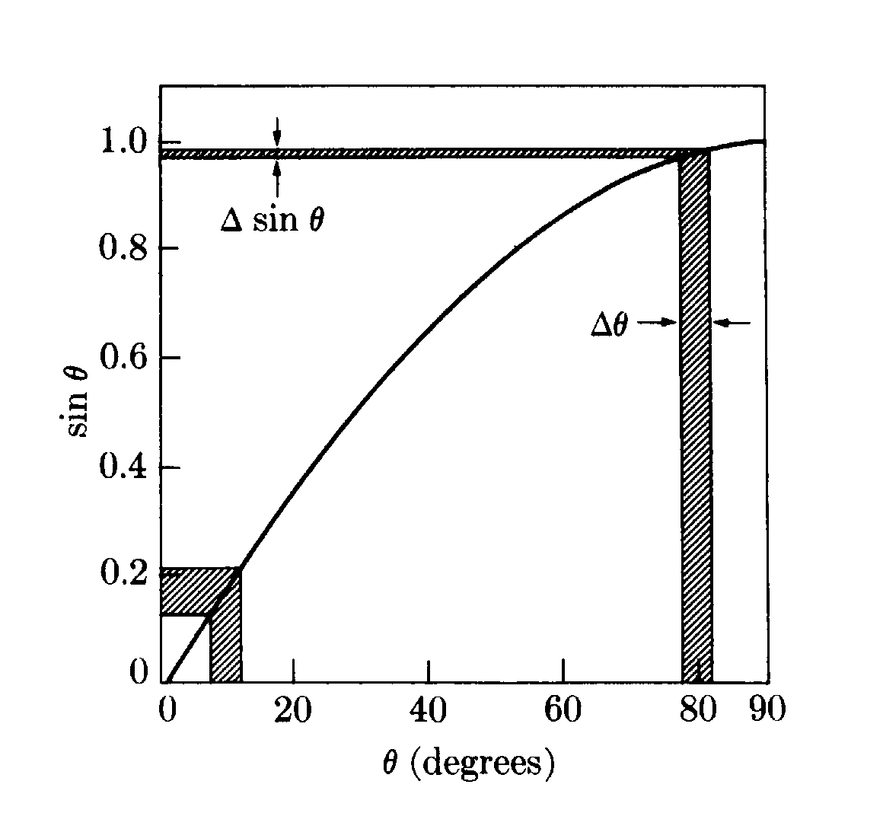
Differentiate Bragg’s Law
Precision lattice parameter measurements are typically performed in the back-reflection regime (2θ→180°)

Slide 16
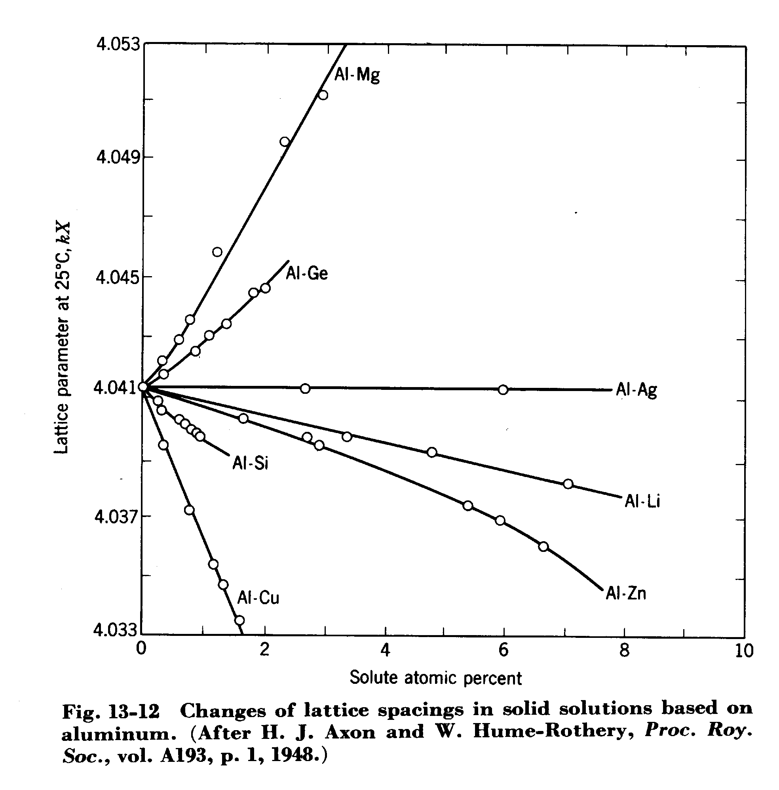

Slide 17
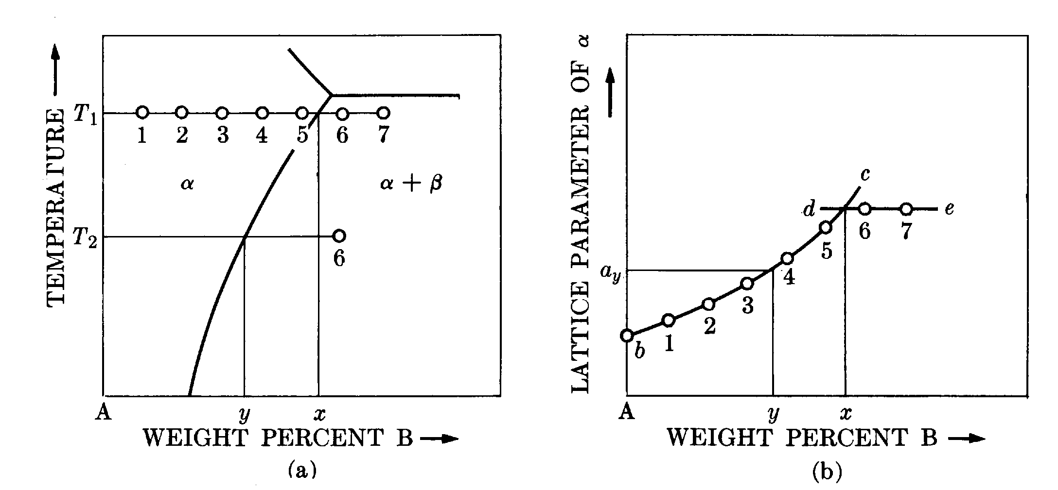
Parametric method

Slide 18
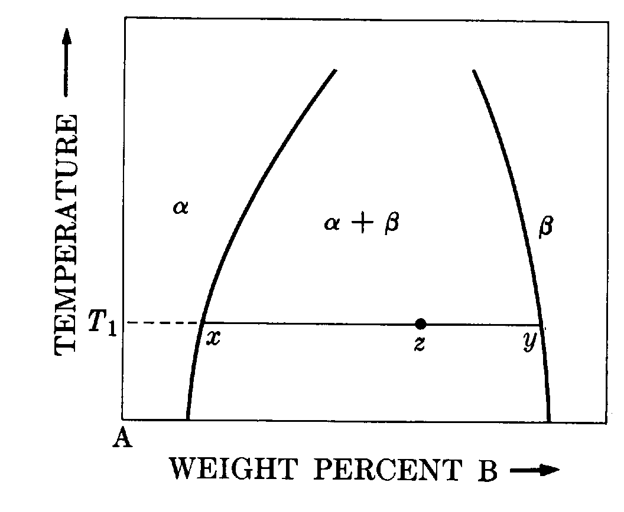
Disappearing phase method
Relies on the “lever rule”:
W_{α} (z-x) = W_{β} (y-z)
As we cross a two-phase field, the powder pattern intensity from one phase will increase, while the other will decrease
Requires accurate intensity data

Slide 19
Order-disorder transformations
In a random solid solution, atoms are arranged (more or less) at random on a crystalline lattice
At a critical (low) temperature, the atoms may spontaneously order (A-atoms preferentially surrounded by B-atoms, and vice versa)
Ordering may exist over many length scales:
short-range order (ordered over a few atomic diameters)
long-range order (ordered over many atomic diameters)
superlattice (ordered over many unit cell, up to the entire crystal)

Slide 20
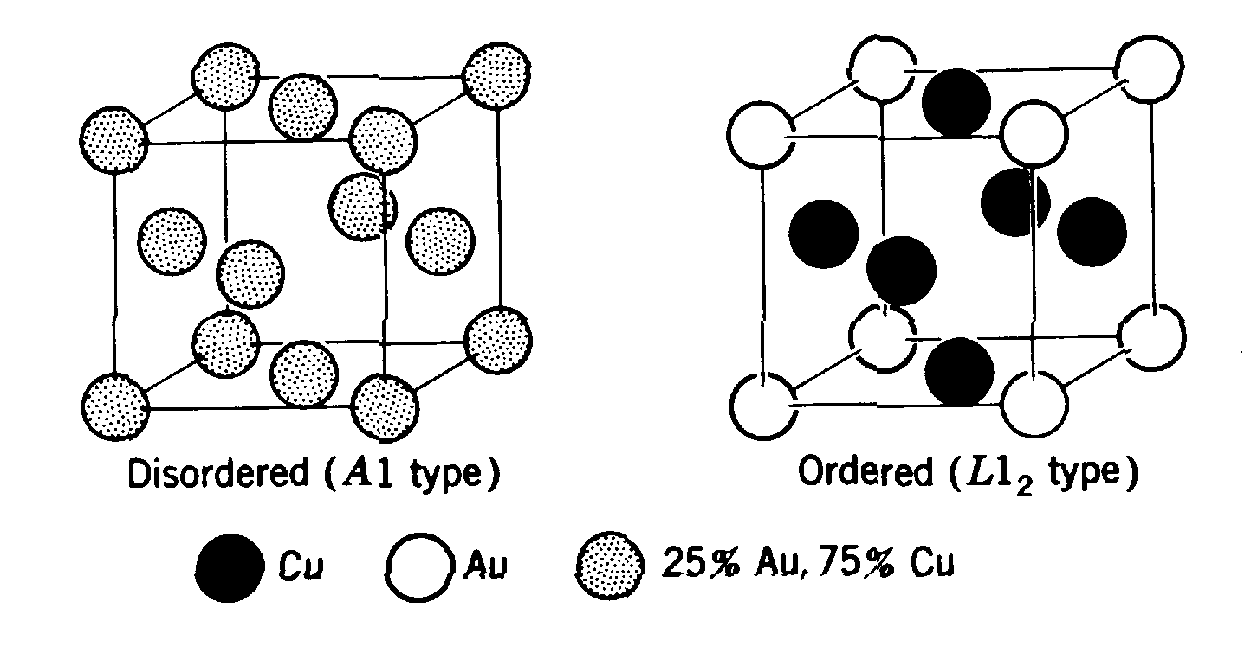
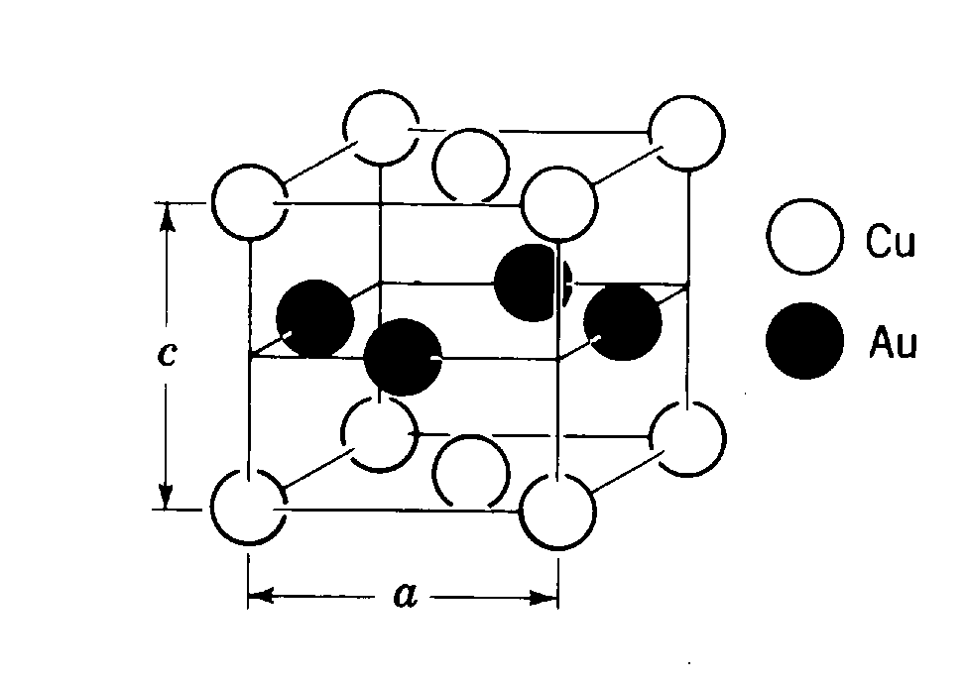
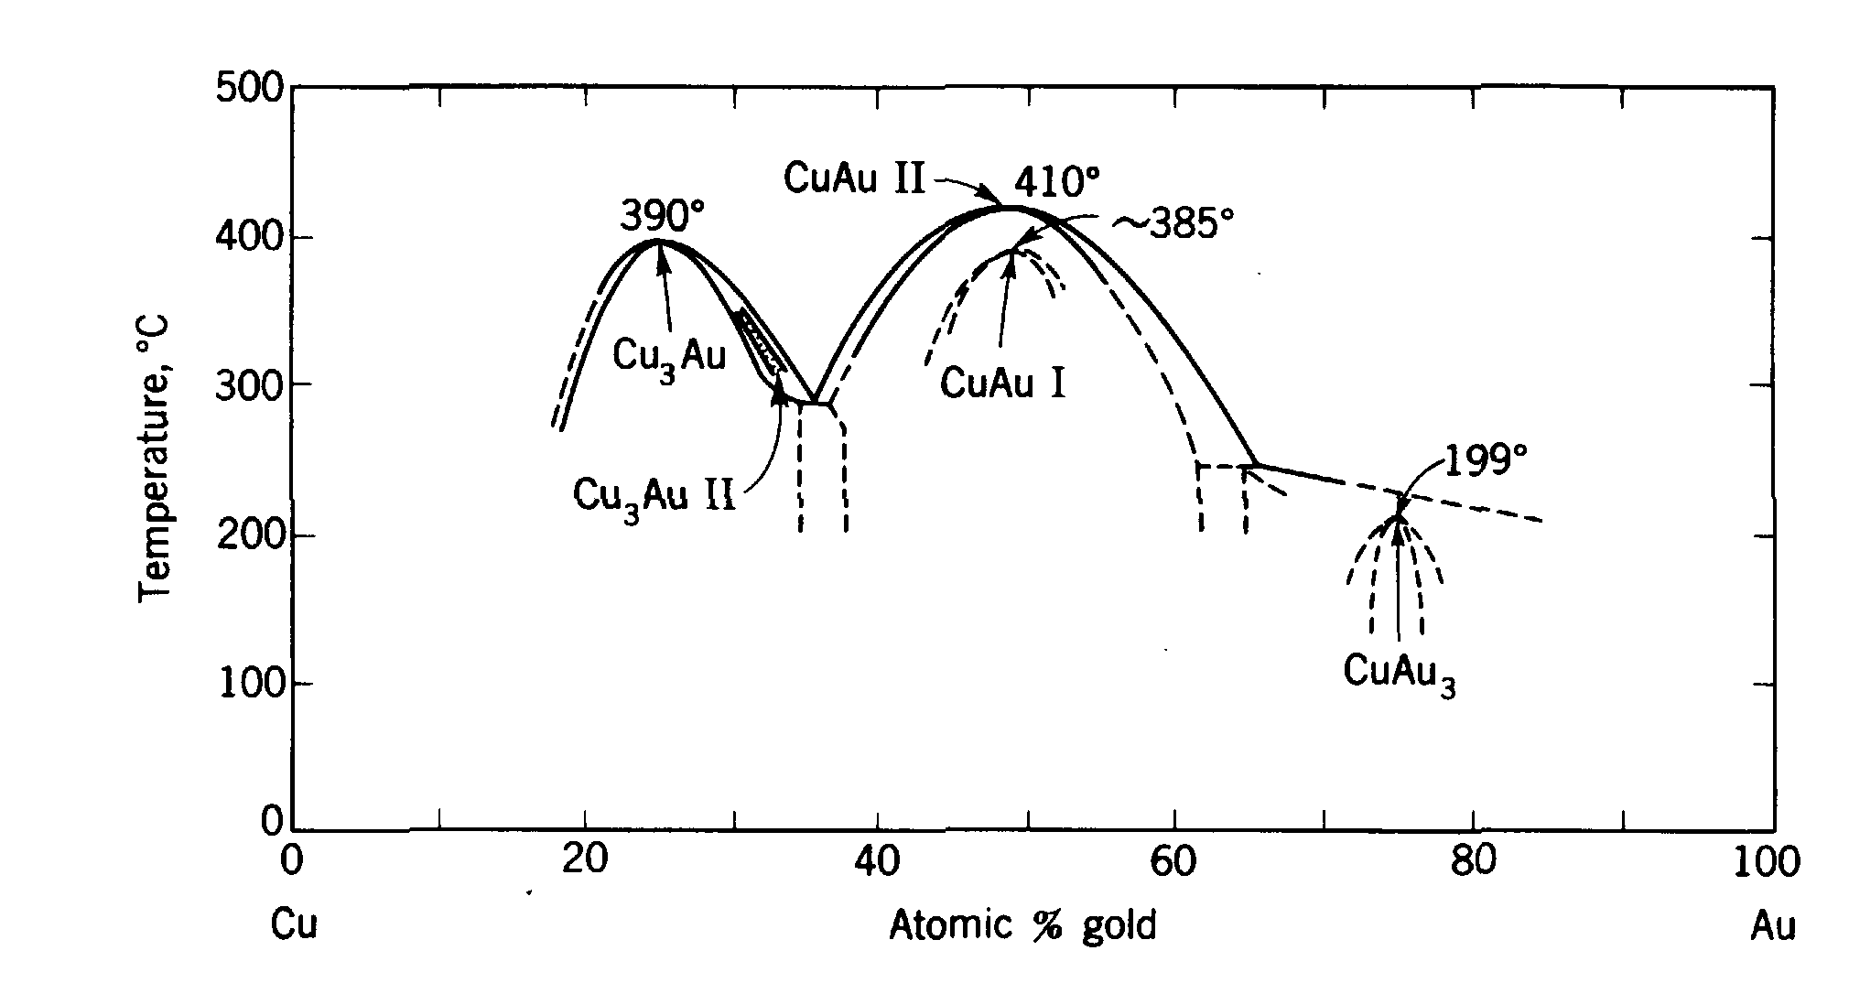
Typical ordered systems
Cu₃Au
CuAu

Slide 21
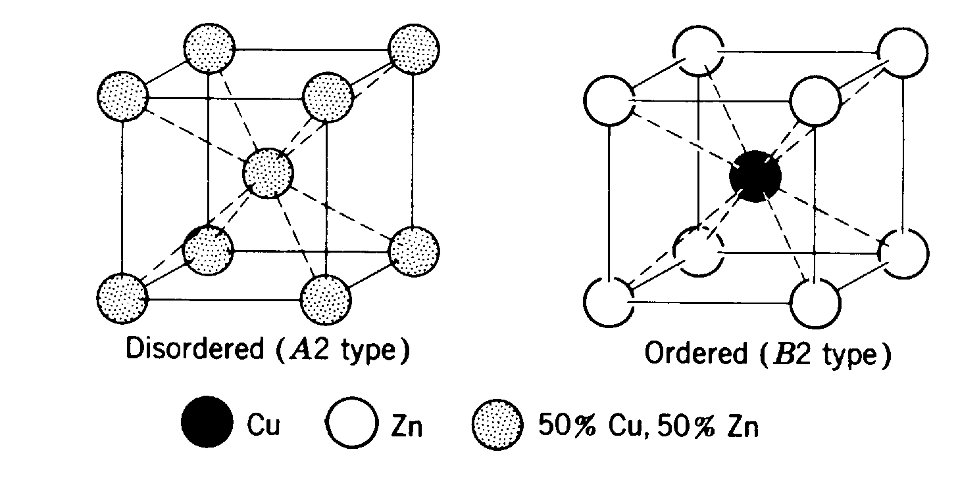
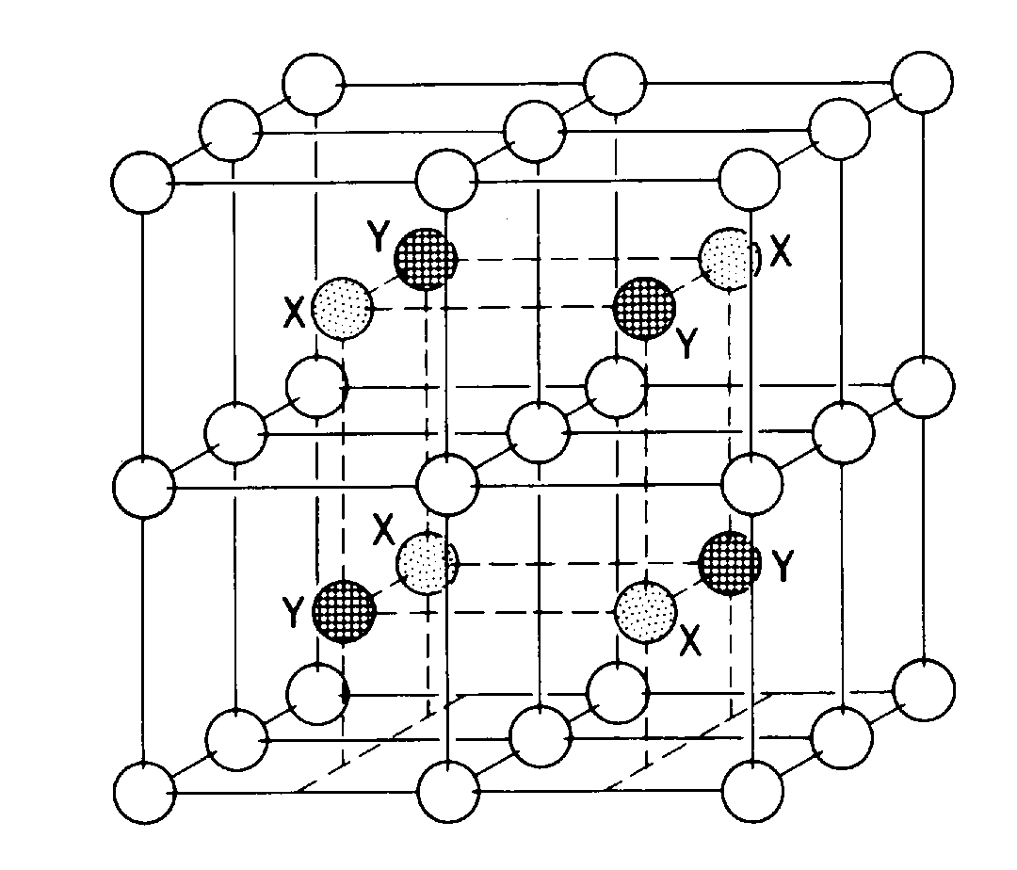
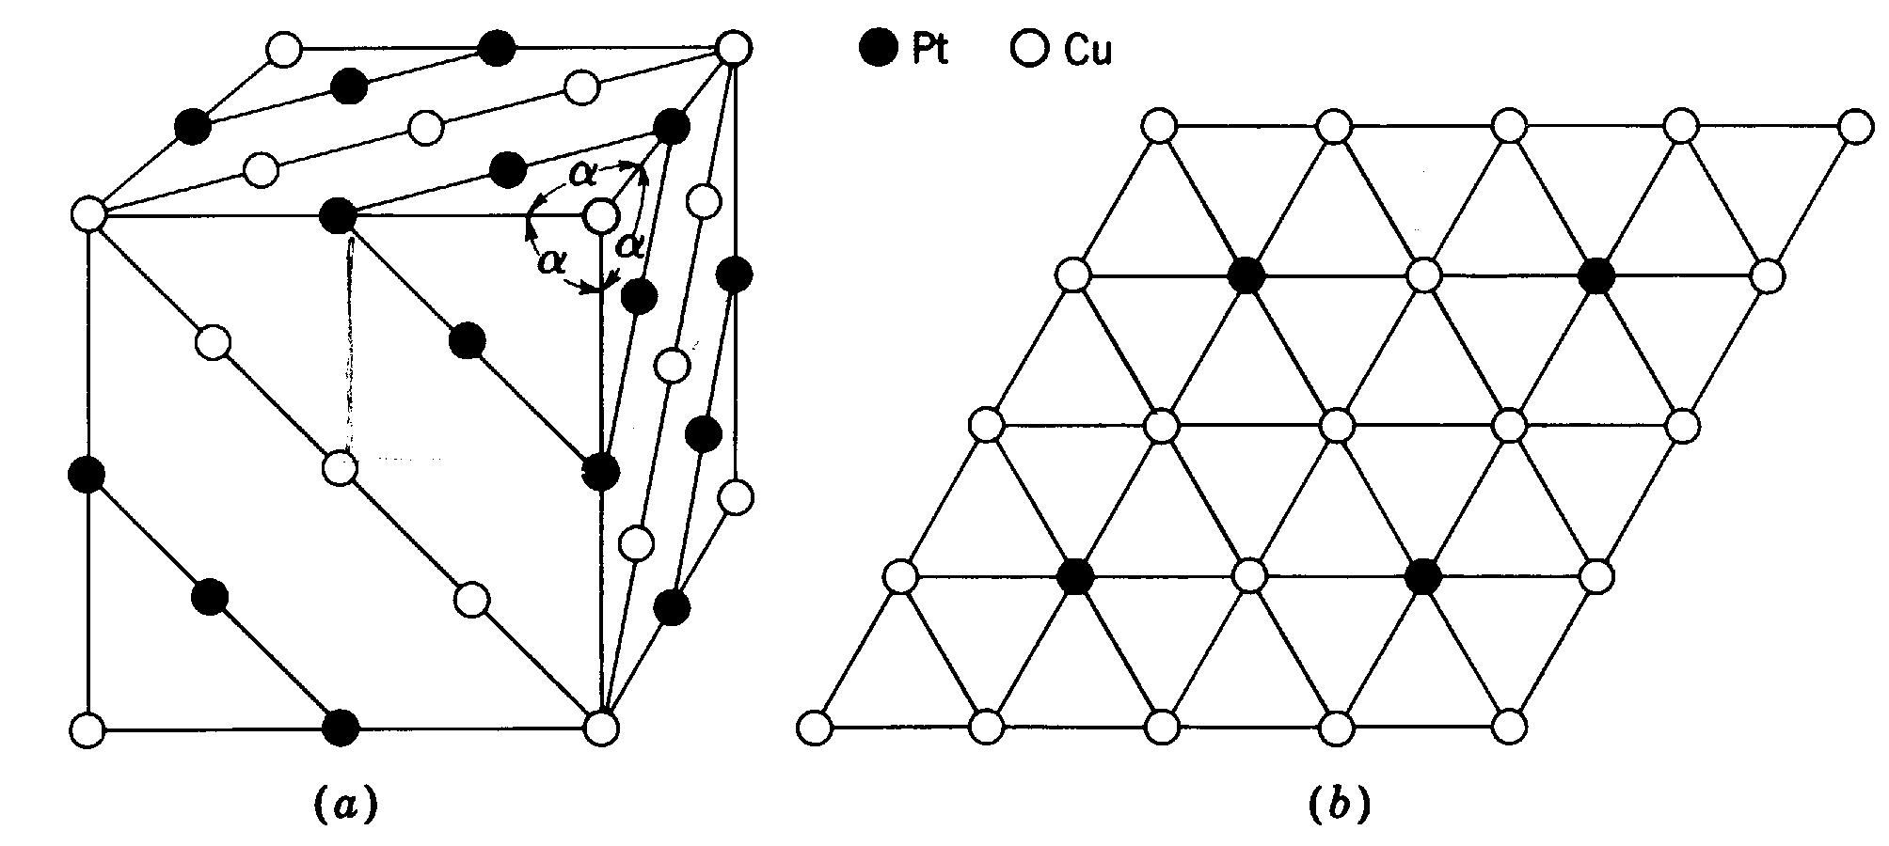
Typical ordered systems
β-brass (CuZn, CsCl-type)
FeAl and Fe₃Al
rhombohedral CuPt

Slide 22
X-ray analyses of order-disorder in Cu₃Au
Disordered structure -- four “average” atoms at 0,0,0; ½, ½, 0; ½, 0, ½; 0, ½, ½
h,k,l unmixed
h,k.l mixed
so:
Ordered structure -- Au at 0,0,0; Cu at ½, ½, 0; ½, 0, ½; 0, ½, ½
h,k,l unmixed (“fundamental lines”)
h,k.l mixed (“superlattice lines”)
so:

Slide 23
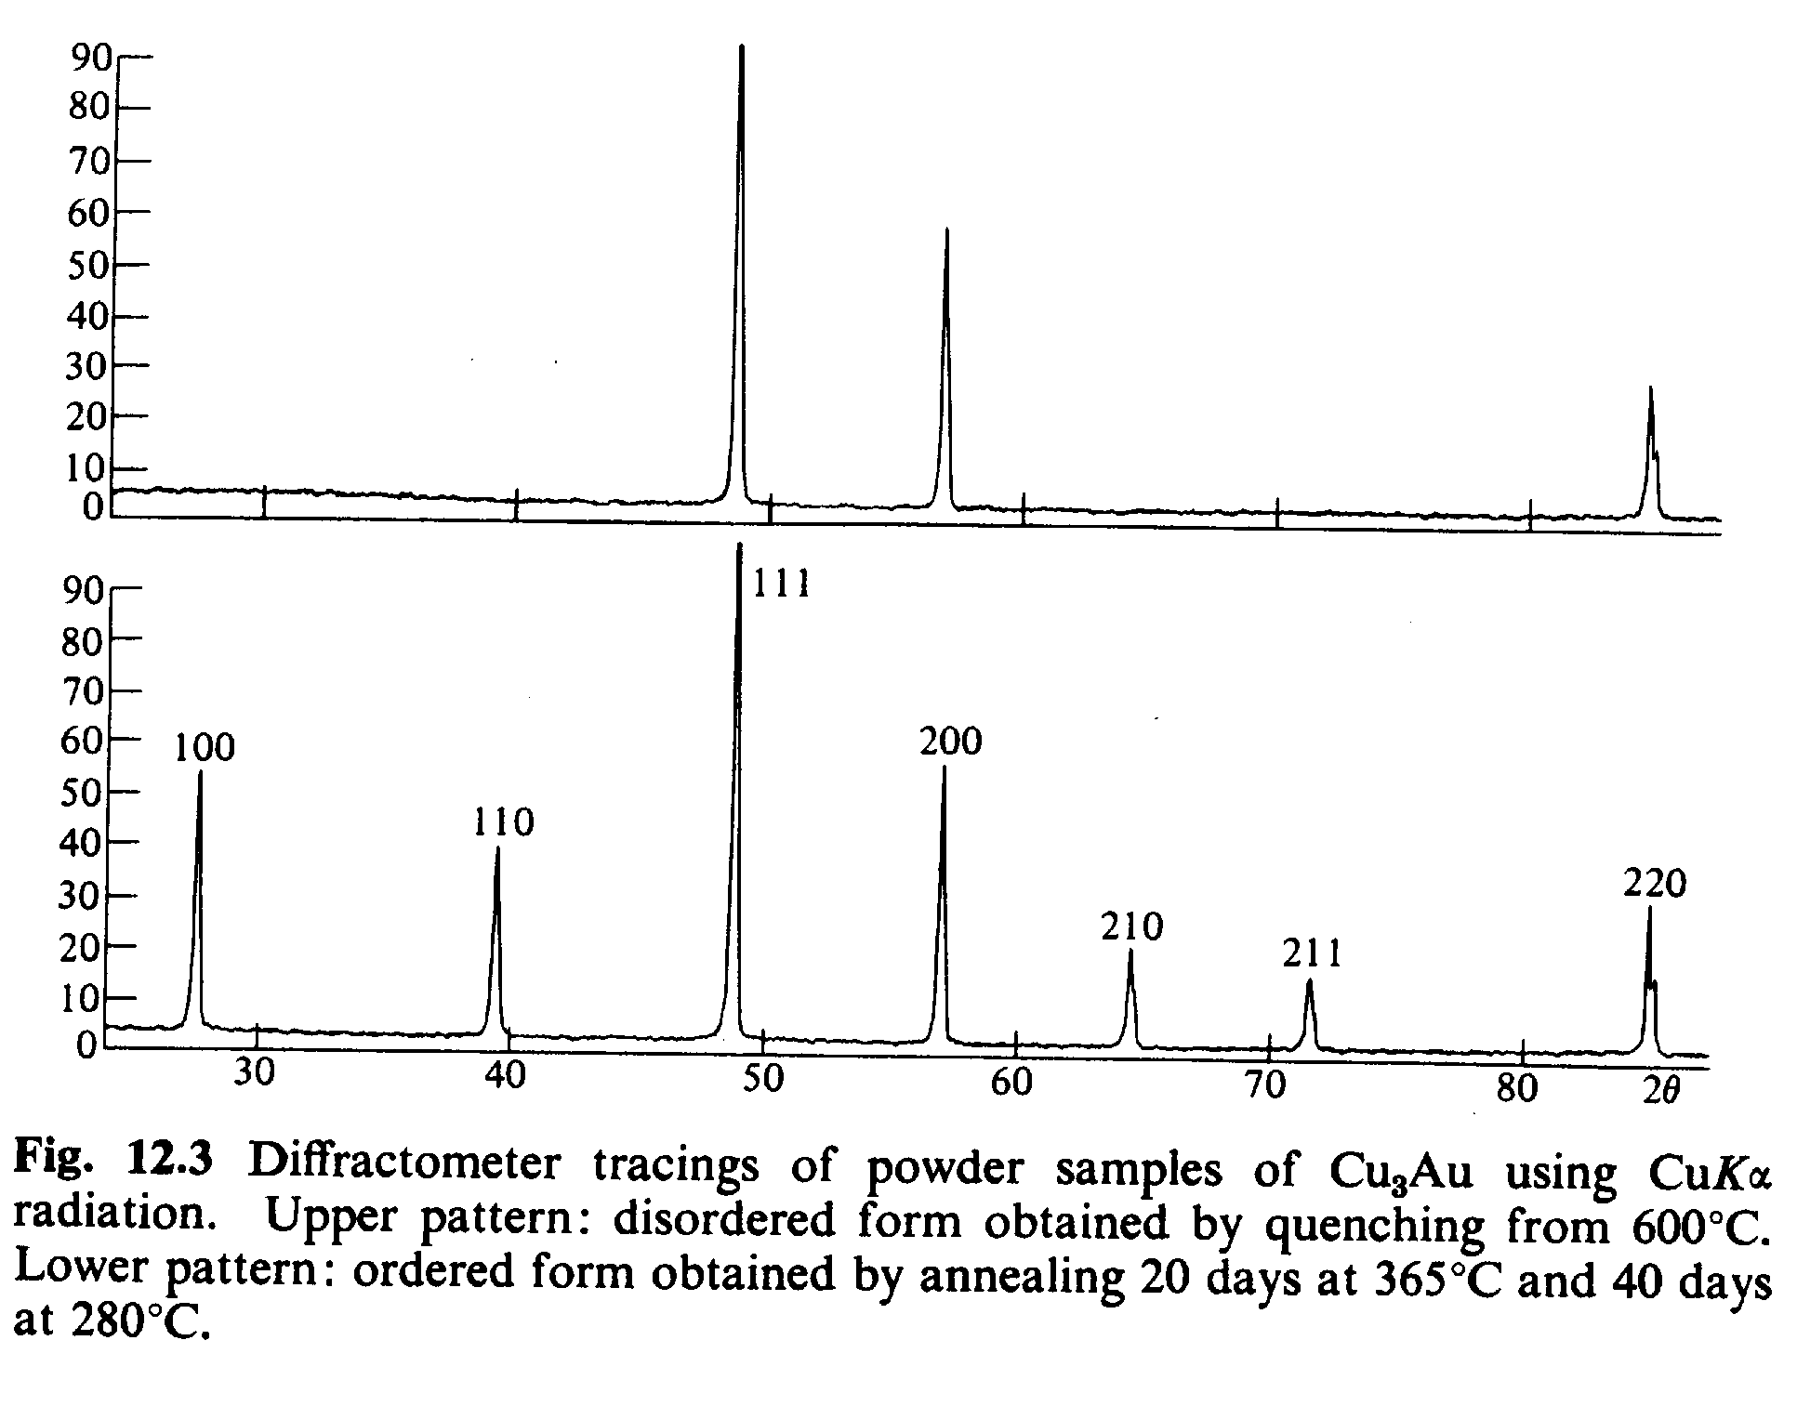
X-ray analyses of order-disorder in Cu₃Au

Slide 24
Basic ideas of chemical analysis by X-ray diffraction
Qualitative analyses -- the goal is to determine what phases are present
Quantitative analyses -- the goal is to determine how much of each phase is present
Note that diffraction methods determine phases, not elements
Diffraction methods have the advantage that the sample does not have to be dissociated, dissolved, or otherwise changed

Slide 25
Quantitative analysis of mulitphase mixtures
Basic assumption: the diffracted intensity from a particular phase in a multiphase mixture is proportional to the concentration of that phase in the mixture
The intensity diffracted by a single-phase powder specimen in a diffractometer is given by:
Fortunately we can simplify this expression to:
we can cancel out the unknown K₁ if we can measure the ratio of I_{α} to some reference line

Slide 26
Methods for quantitative phase analyses
External standard method – compare the experimental line intensity from the mixture to a line from a pure phase
Direct comparison method – compare the experimental line intensity from the mixture to a line from another phase in the mixture
Internal standard method – compare the experimental line intensity from the mixture to a foreign material mixed with the sample

Slide 27
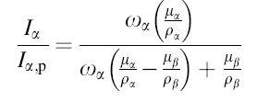
External standard method
The intensity form a pure phase can be written (where p = “pure”) as:
The absorption coefficient is written as:
Writing the concentration in terms of w_{α}ρ_{m}/ρ_{α} so:
Divide the third equation by the first:

Slide 28
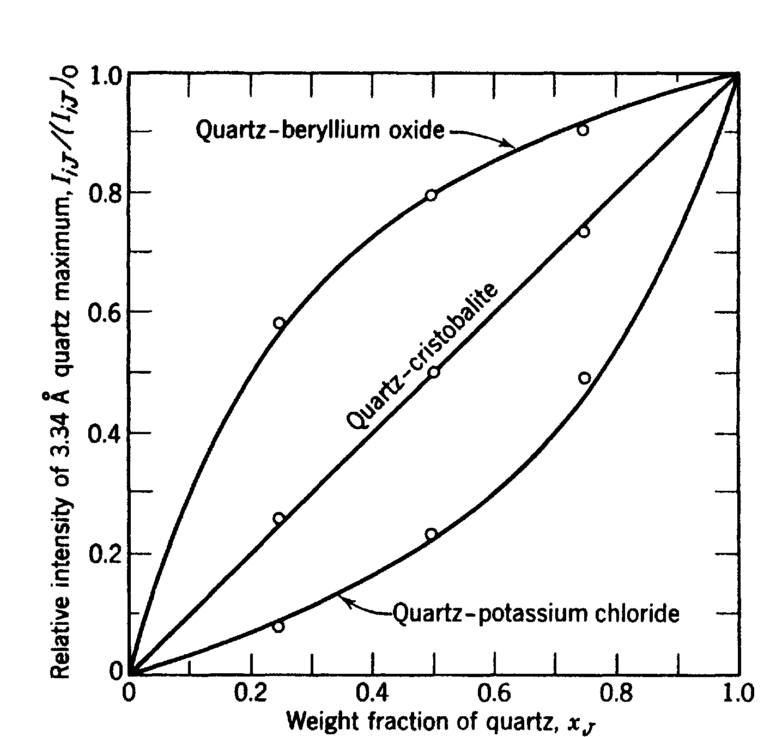
External standard method
Method requires that the mass absorption coefficient of each phase in a two-phase mixture is known
The intensity ratio I_{α}/I_{αp} is linear in w_{α} only when the mass absorption coefficients of the two phases are the same
Measurements of I_{α} and I_{αp} must be made under identical conditions

Slide 29
Direct comparison method
and with a little algebra we get:
where c_{α} + c_{γ} =1 in a two-phase mixture
The α and γ reflections should be well separated from each other
The unit cell volume should be calculated from the observed lattice parameters (since we may have solid solutions)
The integrated intensities must be used

Slide 30
Internal standard method
A diffraction peak from the phase (whose volume fraction is being determined) is compared with a peak from a standard substance (thus restricted to powders)
intensity from phase a (c_{α} = conc. before the addition of standard
intensity from one
line of the standard
Dividing we get:
This method can be extended to multi-component mixtures
By mixing known concentrations of phase α and a constant concentration of a suitable standard and measuring the ratio I_{α}/I_{S} we can establish a calibration curve for measuring α in an unknown specimen

Slide 31
Origin of residual stresses
Residual stresses arise in all materials due to processing
heat-treatment or welding -- differential cooling of one part of a body with respect to another
mechanical processing (shot-peening)
differences in thermal expansion coefficients
A part with a larger
dimension is being fit to a smaller piece; it is first compressed
The compressed part, when joined, will try to elongated, creating a tensile load
The thicker piece hold the thinner one in place, putting it in compression

Slide 32
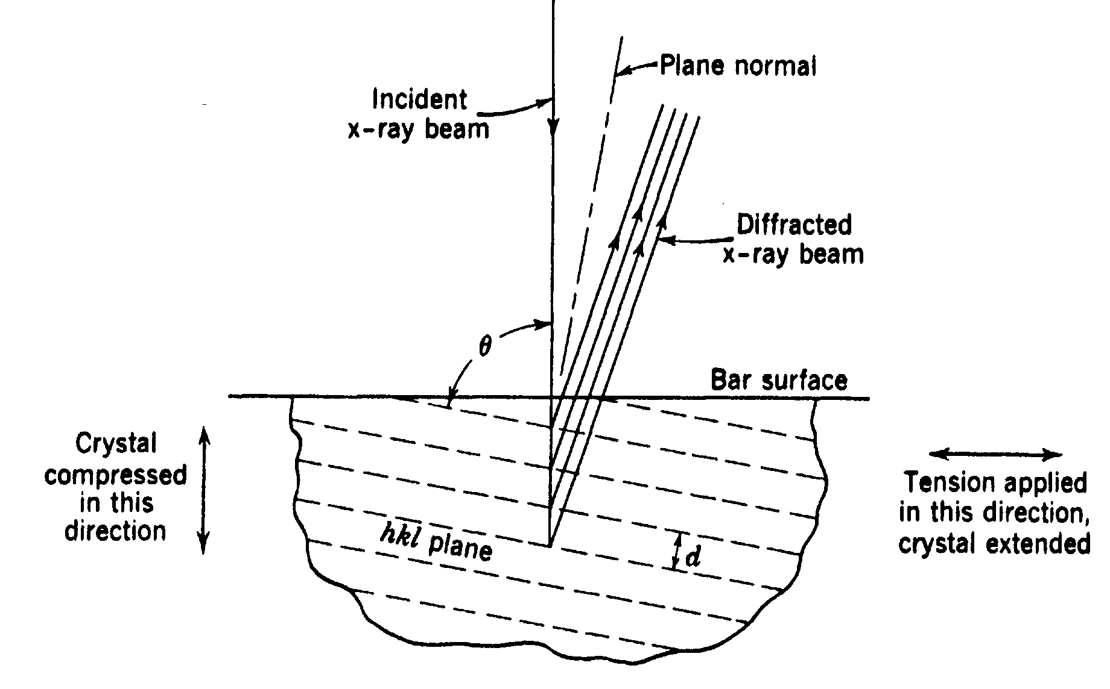
Advantages of X-ray diffraction for residual stress measurements
X-ray diffraction is the only analytical method that can non-destructively measure residual stresses in materials (actually, measure strain, then calculate stress
The unit cell is used as the “strain gauge” for the measurement
Measurements can be made on “real” samples

Slide 33
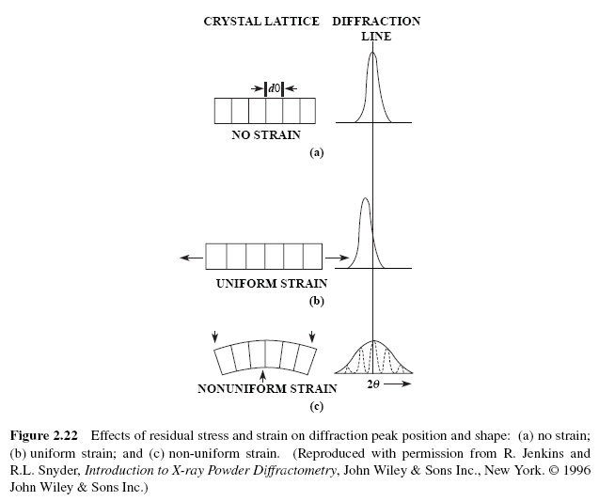

Slide 35
Review of elastic stress-strain relationships
y
Consider a bar of cross-section A subjected to a tensile load in the y-direction
The stress σ_{y}=F/A causes a strain ε_{y}:
σ_{y}, ε_{y}
− ε_{x}
This will cause a stress in the z-direction:
ε_{x} = ε_{z} = –νε_{y}= –νσ_{y}/E
where ν is Poisson’s ratio and E is the elastic modulus
− ε_{z}
x
z

Slide 36
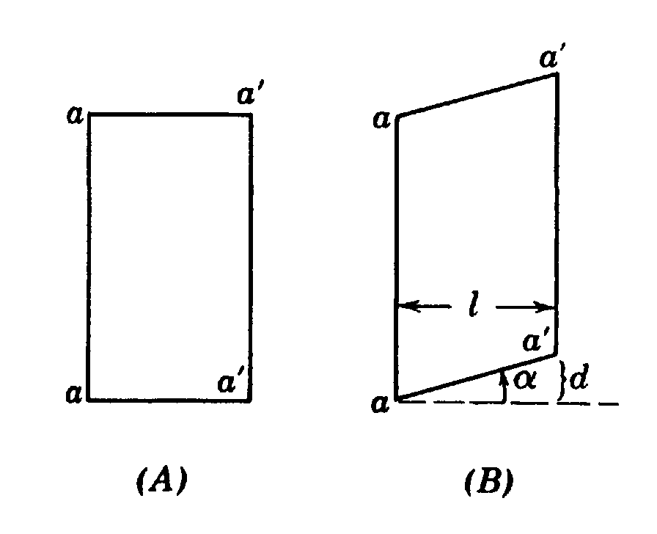
Review of elastic stress-strain relationships
In a three-dimensional stress system we have
these are the normal strains since they are normal to the surface
The normal strains are usually accompanied by shear strains in a plane perpendicular to the stress direction:

Slide 37
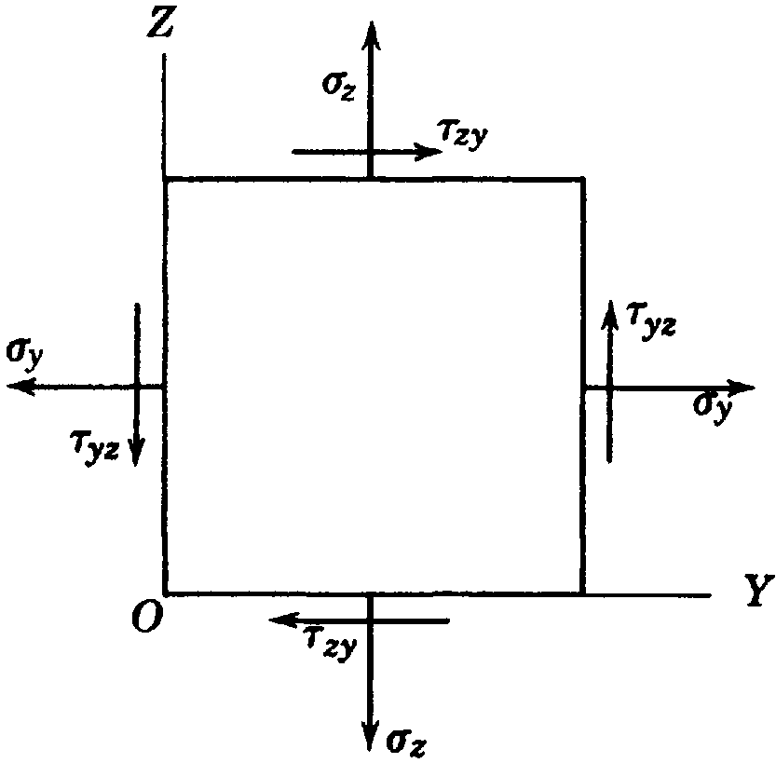
Review of elastic stress-strain relationships
The shear strain γ and shear stress τ are related:
The shear strains cannot be detected by X-ray diffraction, but the normal strains can:
Problem -- use of this equation requires a knowledge of d₀, and that is something we usually do not know

Slide 38
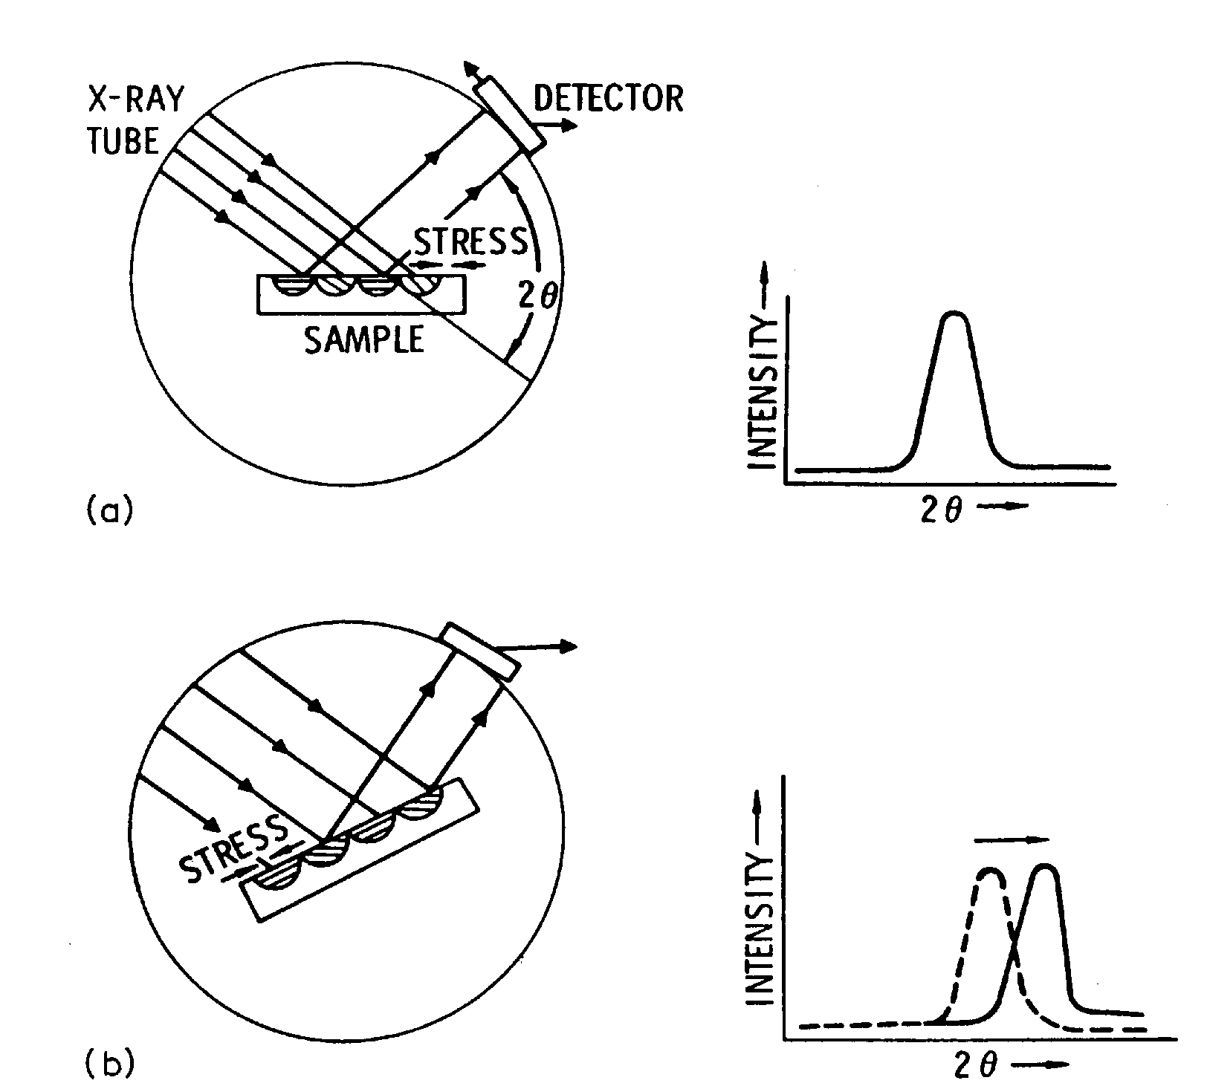
The “sin² ψ” method
The sin²ψ method relies on the fact that if a surface in under biaxial stress, nominally identical crystallographic planes at different angles with the surface will have different d-spacings

Slide 39
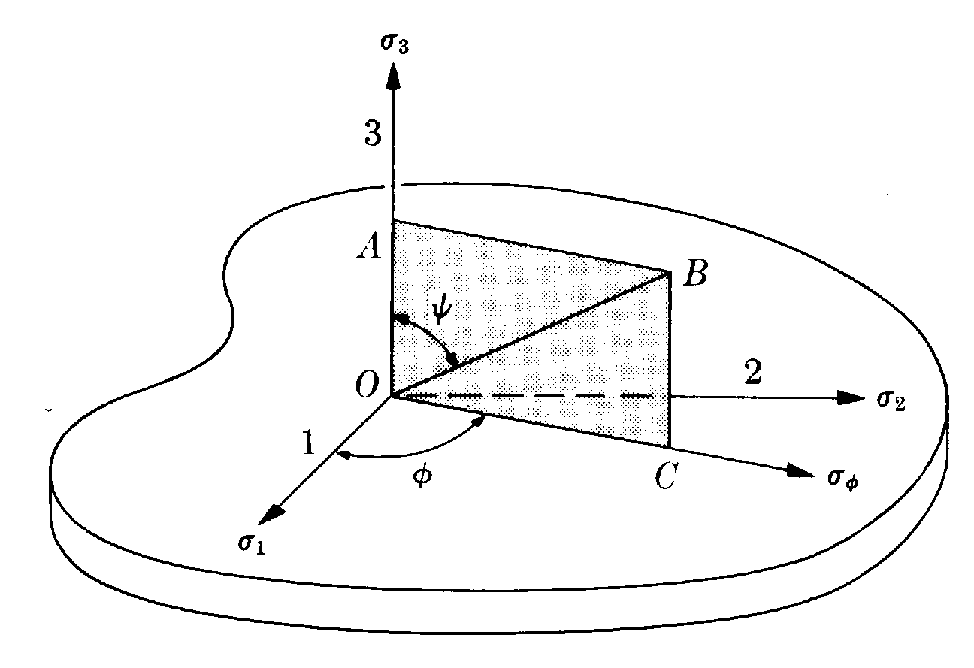
The “sin² ψ” method
d normal to surface
Consider a biaxial stress in a surface (σ₃ = 0):
for an isotropic solid,
or

Slide 40
The “sin² ψ” method
Back to
and rewrite the strain:
so the stress becomes:
The stress in a surface can be determined by measuring the d-spacing as a function of the angle ψ between the surface normal and the diffracting plane normal
Measurements are made in the back-reflection regime (2θ → 180°) to obtain maximum accuracy

Slide 41
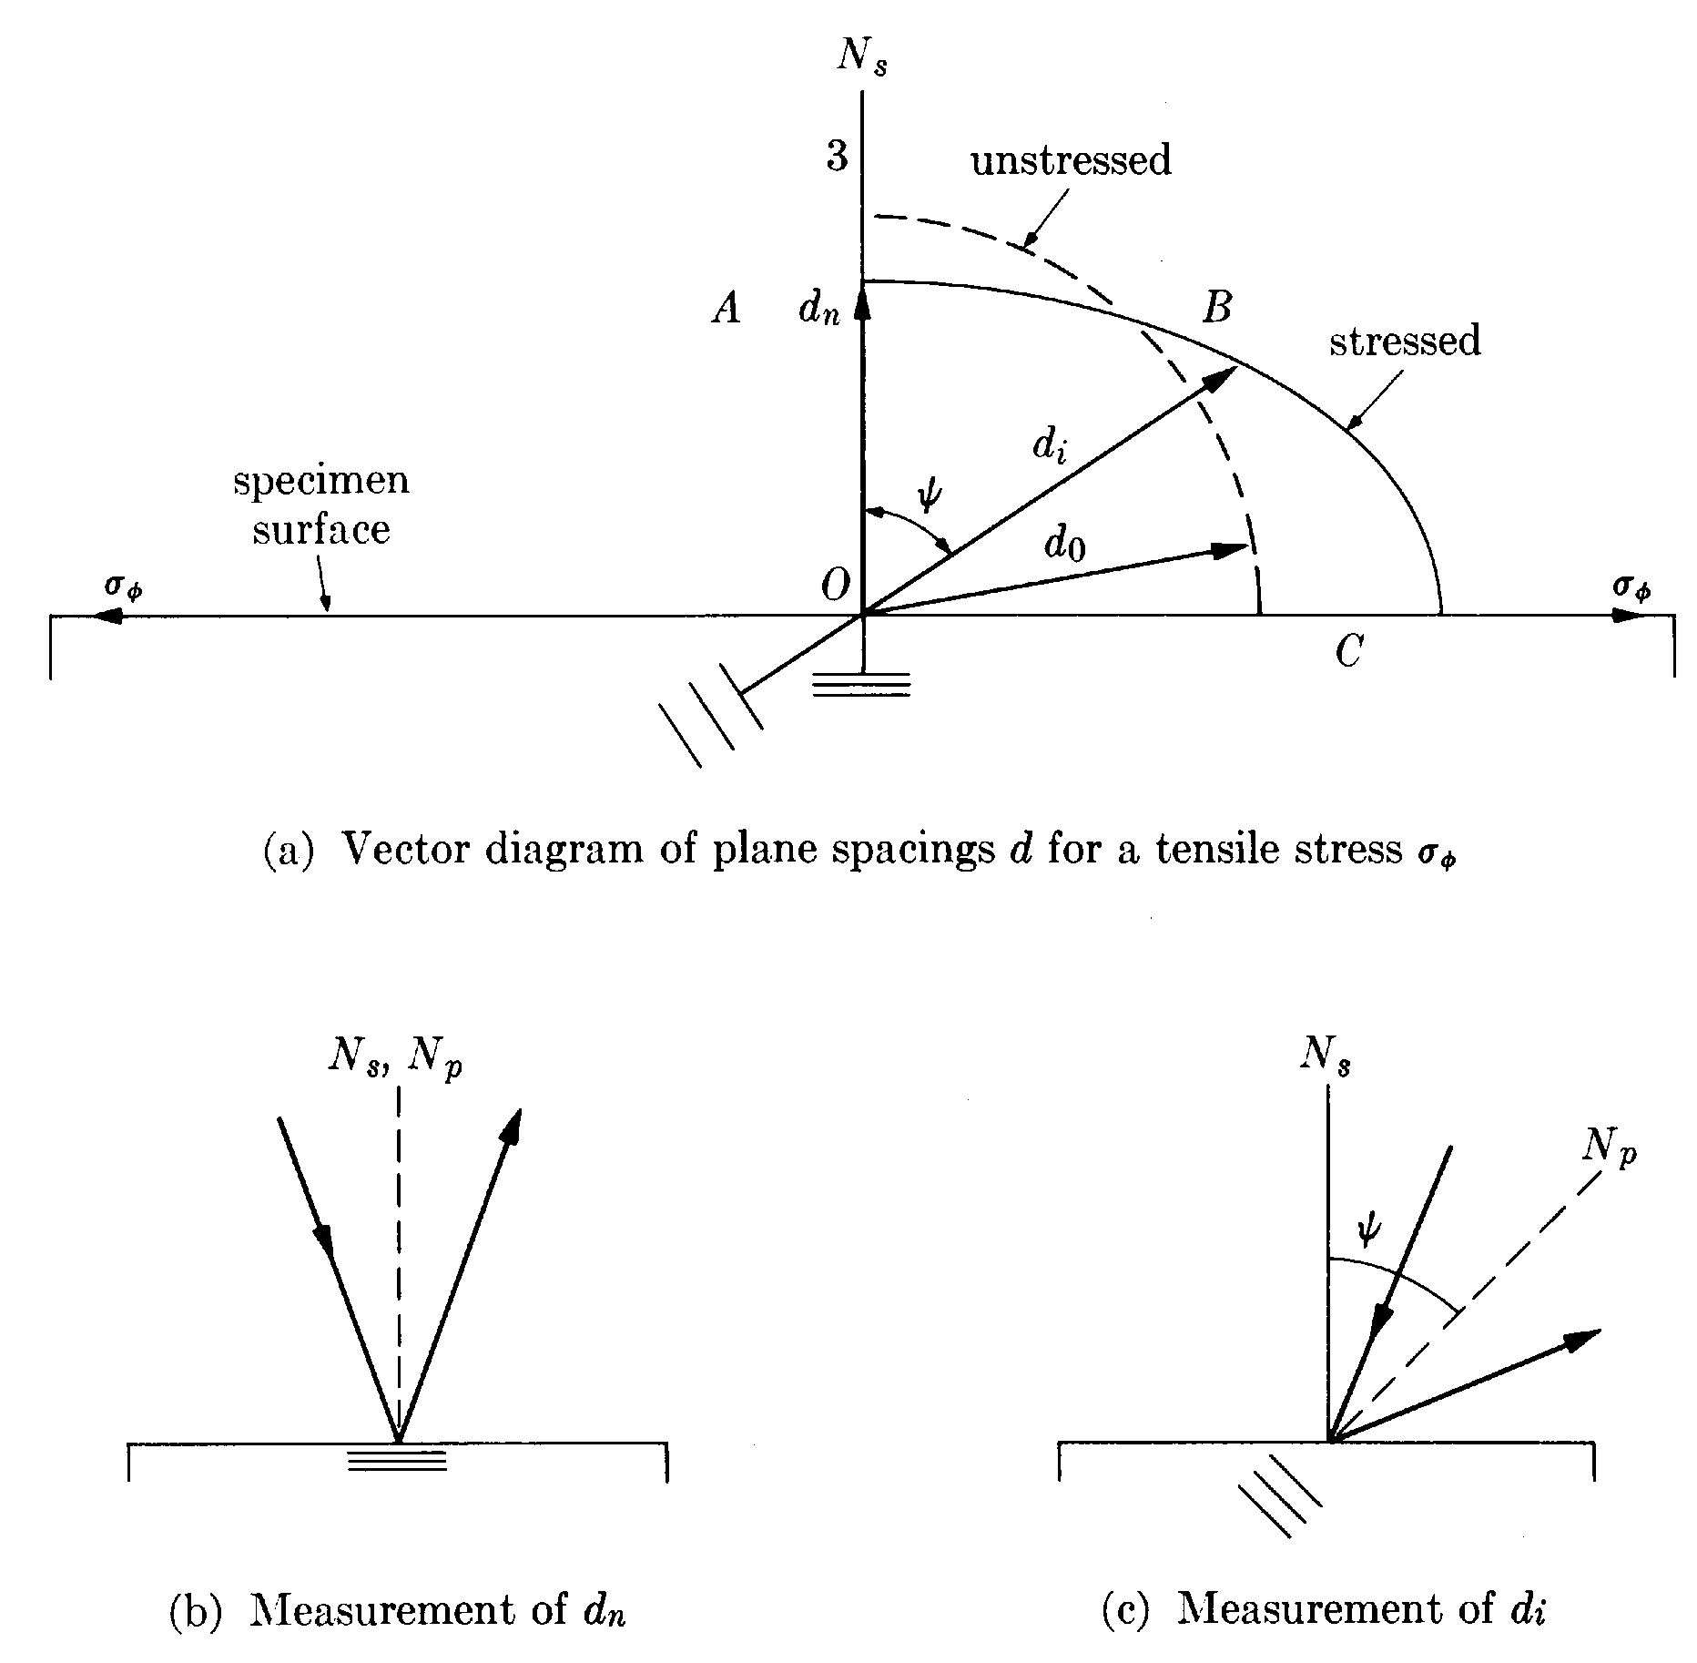
Example: At 2θ ≈ 156° for steel, a stress of 700 Mpa
gives a peak shift of 2° 2θ as ψ is increased from 0° to 60°

Slide 42
