Slide 2
1-4-1-2- First-order chemical reaction preceding an irreversible electron transfer
C_{r}E_{i}
Irreversibility of charge transfer lack of reverse peak
k_{f}
k_{r}
Y Ox
Ox + ne⁻ Red
kº

Slide 3
1.4.1.2 First-order chemical reaction preceding an irreversible electron transfer
slow
K_{f}+k_{r} << α.n_{α}.F.v/R.T
The peak height of the process depends on the equilibrium constant (C* =C_{ox}+C_{Y})
fast
K_{f}+k_{r} >> α.n_{α}.F.v/R.T
Large K : The response appears as if the preceding chemical reaction would be absent (more negative potential for E_{p})
Small K : recognizable S-like curve voltammogram having a limiting current independent from the scan rate
intermediate
K_{f}+k_{r} ≈ α.n_{α}.F.v/R.T
Reaction kinetics are neither too fast nor too slow
K is neither too large nor too small
Then:

Slide 4
1.4.1.2.1 Diagnostic criteria to identify a chemical reaction preceding an irreversible electron transfer
1
S-shaped curve voltammogram
2
increasing i_{pf}/v^{1/2} with v

Slide 5
1.4.2 Following chemical reactions (EC)
Little influence on the forward peak but considerable effect on the reverse peak
Ox + ne⁻ Red
Red Z

Slide 6
I .4.2.1 First-order reversible chemical reaction following a reversible electron transfer
E_{r}C_{r}
Ox + ne⁻ Red
Red Z
k_{f}
k_{r}
Slow
K_{f}+k_{r} << n.F.v/R.T
little effect on the process
simple reversible electron transfer

Slide 7
voltammetry
fast
K_{f}+k_{r} >> n.F.v/R.T
Always be in equilibrium
voltammogram will look like a noncomplicated reversible electron transfer
Potentials less negative than that of a simple electron transfer by an amount of
Due to the fast kinetics of the chemical complication, the Potential will remain at this value regardless of the scan rate

Slide 8
intermediate
K_{f}+k_{r} ≈ n.F.v/R.T
i_{pr}/i_{pf} is about 1 at low scan rates but tends to zero at high scan rates
the reverse peak tends to disappear with scan rate
voltammetry

Slide 9
voltammetry
1.4.2.1 .1 Diagnostic criteria to identify a first-order reversible chemical reaction following a reversible electron transfer
Potential
E_{pf} moves towards negative values with the scan rate
Current
i_{pr}/i_{pf} becomes smaller than 1 with increasing v (the most significant criterion)
i_{Pf} /v^{1/2} mains essentially invariant with the scan rate

Slide 10
1.4.2.2 First-order irreversible chemical reaction following a reversible electron transfer (E_{r}C_{i})
the localization of the voltammetric response depends on the kinetics of the chemical reaction
Different from the other because of not having any K and k_{r}
Ox + ne⁻ Red
Red Z
k_{f}

Slide 11
E_{r}C_{i}
Slow
K_{f}+k_{r} << n.F.v/R.T
The response is very similar
to that of a simple reversible electron transfer at E^{o’}
Intermediate
K_{f}+k_{r} ≈ n.F.v/R.T
E_{p} shifts towards less anodic values with the scan rate
Fast
K_{f}+k_{r} >> n.F.v/R.T
The forward peak is found at potentials more positive than E^{o’}.
The reverse peak is absent
With increasing in scat rate, reverse peak begins to appear

Slide 12
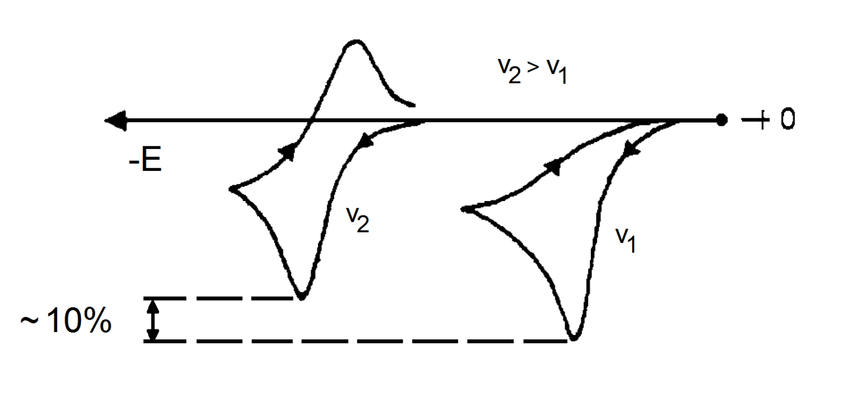
Fig 15
With increasing in scat rate, reverse peak begins to appear
Above this threshold scan rate, i_{pr}/i_{pf} increases
Achieving i_{pr}/i_{pf} = 1, the chemical reaction has been completely prevented
under these conditions E^{o’} can be calculated as the average of the forward and reverse peaks

Slide 13
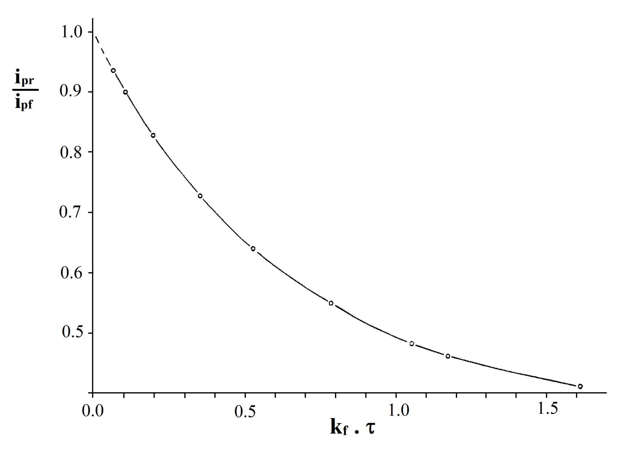
τ = Τhe time for moving from E^{o’} (calculated under the conditions where i_{pr}/i_{pf} = 1) to E_{f}
i_{pr}/i_{pf} = 0.45 – 0.95
Calculating
k_{f}
_{Fig 16}
They must be taken at different v and different E_{f}
t_{1/2} = 0.693/k
(for first order reaction)
So calculate the half life of Red from k_{f}…

Slide 14
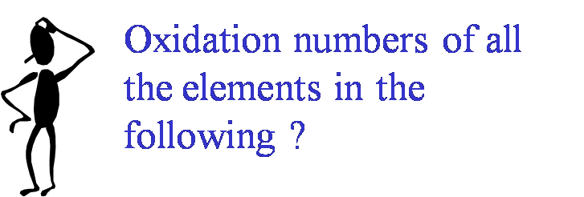
1.4.2.2.1 Diagnostic criteria to identify a first-order irreversible chemical reaction following a reversible electron transfer
E_{pf} shifts towards negative values
potential
i_{pr}/i_{pf} increases with scan rate from values smaller than 1 up to maximum of 1 (significant creterion)
i_{pf}/v^{1/2} remains constant with scan rate
Current

