Slide 1

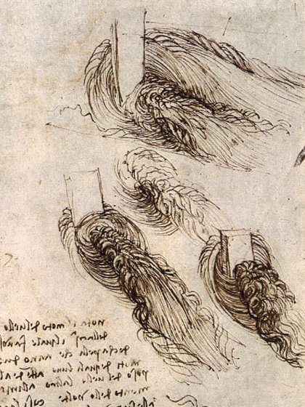
Turbulence Models
Dr. B. Pirzadeh
Department of Civil Engineering, University of Sistan & Baluchestan
References:
TURBULENT FLOWS ; Pope; Cambridge University Press (2000)
A First Course in Turbulence; Tennekes & Lumley ; The MIT Press (1972)
Turbulence Modeling for CFD; David C. Wilcox; DCW Industries (2006)

Slide 2

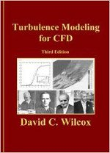

Turbulence Modeling for CFD
ByDavid C. Wilcox
A First Course in Turbulence
Henk Tennekes and John L. Lumley
Turbulent Flows
Stephen B. Pope

Slide 3
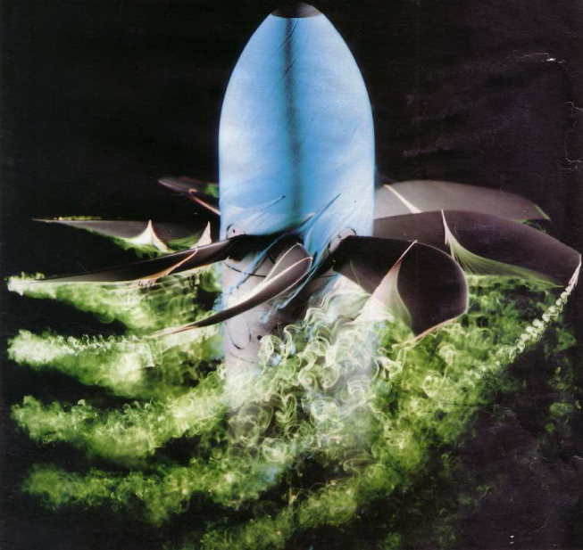
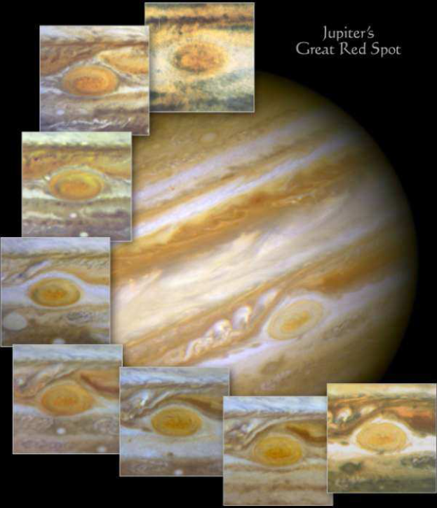
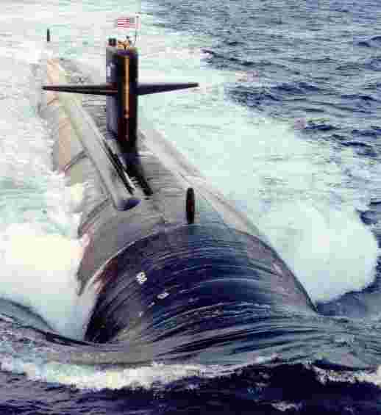
Most flows in nature & technical applications are turbulent
Flow around a submarine
Flow around propellers
Pictures of Jupiter

Slide 4
Conservation Laws of Fluid Motion
The governing equations of fluid flow represent mathematical statements of the conservation laws of physics.
The mass of fluid is conserved.
The rate of change of momentum equals the sum of the forces on a fluid particle (Newton’s second law)
The rate of change of energy is equal to the sum of the rate of heat addition to and the rate of work done on a fluid particle (first law of thermodynamics).

Slide 5
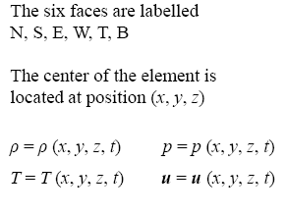
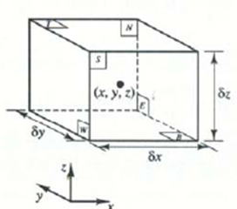
Fluid properties at faces are approximated by means of the two terms of the Taylor series.

Slide 6
Governing Equations- Conservation Equations For Incompressible Fluid
Continuity
Momentum
Energy
where
Note that there is no turbulence equation in the governing Navier-Stokes equations!

Slide 7
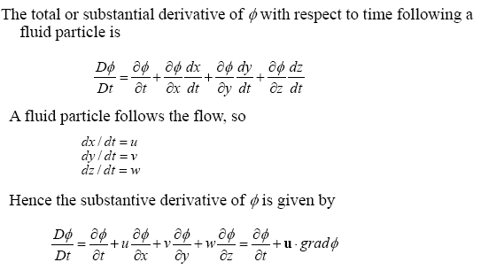
Rates of change following a fluid Particle and for a fluid element

Slide 8
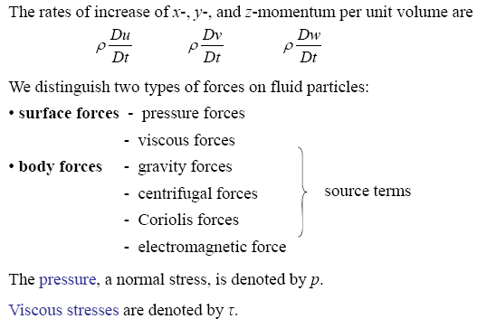
Forces on fluid particles

Slide 9
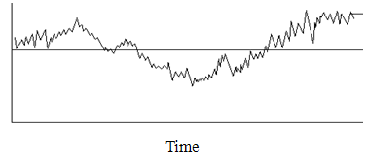

Momentum equation in turbulent flow
The time averages:
The X-direction of momentum equation:
By decomposition for velocity components:

Slide 10
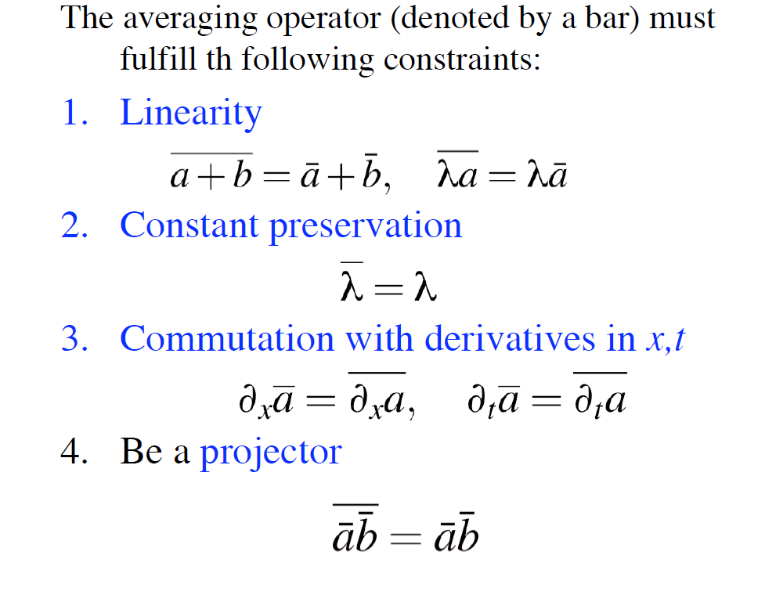
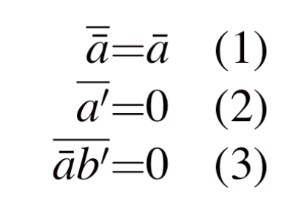
Axioms of O.Reynolds

Slide 11


Take time averaging for steady flow:
Expanding the terms:

Slide 12






Then take the continuity equation for incompressible instantaneous flow:
Reynolds decomposition
Then multiply this by u’ and time averaging:
Add this (which equals to zero) to the LHS of the momentum equation, which in:
And note that:

Slide 13

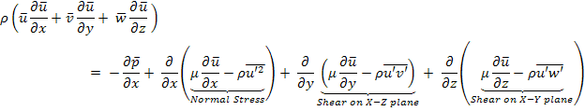
To write the LHS plus u times continuity as:
Transposing these terms yields the final version with the fluctuating momentum terms interpreted as “ Reynolds Stresses”

Slide 14
Time averaged Navier Stokes Equation in another form:
For all the Three Momentum Equation

Slide 15
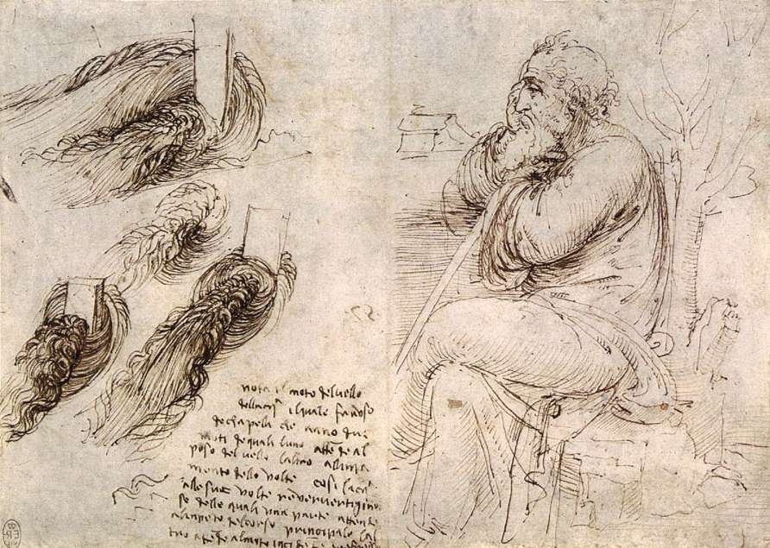
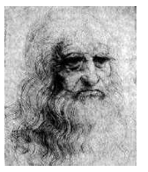
Turbulence
Is the flow turbulent?
What is turbulence?
Effect of turbulence on
Navier-Stokes equations.
Reynolds averaging.
Reynolds stresses.
“Observe the motion
of the water surface,
which resembles
that of hair, that has
two motions: one
due to the weight of the shaft, the other to the shape of the curls; thus, water has eddying motions, one part of which is due to the principal current, the other to the random and reverse motion.”
- Leonardo da Vinci, ca.1510

Slide 16
Is the Flow Turbulent?
Flows can be characterized by the Reynolds Number, Re
External Flows
where
along a surface
around an obstacle
Other factors such as free-stream turbulence, surface conditions, and disturbances may cause transition to turbulence at lower Reynolds numbers
Internal Flows
Natural Convection
where
is the Rayleigh number
is the Prandtl number
Notes:
In fluid mechanics, external flow is such a flow that boundary layers develop freely, without constraints imposed by adjacent surfaces. Accordingly, there will always exist a region of the flow outside the boundary layer in which velocity, temperature, and/or concentration gradients are negligible.
In fluid mechanics, internal flow is a flow for which the fluid is confined by a surface. Hence the boundary layer is unable to develop without eventually being constrained.

Slide 17
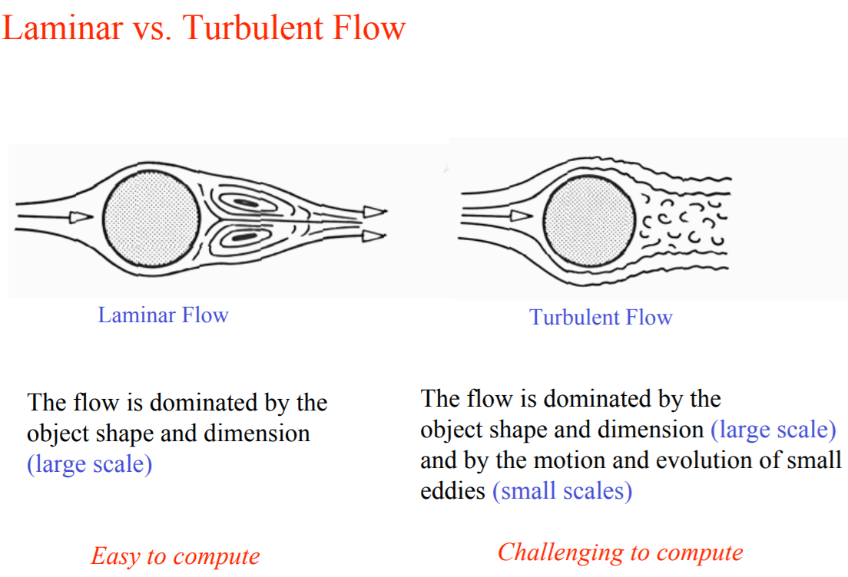

Slide 18
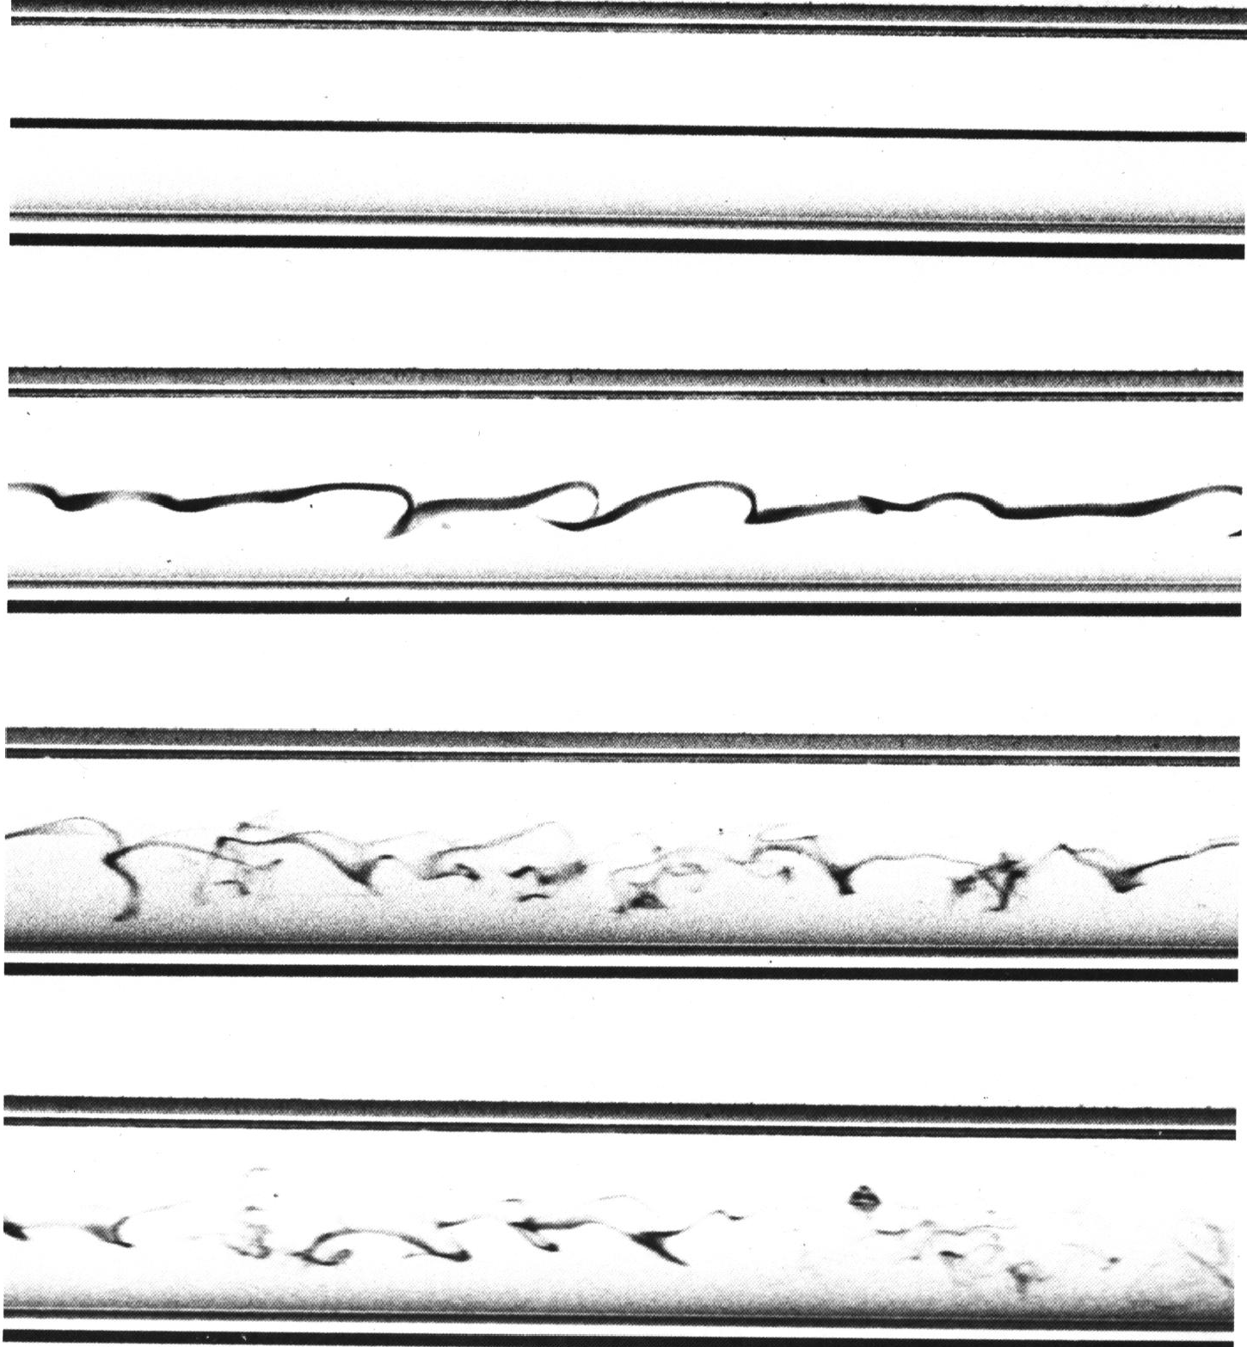
Observation by O. Reynolds
Laminar
(Low Reynolds Number)
Transition
(Increasing Reynolds Number)
Turbulent
(Higher Reynolds Number)

Slide 19
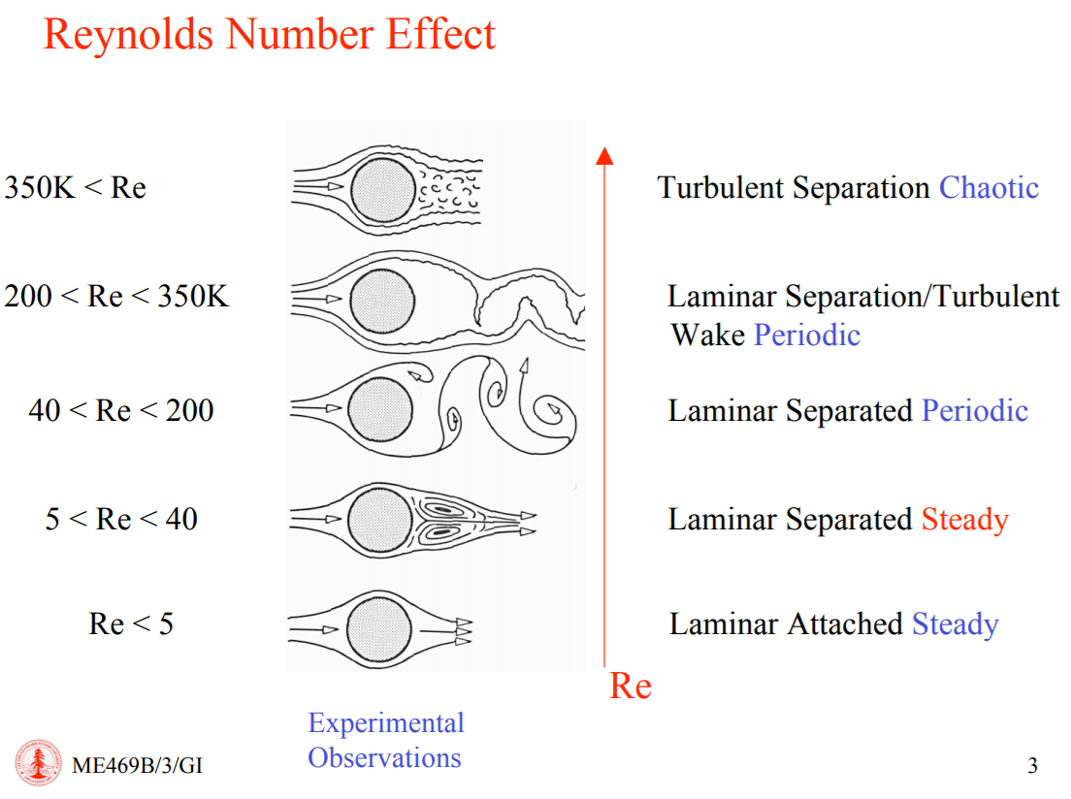

Slide 20
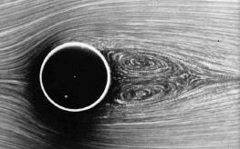
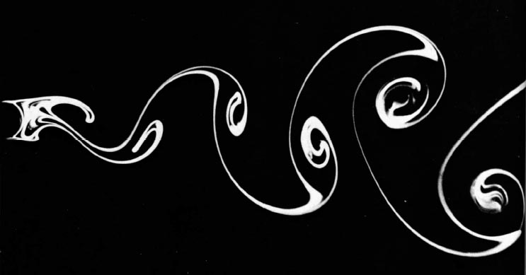
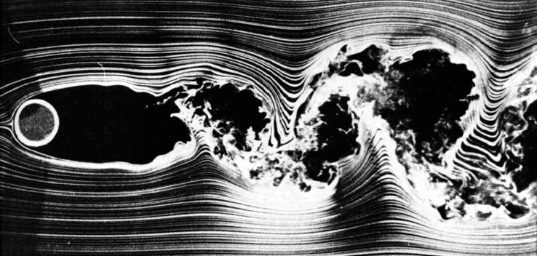
Example: wake flow
At low Re: viscous flow
scale of the flow given by the bl thickness
At high Re: spatial fluctuations, large range of scales from the
obstacle size to very small ones
Re=26
Re=140
Re=10000
Notes:
eddy: a circular movement of air or water

Slide 21
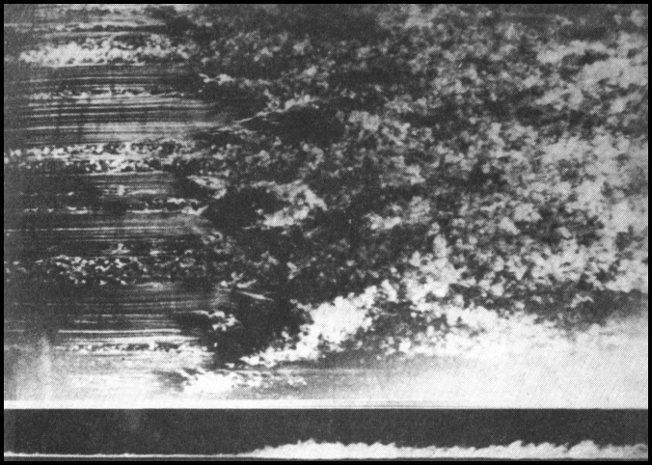
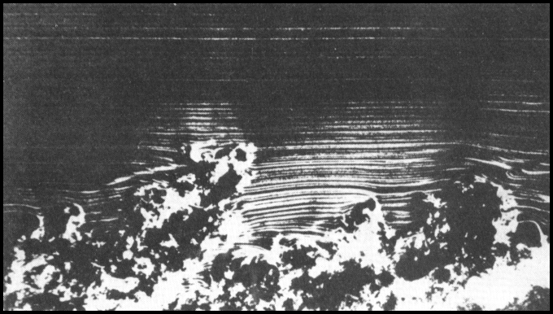
Turbulent boundary layer
Top view
Close-up view of the turbulent boundary layer.
Side view
Merging of turbulent spots and transition to turbulence
in a natural flat plate boundary layer.

Slide 22
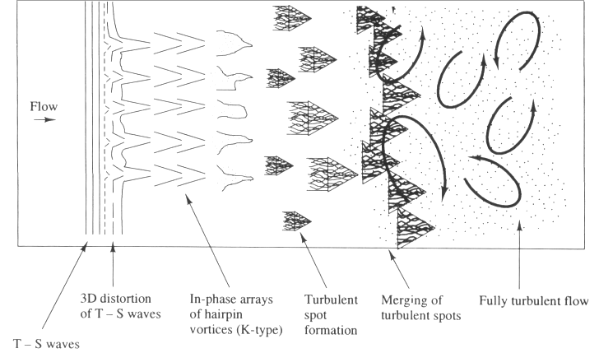
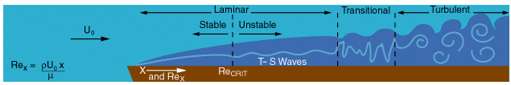
Transition in boundary layer flow over flat plate
Notes:
In fluid dynamics, a Tollmien–Schlichting wave (often abbreviated T-S wave) is a streamwise instability which arises in a viscous boundary layer.

Slide 23
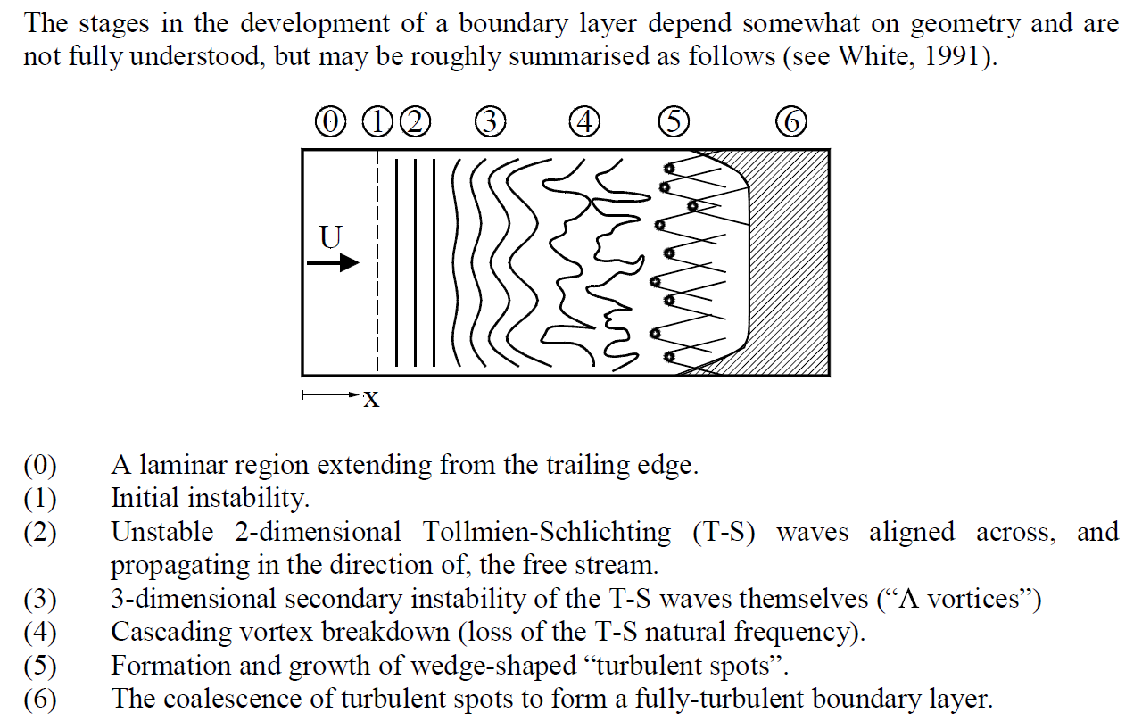
From Instability to Transition
Some of these stages may be bypassed, particularly in the presence of large free-stream
disturbances, the presence of side walls or large roughness.

Slide 24
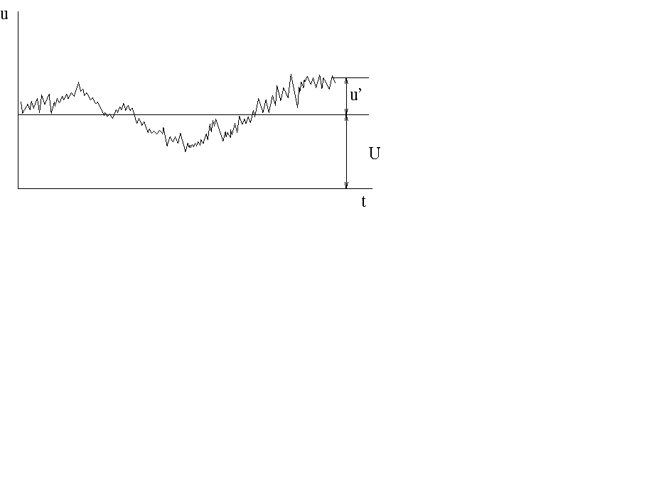
What is turbulence?
Unsteady, an-periodic motion in which all three velocity components fluctuate, mixing matter, momentum, and energy.
Decompose velocity into mean and fluctuating parts:
U_{i}(t) ≡ U_{i} + u_{i}(t).
Similar fluctuations for pressure, temperature, and species concentration values.
Time

Slide 25
Turbulence definition
Taylor, Von Karman:
Turbulence is an irregular motion which in general makes its appearance in fluids, gases or liquids when they flow past solid surface or even when neighbouring streams of the same fluid flow past or over another.
Free turbulence
Wall turbulence

Slide 26
Turbulence definition
Hinz:
Turbulent fluid motion is irregular condition of the flow in which the various quantities show a random variation with time and space coordinate, so that statistically distinct average values can be discerned.
Bradshow:
It is a 3D time dependent motion in which vortex stretching causes velocity fluctuations to spread to all wave lengths between a minimum determined by viscous forces and a maximum determined by the boundary conditions of the flow.

Slide 27
Turbulence definition
Tennekes and Lumely:
The main property of turbulence is irregularity or randomness; it is very diffusive; it causes rapid mixing and increased rates of mass, momentum and heat transfer. Further, turbulence is rotational, 3D and essentially dissipative. It is also a continuum phenomenon since even the smallest eddies that occur in turbulent motion are larger than any molecular length scale.

Slide 28
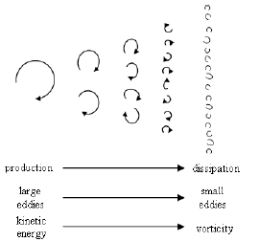
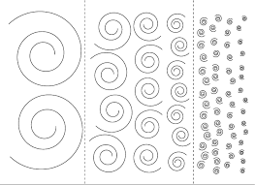
Scales of turbulence
Largest eddies break up due to inertial forces
Smallest eddies dissipate due to viscous forces
Richardson Energy Cascade (1922)

Slide 29

In fluid dynamics, an eddy is the swirling of a fluid and the reverse current created when the fluid is in a turbulent flow regime.
A vortex street around a cylinder.
In fluid dynamics, a vortex is a region in a fluid in which the flow revolves around an axis line, which may be straight or curved. The plural of vortex is either vorticesor vortexes

Slide 30
Scales of turbulence - continue
Large Eddies:
  have large eddy Reynolds number,
  are dominated by inertia effects
  viscous effects are negligible
  are effectively inviscid.
  are anisotropic
Small Eddies:
  motion is dictated by viscosity
  Re ≈ 1
  length scales : 0.1 – 0.01 mm
  frequencies : ≈ 10 kHz
  are isotropic
Energy associated with eddy motions is dissipated and converted into thermal internal energy
Notes:
Isotropy is uniformity in all orientations; it is derived from the Greek isos (ἴσος, "equal")

Slide 31
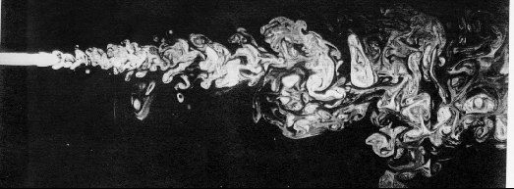
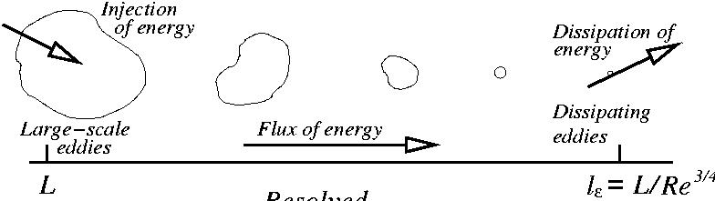
Large-scale vs. small-scale structure
Small Structure
Large Structure
Energy Cascade Richardson (1922)

Slide 32
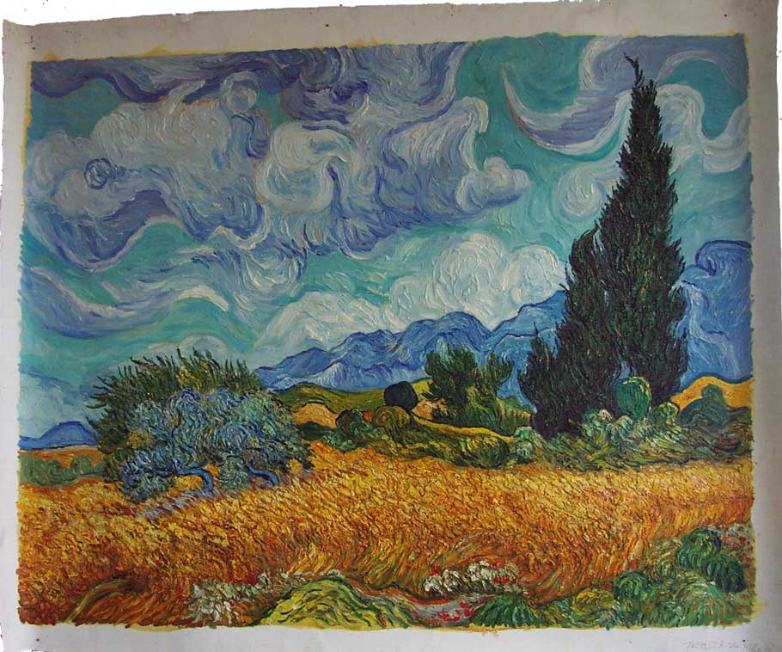
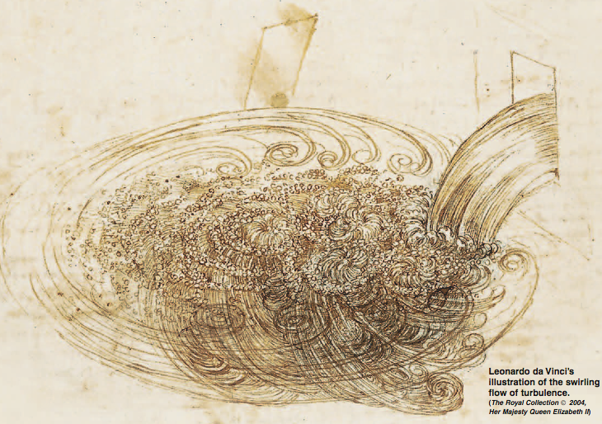
Low-Re flow, Van Gogh’s clouds have no small scales!
High-Re flow!
The sketch of a free water jet issuing from a square hole into a pool
Perhaps the world's first use of visualization as a scientific tool to study a turbulent flow

Slide 33
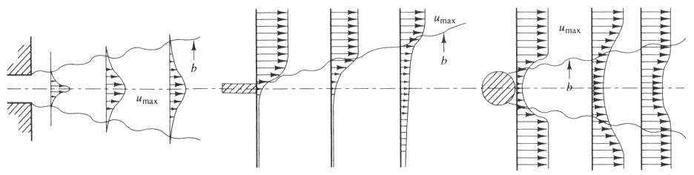
Examples of simple turbulent flows
Some examples of simple turbulent flows are a jet entering a domain with stagnant fluid, a mixing layer, and the wake behind objects such as cylinders.
Such flows are often used as test cases to validate the ability of computational fluid dynamics software to accurately predict fluid flows.
jet
mixing layer
wake

Slide 34
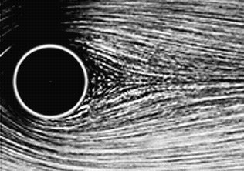
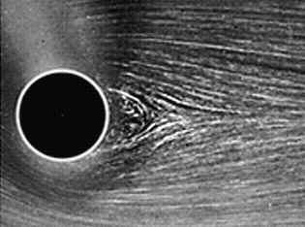
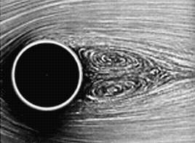
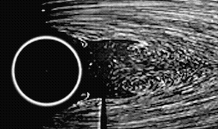
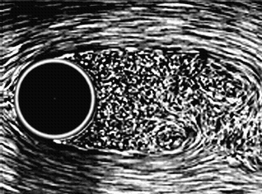
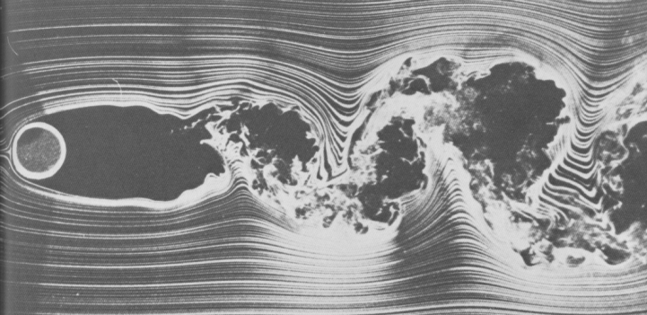
Flow transitions around a cylinder
For flow around a cylinder, the flow starts separating at Re = 5. For Re below 30, the flow is stable. Oscillations appear for higher Re.
The separation point moves upstream, increasing drag up to Re = 2000.
Re = 9.6
Re = 13.1
Re = 26
Re = 30.2
Re = 2000
Re = 10,000

Slide 35
What is turbulence?
Turbulent flows have the following characteristics:
  One characteristic of turbulent flows is their irregularity or randomness. A full deterministic approach is very difficult. Turbulent flows are usually described statistically. Turbulent flows are always chaotic. But not all chaotic flows are turbulent. Waves in the ocean, for example, can be chaotic but are not necessarily turbulent.
  The diffusivity of turbulence causes rapid mixing and increased rates of momentum, heat, and mass transfer. A flow that looks random but does not exhibit the spreading of velocity fluctuations through the surrounding fluid is not turbulent. If a flow is chaotic, but not diffusive, it is not turbulent. The trail left behind a jet plane that seems chaotic, but does not diffuse for miles is then not turbulent.
  Turbulent flows always occur at high Reynolds numbers. They are caused by the complex interaction between the viscous terms and the inertia terms in the momentum equations.
  Turbulent flows are rotational; that is, they have non-zero vorticity. Mechanisms such as the stretching of three-dimensional vortices play a key role in turbulence.
Notes:
Chaotic: is a state of complete confusion and disorder
In fluid dynamics, a vortex is a region in a fluid in which the flow is rotating around an axis line, which may be straight or curved.

Slide 36
What is turbulence? - Continued
  Turbulent flows are dissipative. Kinetic energy gets converted into heat due to viscous shear stresses. Turbulent flows die out quickly when no energy is supplied. Random motions that have insignificant viscous losses, such as random sound waves, are not turbulent.
  Turbulence is a continuum phenomenon. Even the smallest eddies are significantly larger than the molecular scales. Turbulence is therefore governed by the equations of fluid mechanics.
  Turbulent flows are flows. Turbulence is a feature of fluid flow, not of the fluid. When the Reynolds number is high enough, most of the dynamics of turbulence are the same whether the fluid is an actual fluid or a gas. Most of the dynamics are then independent of the properties of the fluid.

Slide 37
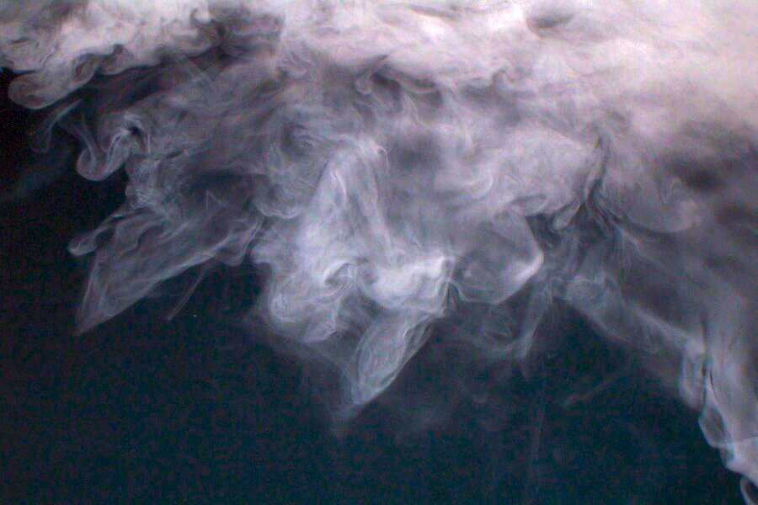
Turbulent flows are chaotic
One characteristic of turbulent flows is their irregularity or randomness. A full deterministic approach is very difficult. Turbulent flows are usually described statistically. Turbulent flows are always chaotic. But not all chaotic flows are turbulent.
Chaotic: is a state of complete confusion and disorder

Slide 38
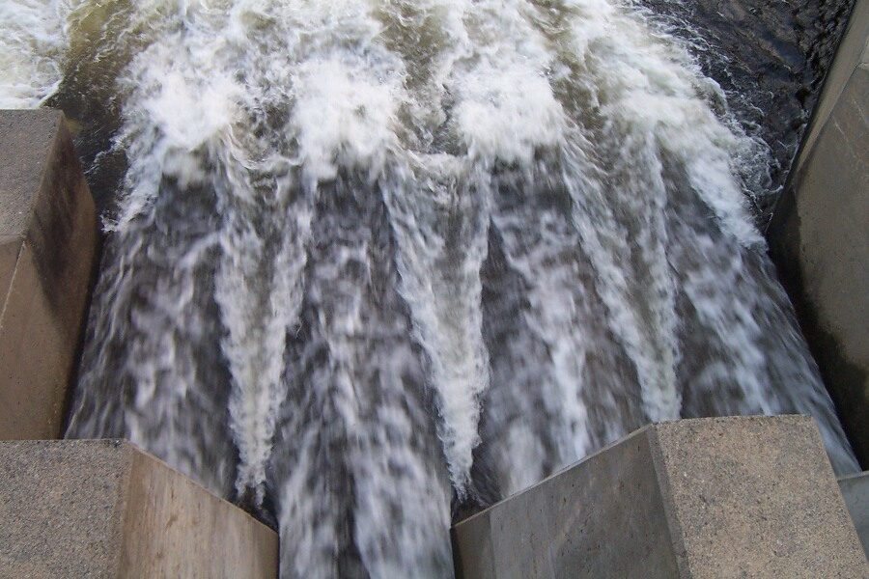
Turbulence: diffusivity
The diffusivity of turbulence causes rapid mixing and increased rates of momentum, heat, and mass transfer. A flow that looks random but does not exhibit the spreading of velocity fluctuations through the surrounding fluid is not turbulent. If a flow is chaotic, but not diffusive, it is not turbulent.

Slide 39
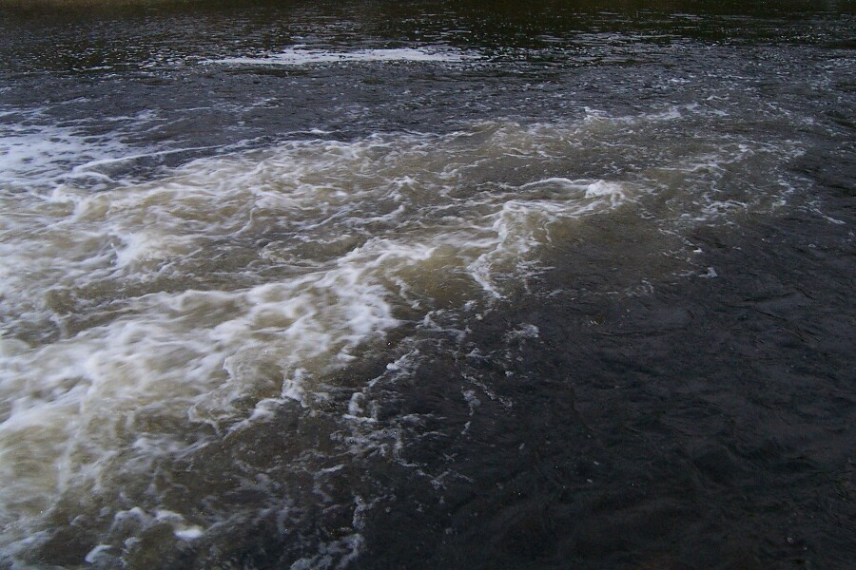
Turbulence: dissipation
Turbulent flows are dissipative. Kinetic energy gets converted into heat due to viscous shear stresses. Turbulent flows die out quickly when no energy is supplied. Random motions that have insignificant viscous losses, such as random sound waves, are not turbulent.

Slide 40
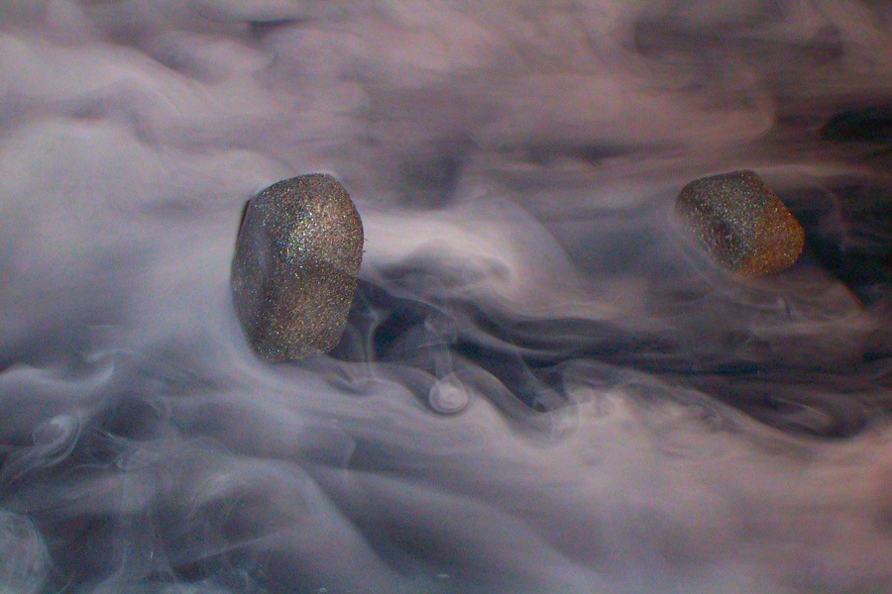
Turbulence: rotation and vorticity
Turbulent flows are rotational; that is, they have non-zero vorticity. Mechanisms such as the stretching of three-dimensional vortices play a key role in turbulence.
Vortices
In fluid dynamics, a vortex is a region in a fluid in which the flow is rotating around an axis line, which may be straight or curved.

Slide 41
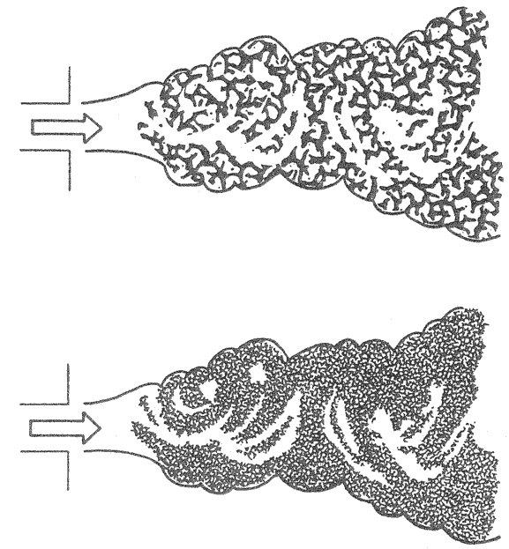
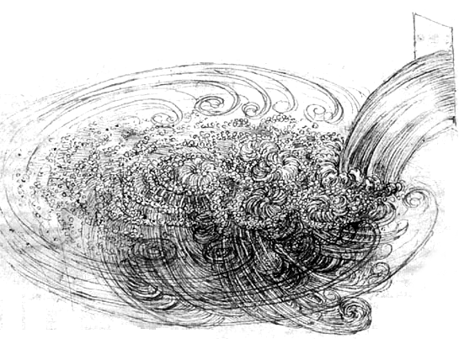
Velocity and length scale in turbulent flows
Relatively low Reynolds number
Relatively high Reynolds number

Slide 42
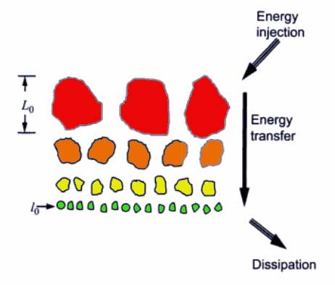
(Richardson 1922)
Turbulence is composed of eddies
Kinetic energy enters the turbulence at the large scales of motion and it is transferred by an invisicd process to the smallest scales where it is dissipated
Instabilities create largest eddies
A large energy eddy splits into middle-size eddies which split into smaller-size eddies, and so on. This is a series cascade process of energy dissipation.
Vortex streching breaks up unstable large eddies
Schematic representation of the energy cascade.

Slide 43
Energy transfer rate
Dissipation ε
Production P
Transfer of energy to
successively smaller scales
η
l_{DI}
l_{EI}
l₀
L
Dissipation
range
Inertial
subrange
Energy
containing
range

Slide 44
Vorticity and vortex stretching
Existence of eddies implies rotation or vorticity.
Vorticity concentrated along contorted vortex lines or bundles.
As end points of a vortex line move randomly further apart the vortex line increases in length but decreases in diameter. Vorticity increases because angular momentum is nearly conserved. Kinetic energy increases at rate equivalent to the work done by large-scale motion that stretches the bundle.
Viscous dissipation in the smallest eddies converts kinetic energy into thermal energy.
Vortex-stretching cascade process maintains the turbulence and dissipation is approximately equal to the rate of production of turbulent kinetic energy.
Typically energy gets transferred from the large eddies to the smaller eddies. However, sometimes smaller eddies can interact with each other and transfer energy to the (i.e. form) larger eddies, a process known as backscatter.

Slide 45
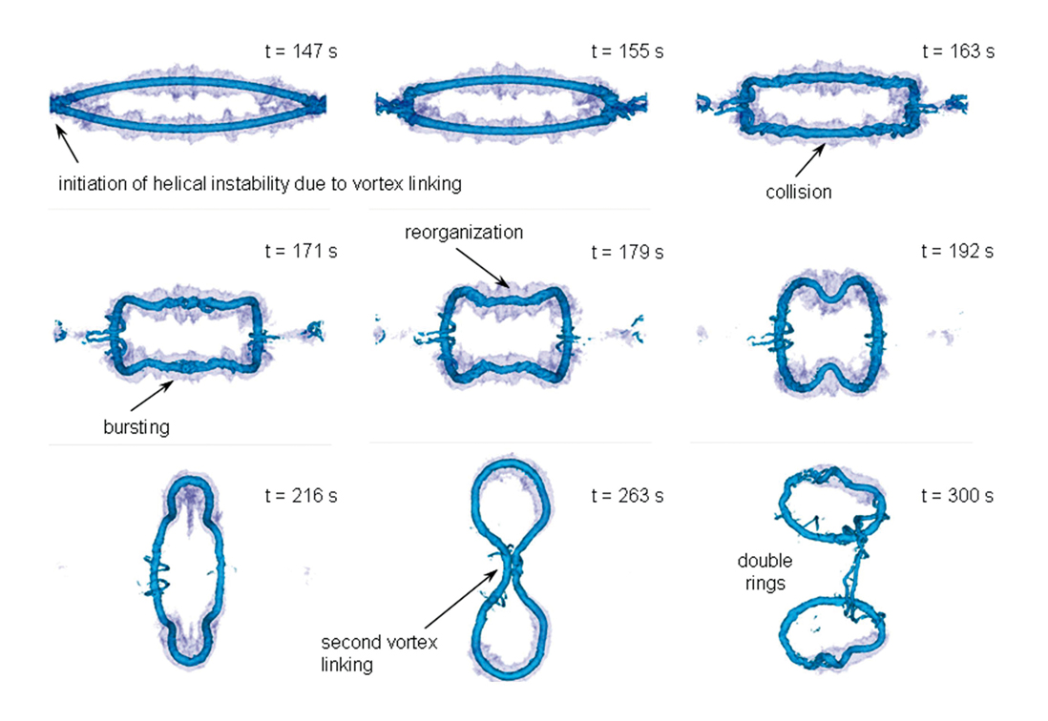

Slide 46
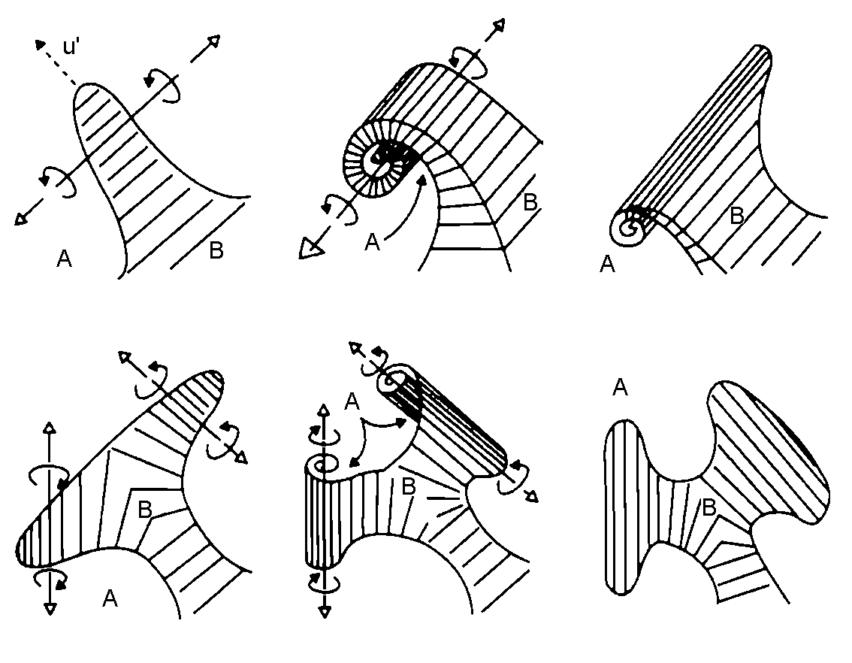
Vortex stretching
t₁
t₂
t₃
t₄
t₅
t₆
(Baldyga and Bourne, 1984)

Slide 47
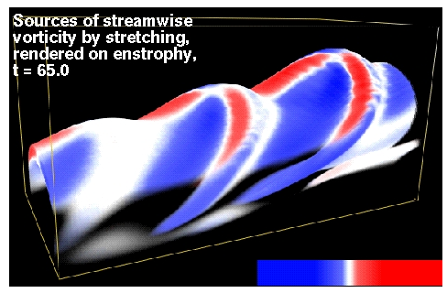

Strain source of vorticity visualized on a vorticity structure

Slide 48






Smoke ring
A smoke ring (green) impinges on a plate where it interacts with the slow moving smoke in the boundary layer (pink). The vortex ring stretches and new rings form.
The size of the vortex structures decreases over time.

Slide 49


Slide 50



Slide 51
Turbulence modeling objective
The objective of turbulence modeling is to develop equations that will predict the time averaged velocity, pressure, and temperature fields without calculating the complete turbulent flow pattern as a function of time.
  This saves us a lot of work!
  Most of the time it is all we need to know.
  We may also calculate other statistical properties, such as RMS values.
Important to understand: the time averaged flow pattern is a statistical property of the flow.
  It is not an existing flow pattern!
  It does not usually satisfy the steady Navier-Stokes equations!
  The flow never actually looks that way!!

Slide 52



Example: flow around a cylinder at Re=1E4
The figures show:
  An experimental snapshot.
  Streamlines for time averaged flow field. Note the difference between the time averaged and the instantaneous flow field.
  Effective viscosity used to predict time averaged flow field.
Experimental Snapshot
Streamlines
Effective Viscosity

Slide 53


Slide 54
Reynolds Averaged Navier-Stokes (RANS) Equations
Velocity or a scalar quantity can be represented as the sum of the mean value and the fluctuation about the mean value as:
Using the above relationship for velocity(let φ = u) in the Navier-Stokes equations gives (as momentum equation for incompressible flows with body forces).
The Reynolds Stresses cannot be represented uniquely in terms of mean quantities and the above equation is not closed. Closure involves modeling the Reynolds Stresses.

Slide 55
Turbulence models
• A turbulence model is a computational procedure to close the system of mean flow equations.
• For most engineering applications it is unnecessary to resolve the details of the turbulent fluctuations.
• Turbulence models allow the calculation of the mean flow without first calculating the full time-dependent flow field.
• We only need to know how turbulence affected the mean flow.
• In particular we need expressions for the Reynolds stresses.
• For a turbulence model to be useful it:
    – must have wide applicability,
    – be accurate,
    – simple,
    – and economical to run.

Slide 56
Characteristics of the Engineering Turbulence Model
Numerical modeling of turbulence can serve to improve the engineers ability to analyze turbulent flow in design particularly when precise measurements cannot be obtained and when extensive experimentation is costly and time-consuming.
The ideal turbulence model should introduce minimal complexity while capturing the essence of the relevant physics.

Slide 57
Modeling Turbulent Flows
Turbulent flows can be modeled in a variety of ways. With increasing levels of complexity they are:
  Correlations
    Moody chart, Nusselt number correlations
  Integral equations
    Derive ODE’s from the equations of motion
  Reynolds Averaged Navier Stokes or RANS equations
    Average the equations of motion over time
    Requires closure
  Large Eddy Simulation or LES
    Solve Navier-Stokes equations for large scale motions of the flow. Model only the small scale motions
  DNS
    Navier-Stokes equations solved for all motions in the turbulent flow

Slide 58
Common turbulence models
• Classical models. Based on Reynolds Averaged Navier-Stokes (RANS) equations (time averaged):
  1. Zero equation model: mixing length model.
  2. One equation model: Spalart-Almaras.
  3. Two equation models: k-ε style models (standard, RNG, realizable), k-w model, and ASM.
  4. Seven equation model: Reynolds stress model(RSM).
• The number of equations denotes the number of additional PDEs that are being solved.
• Large eddy simulation. Based on space-filtered equations. Time dependent calculations are performed. Large eddies are explicitly calculated. For small eddies, their effect on the flow pattern is taken into account with a “subgrid model” of which many styles are available.

Slide 59
Turbulence Modeling Approaches
Zero-Equation Models
One-Equation Models
Two-Equation Models
Standard k-e
RNG k-e
Second-order closure
Reynolds-Stress Model
Large-Eddy Simulation
Direct Numerical Simulation
Zero-Equation Models
One-Equation Models
Two-Equation Models
Standard k-ε
RNG k-ε
Second-order closure
Reynolds-Stress Model
Large-Eddy Simulation
Direct Numerical Simulation
Include
More
Physics
Increase
Computational
Cost
Per Iteration

Slide 60

Prediction Methods
l
η = l/Re^{3/4}
Direct numerical simulation (DNS)
Large eddy simulation (LES)
Reynolds averaged Navier-Stokes equations (RANS)

Slide 61


Boussinesq hypothesis
Many turbulence models are based upon the Boussinesq hypothesis.
  – It was experimentally observed that turbulence decays unless there is shear in isothermal incompressible flows.
  – Turbulence was found to increase as the mean rate of deformation increases.
  – Boussinesq proposed in 1877 that the Reynolds stresses could be linked to the mean rate of deformation.
• Using the suffix notation where i, j, and k denote the x-, y-, and z directions respectively, viscous stresses are given by:
Similarly, link Reynolds stresses to the mean rate of deformation:

Slide 62

Turbulent viscosity
A new quantity appears: the turbulent viscosity μ_{t}:
• Its unit is the same as that of the molecular viscosity: Pa.s.
• It is also called the eddy viscosity.
• We can also define a kinematic turbulent viscosity: ν_{t} = μ_{t}/ρ. Its unit is m²/s.
• The turbulent viscosity is not homogeneous, i.e. it varies in space.
• It is, however, assumed to be isotropic. It is the same in all directions. This assumption is valid for many flows, but not for all (e.g. flows with strong separation or swirl).

Slide 63
Predicting the turbulent viscosity
The following models can be used to predict the turbulent viscosity:
    – Mixing length model.
    – Spalart-Allmaras model.
    – Standard k-ε model.
    – k-ε RNG model.
    – Realizable k-ε model.
    – k-ω model.
We will discuss these one by one.

Slide 64



Mixing length model
On dimensional grounds one can express the kinematic turbulent viscosity as the product of a velocity scale and a length scale:
If we then assume that the velocity scale is proportional to the length scale and the gradients in the velocity (shear rate, which has dimension 1/s):
we can derive Prandtl’s (1925) mixing length model:
Algebraic expressions exist for the mixing length for simple 2-D flows, such as pipe and channel flow.

Slide 65
Mixing length model discussion
Advantages:
    – Easy to implement.
    – Fast calculation times.
    – Good predictions for simple flows where experimental correlations for the mixing length exist.
Disadvantages:
    – Completely incapable of describing flows where the turbulent length scale varies: anything with separation or circulation.
    – Only calculates mean flow properties and turbulent shear stress.
Use:
    – Sometimes used for simple external aero flows.
    – Pretty much completely ignored in commercial CFD programs today.
Much better models are available.

Slide 66

Spalart-Allmaras one-equation model
Solves a single conservation equation (PDE) for the turbulent viscosity:
    – This conservation equation contains convective and diffusive transport terms, as well as expressions for the production and dissipation of ν_{t}.
    – Developed for use in unstructured codes in the aerospace industry.
Economical and accurate for:
    – Attached wall-bounded flows.
    – Flows with mild separation and recirculation.
Weak for:
    – Massively separated flows.
    – Free shear flows.
    – Decaying turbulence.
Because of its relatively narrow use we will not discuss this model in detail.

Slide 67


The k-ε model
The k-ε model focuses on the mechanisms that affect the turbulent kinetic energy (per unit mass) k.
The instantaneous kinetic energy k(t) of a turbulent flow is the sum of mean kinetic energy K and turbulent kinetic energy k:
ε is the dissipation rate of k.
If k and ε are known, we can model the turbulent viscosity as:
We now need equations for k and ε.

Slide 68
Standard k-ε Model
Turbulent Kinetic Energy
Dissipation
Convection
Generation
Diffusion
Dissipation Rate
Convection
Generation
Diffusion
Destruction
are empirical constants
(equations written for steady, incompressible flow body forces)

Slide 69
k-ε model discussion
Advantages:
    – Relatively simple to implement.
    – Leads to stable calculations that converge relatively easily.
    – Reasonable predictions for many flows.
Disadvantages:
  – Poor predictions for:
    • swirling and rotating flows,
    • flows with strong separation,
    • axi-symmetric jets,
    • certain unconfined flows, and
    • fully developed flows in non-circular ducts.
  – Valid only for fully turbulent flows.
  – Simplistic ε equation.

Slide 70
More two-equation models
The k-ε model was developed in the early 1970s. Its strengths as well as its shortcomings are well documented.
Many attempts have been made to develop two-equation models that improve on the standard k-ε model.
We will discuss some here:
    – k-ε RNG model.
    – k-ε realizable model.
    – k-ω model.
    – Algebraic stress model.
    – Non-linear models.

Slide 71
Improvement: RNG k- ε
k-ε equations are derived from the application of a rigorous statistical technique (Renormalization Group Method) to the instantaneous Navier-Stokes equations.
Similar in form to the standard k-ε equations but includes:
    – Additional term in e equation for interaction between turbulence dissipation and mean shear.
    – The effect of swirl on turbulence.
    – Analytical formula for turbulent Prandtl number.
    – Differential formula for effective viscosity.
Improved predictions for:
    – High streamline curvature and strain rate.
    – Transitional flows.
    – Wall heat and mass transfer.
But still does not predict the spreading of a round jet correctly.

Slide 72
RNG k-ε Model
Turbulent Kinetic Energy
where
Generation
Dissipation
Convection
Diffusion
Dissipation Rate
Additional term
related to mean strain
& turbulence quantities
Convection
Generation
Diffusion
Destruction
are derived using RNG theory
(equations written for steady, incompressible flow body forces)

Slide 73
Improvement: realizable k-ε
Shares the same turbulent kinetic energy equation as the standard k-ε model.
Improved equation for ε.
Variable Cμ instead of constant.
Improved performance for flows involving:
    – Planar and round jets (predicts round jet spreading correctly).
    – Boundary layers under strong adverse pressure gradients or separation.
    – Rotation, recirculation.
    – Strong streamline curvature.

Slide 74


Realizable k- ε equations
Distinctions from standard k-ε model:
  – Alternative formulation for turbulent viscosity:
New transport equation for dissipation rate, ε:

Slide 75

Realizable k- ε C_{μ} equations
Eddy viscosity computed from:

Slide 76



Realizable k- ε positivity of normal stresses
Boussinesq viscosity relation:
Normal component:
Normal stress will be negative if:

Slide 77


Comparison: RNG k-ε vs. Standard k-ε

Slide 78

k-ω model
This is another two equation model. In this model ω is an inverse time scale that is associated with the turbulence.
This model solves two additional PDEs:
  – A modified version of the k equation used in the k-ε model.
  – A transport equation for ω.
The turbulent viscosity is then calculated as follows:
Its numerical behavior is similar to that of the k-ε models.
It suffers from some of the same drawbacks, such as the assumption that μ_{t} is isotropic.

Slide 79

Standard (Wilcox) k–ω turbulence model
Turbulence Kinetic Energy and Specific Dissipation Rate equations:
For recommendations for the values of the different parameters, see Wilcox (2008).

Slide 80


Slide 81


Slide 82
Algebraic stress model
The same k and ε equations are solved as with the standard k-ε model.
However, the Boussinesq assumption is not used.
The full Reynolds stress equations are first derived, and then some simplifying assumptions are made that allow the derivation of algebraic equations for the Reynolds stresses.
Thus fewer PDEs have to be solved than with the full RSM and it is much easier to implement.
The algebraic equations themselves are not very stable, however, and computer time is significantly more than with the standard k-ε model.
This model was used in the 1980s and early 1990s. Research continues but this model is rarely used in industry anymore now that most commercial CFD codes have full RSM implementations available.

Slide 83

Non-linear models
The standard k-ε model is extended by including second and sometimes third order terms in the equation for the Reynolds stresses.
One example is the Speziale model:
Here f(…) is a complex function of the deformation tensor, velocity field and gradients, and the rate of change of the deformation tensor.
The standard k-ε model reduces to a special case of this model for flows with low rates of deformation.
• These models are relatively new and not yet used very widely.

Slide 84
Reynolds stress model
RSM closes the Reynolds-Averaged Navier-Stokes equations by solving additional transport equations for the six independent Reynolds stresses.
  – Transport equations derived by Reynolds averaging the product of the momentum equations with a fluctuating property.
  – Closure also requires one equation for turbulent dissipation.
  – Isotropic eddy viscosity assumption is avoided.
Resulting equations contain terms that need to be modeled.
RSM is good for accurately predicting complex flows.
  – Accounts for streamline curvature, swirl, rotation and high strain rates.
Cyclone flows, swirling combustor flows.
Rotating flow passages, secondary flows.
Flows involving separation.

Slide 85
Reynolds stress transport equation
Convection
Diffusion
Pressure-Strain
redistribution
Generation
Dissipation

Slide 86
Reynolds Stress Model
Generation
(computed)
Pressure-Strain
Redistribution
(modeled)
Dissipation
(related to ε)
Turbulent
Diffusion
(modeled)
Pressure/velocity
fluctuations
Turbulent
transport
(equations written for steady, incompressible flow w/o body forces)
Notes:
The RSM attempts to more mechanistically account for the various physical phenomena that contribute to the behavior of the turbulent stresses. The convective and generation/destruction terms are computed directly while the pressure-strain, potentially anisotropic dissipation, and turbulent diffusion terms need to modeled to provide closure. In addtion to the mean momentum equations and pressure equation, the RSM model solves 6 transport equations for the Reynolds stresses and one transport equation for the dissipation rate.

Slide 87


Slide 88


Slide 90

Comparison of RANS turbulence models

Slide 91

Home exercise:

Slide 92
Direct Numerical Simulation (DNS)
Currently DNS is the most exact approach to modeling turbulence since no averaging is done or approximations are made.
Since the smallest scales of turbulence are modeled, called the Kolmogoroff scale, the size of the grid must be scaled accordingly.
A DNS simulation scales with Re_{L}³ (u´L/n) where Re_{L} ~ 0.01Re. Turbulent flow past a cylinder would require at least (0.01 x 20,000)³ or 8 million cells.
Given the current processing speed and memory of the largest computers, only very modest Reynolds number flows with simple geometries are possible.
Advantages: DNS can be used as numerical flow visualization and can provide more information than experimental measurements; DNS can be used to understand the mechanisms of turbulent production and dissipation.
Disadvantages: Requires supercomputers; limited to simple geometries.

Slide 93

DNS equations

Slide 94


Resolution requirements for DNS
Free shear flows
Large (integral) scale L
Small (Kolmogorov) scales η
Computational domain size is of the order of the integral scale, L
Grid size must be of the order of the Kolomogorov scale, η
Grid count:

Slide 95

Resolution requirements: DNS
Free shear flows
Large (integral) scale L
Small (Kolmogorov) scales η
The equations must be integrated for a time of the order of the integral time scale, T
Assuming the timestep is proportional to the grid spacing (CFL condition, implicit treatment of diffusion terms)

Slide 96







Resolution requirements: DNS
Boundary layers
Inner layer poses the most stringent resolution requirements
Number of points in a given direction:
(constant)
Above result using

Slide 97


Resolution requirements: DNS
Boundary layers
Number of points in a given direction:
Using α ~ 0.2

Slide 98

DNS: computational costs

Slide 99

DNS: computational costs

Slide 100

Large Eddy Simulation (LES)
DNS
u
LES
DNS
LES
t
LES is a three dimensional, time dependent and computationally expensive simulation, though less expensive than DNS.
LES solves the large scale motions and models the small scale motions of the turbulent flow.
The premise of LES is that the large scale motions or eddies contain the larger fraction of energy in the flow responsible for the transport of conserved properties while the small.

Slide 101
Large Eddy Simulation (LES)
The large scale components of the flow field are filtered from the small scale components using a wavelength criteria related to the size of the eddies.
The filter produces the following equation used to model the small scale motions.
      where
The inequality is then modeled as:
τ_{ij} is called the subgrid scale (SGS) Reynolds Stress. Different subgrid scale models are available to approximate τ_{ij} .

Slide 102


Large Eddy Simulation (LES)

Slide 103






SPATIAL FILTERING
FULLY
RESOLVED
LOWPASS FILTER CUTOFF WAVENUMBER Κ_{C}

Slide 104
FULLY
RESOLVED
PARTIALLY
RESOLVED
LOWPASS FILTER CUTOFF WAVENUMBER Κ_{C}

Slide 105
FULLY
RESOLVED
MEAN
PARTIALLY
RESOLVED
LOWPASS FILTER CUTOFF WAVENUMBER Κ_{C}

Slide 106




Sub-Grid Scale (SGS) Models
Smagorinsky model
C_{S} ≅ 0.1 – 0.2

Slide 107
SGS modelling
Smagorinsky model suffers from some well known deficiencies
  Model coefficient requires adjustment in sheared turbulence, transitional flows, near solid surfaces, etc.
  Does not account for local interactions
  Absolutely dissipative (cannot account for backscatter of energy)
Many improvements possible…
  Two-point closures (Kraichnan 1976, Chollet and Lesieur 1981, Metais and Lesieur 1992)
  Scale-similar and mixed models (Bardina, Ferziger and Reynolds 1980, Anderson and Meneveau 1999, … )
  Dynamic models (Germano, Piomelli, Cabot and Moin 1991, Moin, Squires, Cabot and Lee 1991, Meneveau, Lund and Cabot 1996)
  Deconvolution models (Shah and Ferziger 1995, Domaradzki and Loh 1999, Stoltz and Adams 1999… )
  …

Slide 108
Resolution requirements for LES
Large (integral) scale L
Only resolve the integral length scale (energy containing eddies)
Integral scale varies only weakly with Reynolds number
  Computational cost of LES away from solid boundaries varies slowly with Reynolds number
Infinite Reynolds number computations are possible

Slide 109


Resolution requirements: LES
Boundary layers
Outer layer (Chapman 1979)
  Only scales of order δ need to be resolved
Inner layer (Chapman 1979)
  Must resolve near-wall eddies
Computational cost ~ Re^{2.4}
While not as demanding as DNS, LES still poses considerable computational cost

Slide 110


Governing Equations- LES
Separate the large and the small scales by the filtering operation:
Filter width

Slide 111



Governing Equations- LES
Apply the filtering operation to the Navier-Stokes equations
Filtered equations of motion…
Subgrid-scale (SGS) stress (which needs to be modeled)

Slide 112

The filtering operation
Filtering is a local spatial averaging over the filter width Δ
Increasing Δ removes more scales from the velocity field
  Increases the contribution of τ_{ij}
(should expect to see the filter width In the expressions for the models of τ_{ij})

Slide 113



Wall-normal velocity in channel flow DNS
Filtered with width = 4Δ
Filtered with width = 8Δ
Increasing the filter width removes more scales from the velocity field (and increases the contribution from the model)

Slide 114



Filters in LES
Sharp Fourier cut-off filter in wave space
Gaussian
Top-hat filter in physical space

Slide 115

Effect of the filters
Sharp Fourier cutoff
Gaussian
Tophat
Unfiltered
Unfiltered and filtered velocity spectra.

Slide 116


Slide 117


Slide 118


Slide 119


Slide 120


Turbulent kinetic energy in the wake region
velocity in the wake region

Slide 122

Pressure distribution

Slide 123
Summary:
Large Eddy Simulation (LES)
  Resolves the large eddies, models the small eddies
  Problem: Requires a very fine boundary layer mesh, making it impractical for most flows
Detached Eddy Simulation (DES)
  Uses a RANS model in the boundary layer, switches over to LES in the bulk flow
  A “standard” boundary layer mesh can be used
  Problem: the RANS to LES switch depends on the mesh, which can give unphysical results on the “wrong” mesh
Scale-Adaptive Simulation (SAS)
  Like DES, but without the mesh dependency problems

Slide 124

What is CFD?
CFD is the simulation of fluids engineering systems using modeling (mathematical physical problem formulation) and numerical methods (discretization methods, solvers, numerical parameters, and grid generations, etc.)
Historically only Analytical Fluid Dynamics (AFD) and Experimental Fluid Dynamics (EFD).
CFD made possible by the advent of digital computer and advancing with improvements of computer resources.

Slide 125
Why use CFD?
Analysis and Design
1. Simulation-based design instead of “build & test”
  More cost effective and more rapid than EFD
  CFD provides high-fidelity database for diagnosing flow field
2. Simulation of physical fluid phenomena that are difficult for experiments
  Full scale simulations (e.g., ships and airplanes)
  Environmental effects (wind, weather, etc.)
  Hazards (e.g., explosions, radiation, pollution)
  Physics (e.g., planetary boundary layer, stellar evolution)
3. Knowledge and exploration of flow physics

Slide 127





Where is CFD used?
Aerospacee
Automotive
Biomedical
Chemical Processing
Hydraulics
Marine
Oil & Gas
Power Generation
Sports

Slide 128
CFD process
Purposes of CFD codes will be different for different applications:
  investigation of bubble-fluid interactions for bubbly flows,
  study of wave induced massively separated flows for free-surface, etc.
Depending on the specific purpose and flow conditions of the problem, different CFD codes can be chosen for different applications (aerospace, marines, combustion, multi phase flows, etc.)
Once purposes and CFD codes chosen, “CFD process” is the steps to set up the problem and run the code:

Slide 129

How does a CFD code work?

Slide 130


Three basic elements in CFD
All commercial codes contain three basic elements:
    1. Pre-processor
    2. Solver
    3. Post-processor

Slide 131
1- Pre-processor
Provides the input of the problem and transforms this input in a form suitable for use by the solver. Pre-processing involve:
Definition of the geometry of the region of interest: the computational domain.
Selection of an appropriate coordinate
Determine the domain size and shape
Any simplifications needed?
What kinds of shapes needed to be used to best resolve the geometry? (lines, circular, ovals, etc.)
For commercial code, geometry is usually created using commercial software (either separated from the commercial code itself, like Gambit, or combined together, like FlowLab)
One of the commercial geometry and mesh modeller is Gridgen.

Slide 132




Grids
Structured grid
  all nodes have the same number
  of elements around it
  only for simple domains
Unstructured grid
  for all geometries
  irregular data structure
Block-structured grid

Slide 133


Slide 134
2- SOLVER
There are three basic numerical solution techniques:
    a) Finite difference methods
    b) Finite element methods
    c) Spectral methods
All of these numerical methods perform the following steps:
Approximation of the unknown flow variables by means Functions of simple functions.
Discretisation by substitution of the approximations into the governing flow equations and subsequent mathematical manipulations.
Solution of the algebraic equations.

Slide 135
Boundary conditions
Wall : no fluid penetrates the boundary
  No-slip, fluid is at rest at the wall
  Free-slip, no friction with the wall
Inflow (inlet): convective flux prescribed
Outflow (outlet): convective flux independent of coordinate normal to the boundary
Symmetry

Slide 136
Numerical methods, properties
Consistency
Truncation error : difference between discrete eq and the exact one
Truncation error becomes zero when the mesh is refined.
Method order n if the truncation error is proportional to
or
Stability
Errors are not magnified
Bounded numerical solution

Slide 137
Numerical methods, properties (Continue)
Convergence
Discrete solution tends to the exact one as the grid spacing tends to zero.
Lax equivalence theorem (for linear problems):
Consistency + Stability = Convergence
For non-linear problems: repeat the calculations in successively refined grids to check if the solution converges to a grid-independent solution.

Slide 138
3- Post Processor
The leading CFD packages are now equipped With versatile data visualization tools. These include:
Domain geometry and grid display
Vector plots
Line and shaded contour plots
2D and 3D surface plots
Particle tracking
View manipulation (translation, rotation, scaling etc)
Color postscript output.

Slide 139

Turbulence Modeling Guidelines
Successful turbulence modeling requires engineering judgment of:
  Flow physics
  Computer resources available
  Project requirements
    Accuracy
    Turnaround time
  Near-wall treatments
Modeling procedure
  Calculate characteristic Re and determine whether the flow is turbulent
  Estimate y⁺ before generating the mesh
  Select the appropriate turbulence model according your knowledge of turbulence modeling and literature review.

Slide 140

Turbulence models in Fluent

Slide 141

Turbulence models in Flow3D

Slide 142

Turbulence models in Flow3D

Slide 143

Turbulence models in MIKE

Slide 144

Turbulence models in CFX

Slide 145


