Slide 3
2. Electrochemical techniques complementary to cyclic voltammetry

Slide 4
2.1. Pulsed Voltammetric Techniques
Why?
How?
overlapping peak-systems(potentials separated by less than 0.1 V)
exalting the faradic currents while minimizing the interfering capacitive currents
exploiting the different decay rate of the faradic currents (with t^{1/2}, decay rather slowly)with respect to the decay rate of the capacitive currents (exponentially with t, decay quickly)
after a short time from the application of potential, the current is purely faradic

Slide 5
1. Differential pulse voltammetry
DPV
Techniques
Techniques
SWV
2. Square wave voltammetry

Slide 6
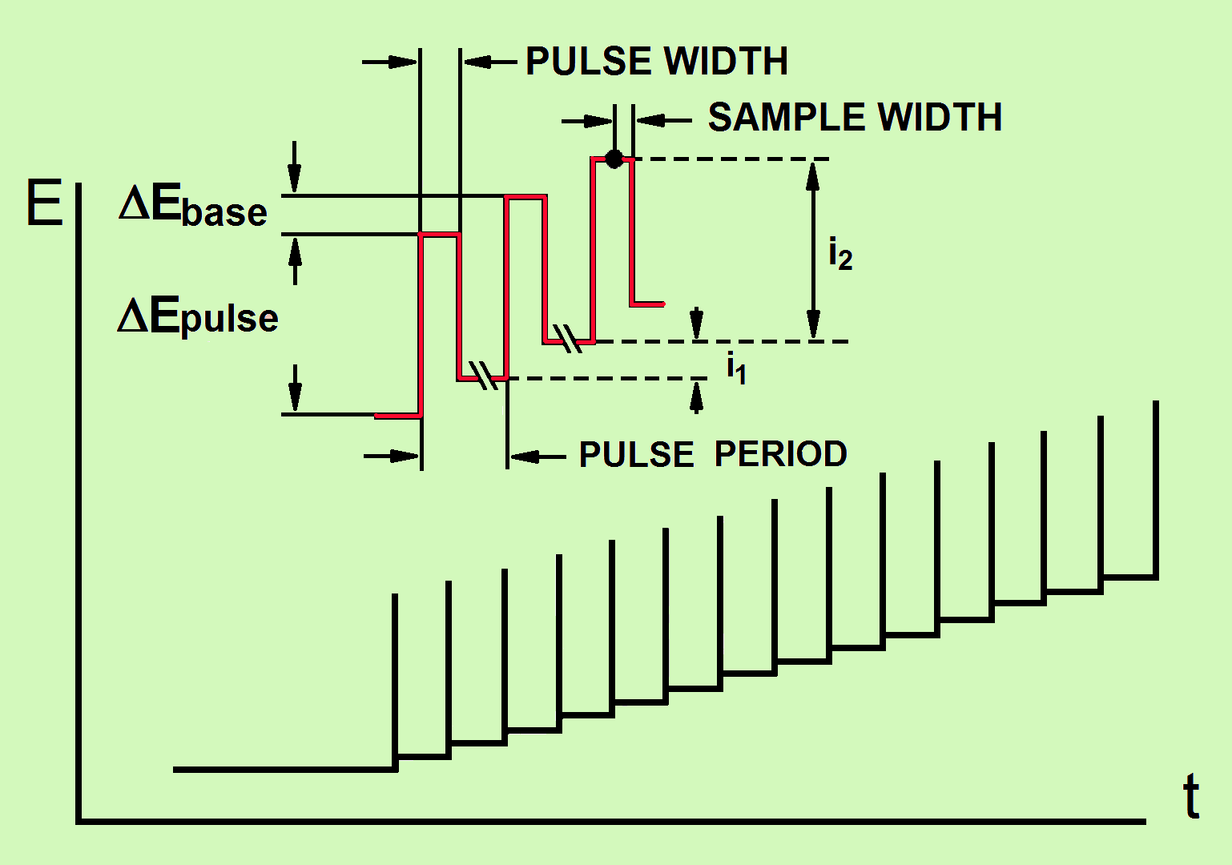
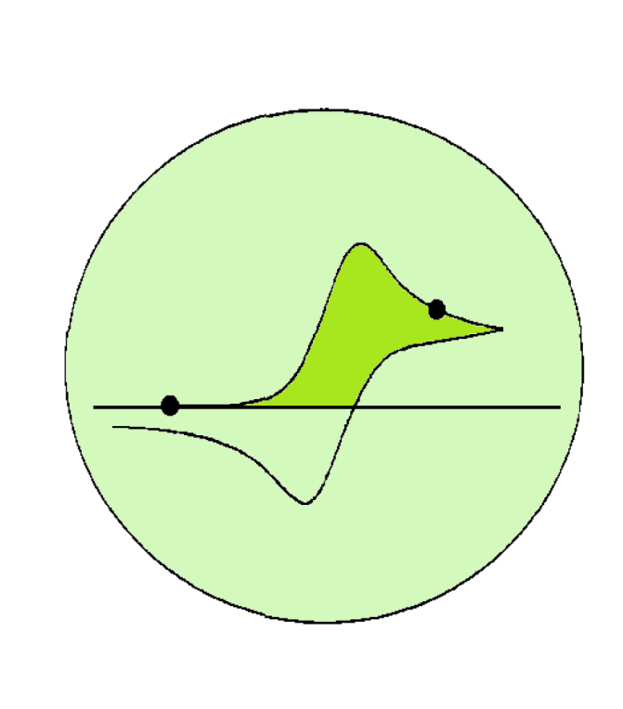
2.1.1 Differential Pulse Voltammetry (DPV)
superimposing small constant-amplitude potential pulses (10 < ΔE_{pulse} < 100 mV) upon a staircase waveform of steps of constant height but smaller than the previous pulses (1 < ΔE_{base} < 5 mV).
Fig 38

Slide 7
The important parameters
pulse amplitude (ΔE_{pulse}): height (in mV) of the applied potential pulse
pulse width: length of the time (in ms) in which the pulse is maintained
sample width: time of measuring current after the application of the potential pulse
pulse period: time (in ms) needed to make one cycle of variation of potential.

Slide 8
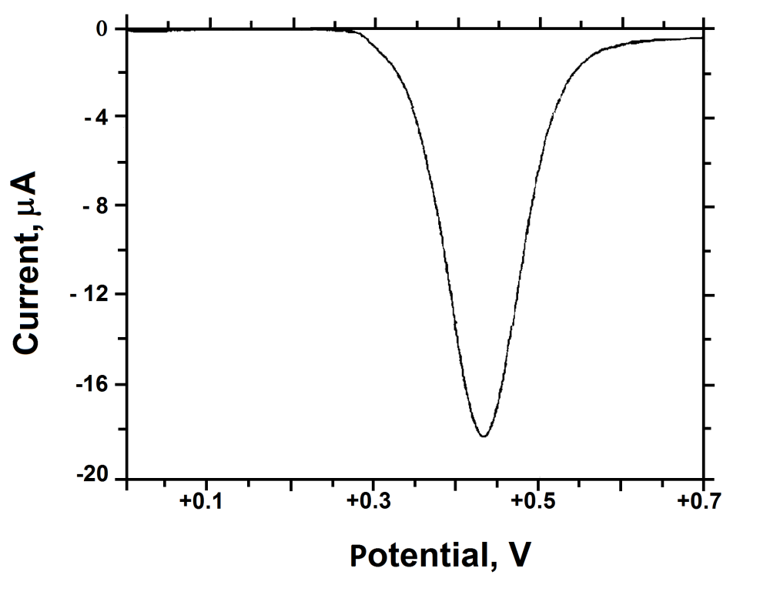
Elimination of capacitive currents from (i₂-i₁)
Current sampling during a pulse period
before the pulse, i₁ (at the foot of the forward peak)
end of the pulse, i₂ (just after the forward peak)
In contrast to linear single sweep or cyclic voltammetry:
symmetric peaks
start from zero-current and finish at zero-current
Fig 39
i₂ – i₁

Slide 9
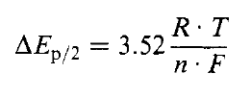
for reversible electron transfers
usually low (≈ 50 mV).

Slide 10
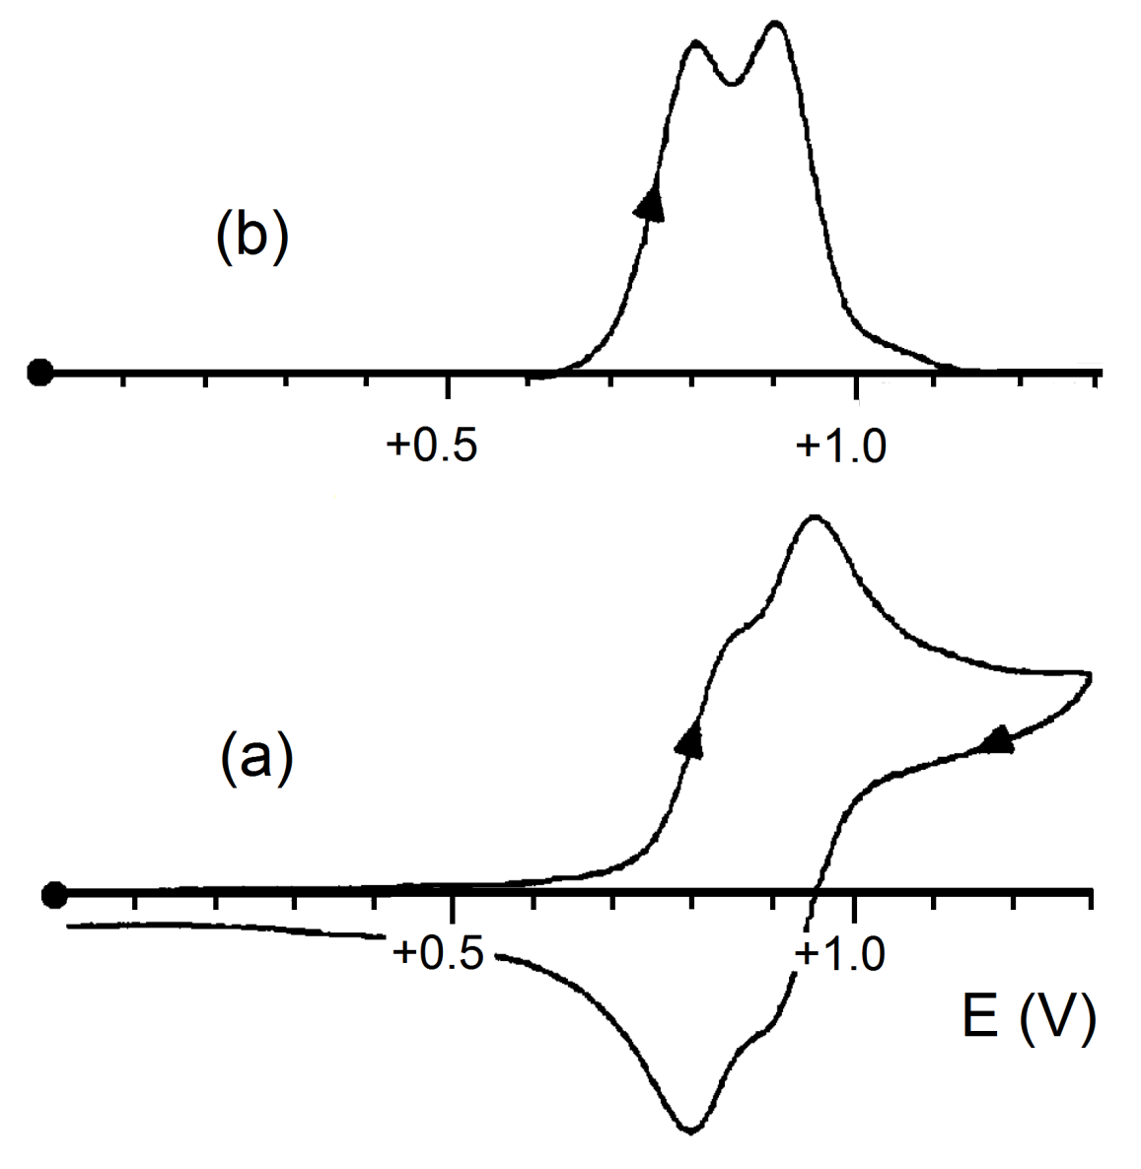
Undergoing two closely spaced one-electron oxidations
differential-pulse voltammogram
cyclic voltammogram
Fig 40

Slide 11
DPV limitations
use of the Dropping Mercury Electrode
low scan rates (lower than 0.02 Vs⁻¹ ), difficulty in interpreting responses in which the electro generated species are not stable (following chemical complications)

Slide 12
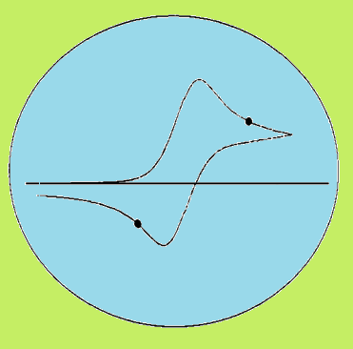
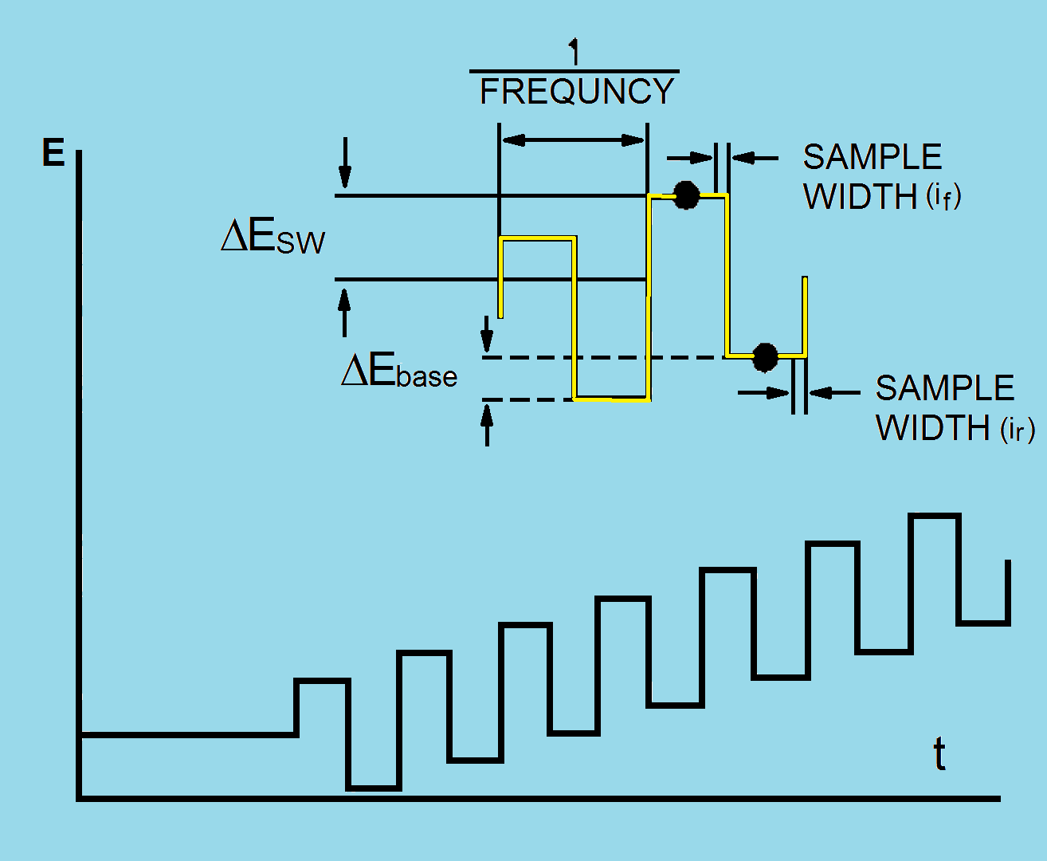
2.1.2. Square Wave Voltammetry
in particular Osteryoung SWV
in-phase combination of:
a staircase waveform of small and constant step height (1 <ΔE_{base}< 40 mV) with periodic square wave pulses
(1 ≤ ΔE_{sw} ≤250 )
pulses alternating in direction(succession of forward (red/ox) and reverse (ox/red) cycles(1 ≤ frequency SW < 2000 Hz)
a sequence of equally spaced steps
forward step of height(2ΔE_{sw}+ΔE_{base})
the reverse step of height(-2ΔE_{sw})
Sampling current at the end of either the forward pulse or the reverse one(waiting times before each sampling make the capacitive currents disappear)
Fig 41

Slide 13
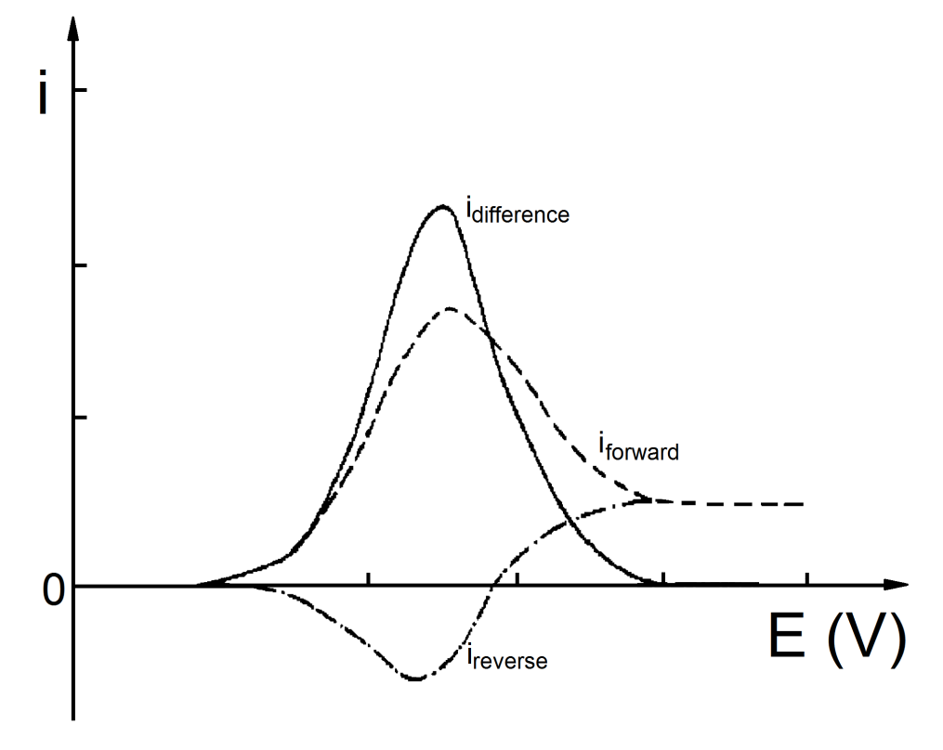
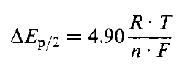
Shape of the voltammogram
As in DPV is peak-shaped:
but it consists of a differential curve between the current recorded in the forward half-cycle and the current recorded in the reverse half-cycle
As in DPV, if ΔE_{sw} is small (≈50/n mV), the peak potential for a
Reversible process coincides with the formal electrode potential

Slide 14
Like DPV, OSWV is very effective in solving almost overlapping processes
With respect to DPV, OSWV can use higher scan rates . The typical scan rate
(SW frequency x ΔE_{base}) is around 0.2 Vs⁻¹ (which is the typical scan rate of cyclic voltammetry).
Some aspects
This allows one to compete with the eventual presence of chemical complications coupled to the electron transfers

Slide 15
2.2. Hydrodynamic Techniques
(hydrodynamics = liquids in motion)
the working electrode is moved with respect to the solution
1
solution is agitated
2
electrode is rotated
3
electrode is vibrated
thickness of the diffusion layer
so that the concentration gradient
rate of the mass transport
faradic currents

Slide 16
Advantages
study of electrode kinetics
cover a drawback of cyclic voltammetry (cyclic voltammetry is unable to discriminate between oxidation and reduction processes)
starting potential for a cyclic voltammetric scan is on the basis of the zero-current condition (no electron transfer occur)
Impossible to realize that the potential is wrong, in that small currents (the stationary conditions of the solution and use of electrodes of a small area)

Slide 17
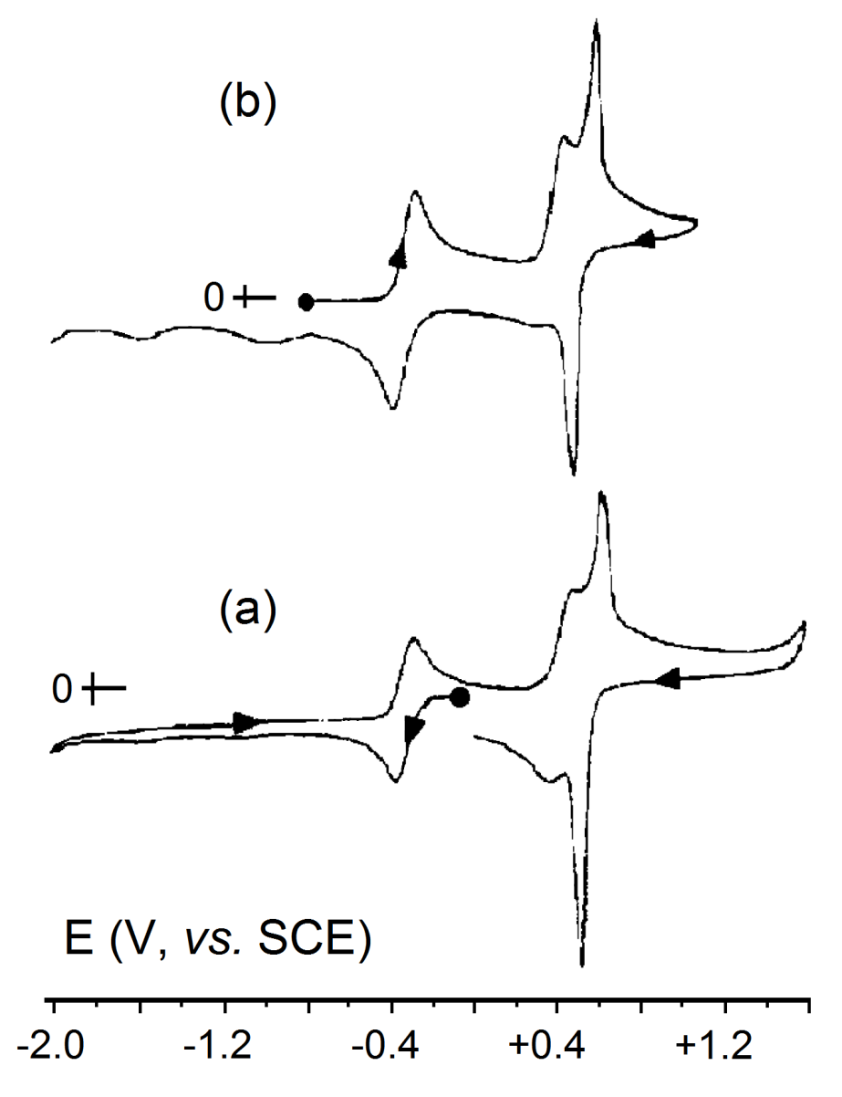
Example
Fig 43
difficult to decide if the first process is
a reduction step (Fig 43a)
an oxidation step ( fig 43b)

Slide 18
Rotating Disk Electrode (RDE) voltammetry
voltammetry at an electrode with periodical renewal of the diffusion layer('polarography' at solid electrodes)
Methods
with the same equipment used for CV
setting the working electrode in periodical motion either along its axis or perpendicular to its axis
Percussing the top of the electrode through a timed knocker (3 – 5 s) or a finger,during a linear potential sweep (scan rates from 0.005 V s⁻¹ to 0.02 Vs⁻¹)
resulting voltammogram is similar to a classical polarogram
independently from the starting potential, is able to distinguish the
anodic or cathodic nature of the process

Slide 19
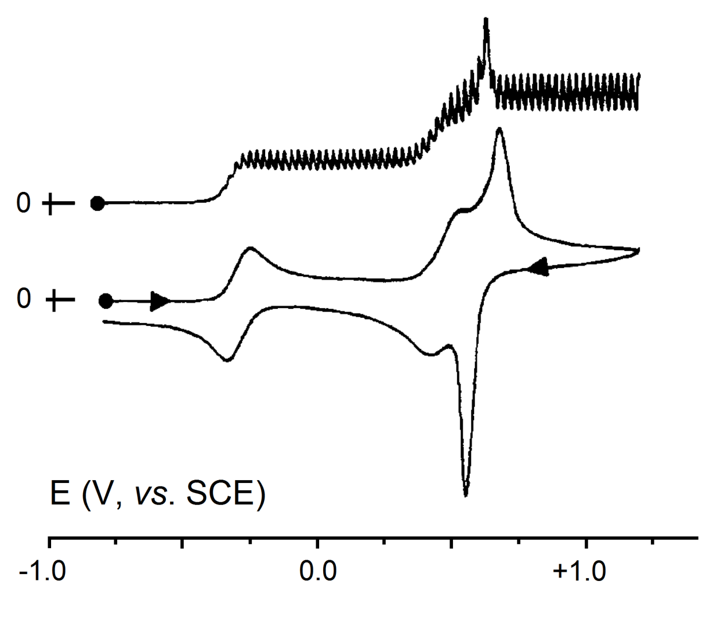
Fig 44
use of a platinum electrode with periodical renewal of the diffusion layer.
(species undergoes consecutive oxidation processes)
Compare with 43b

Slide 20
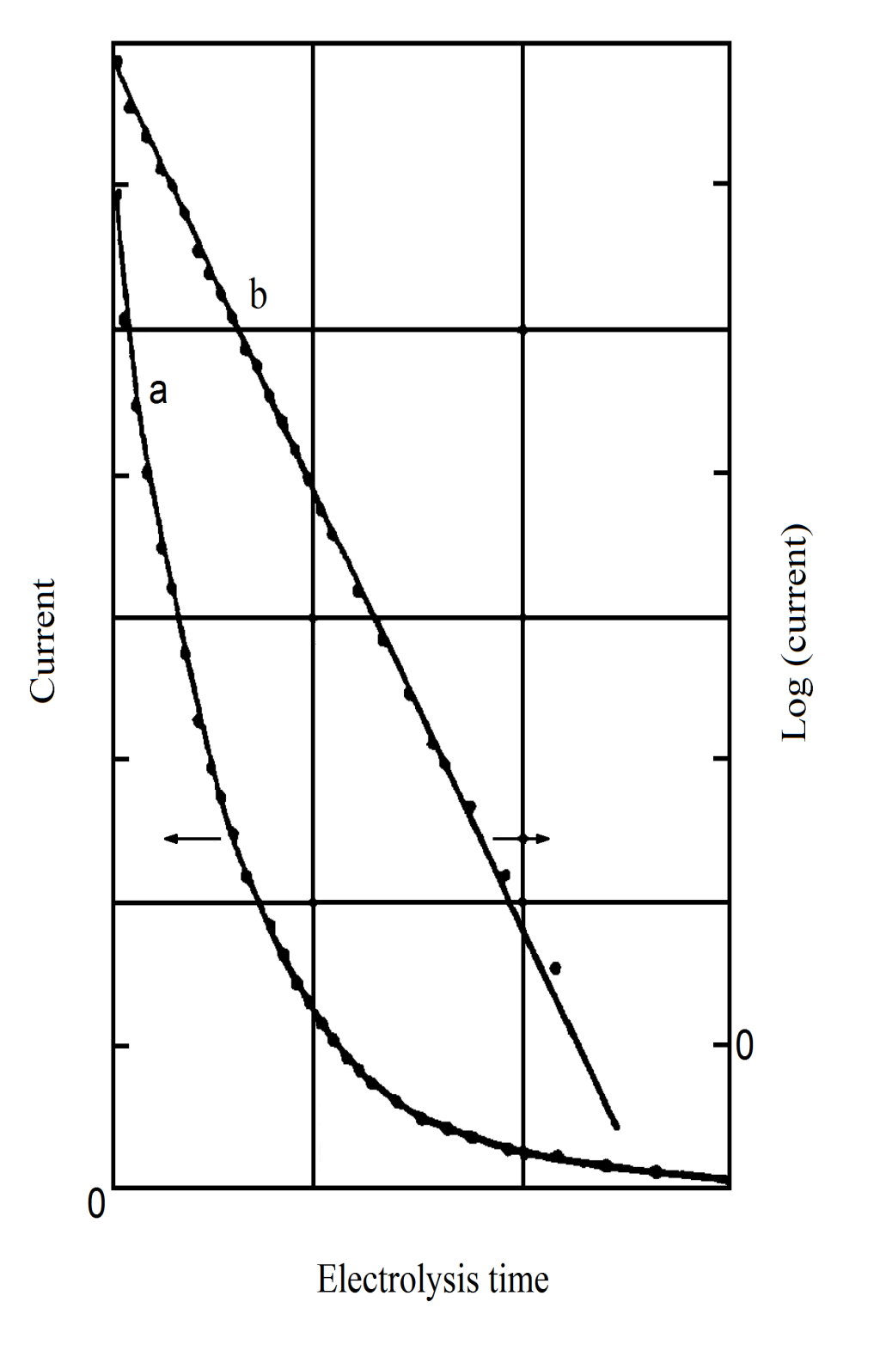
2.3 Controlled Potential Electrolysis
Remember that:
the absence of chemical complications
an electrochemically reversible process
the measurement of the diffusion coefficient D
the measurement of the area of the electrode A
in other cases knowledge of α
controlled potential coulometry
1
Ox +ne⁻ Red
(i vs. t)
[Ox]_{o}
D.A/vol.
Thickness of diffusion
layer
(log i vs. t)
slope=
Intercept=
45a
2
1
3
45b

Slide 21
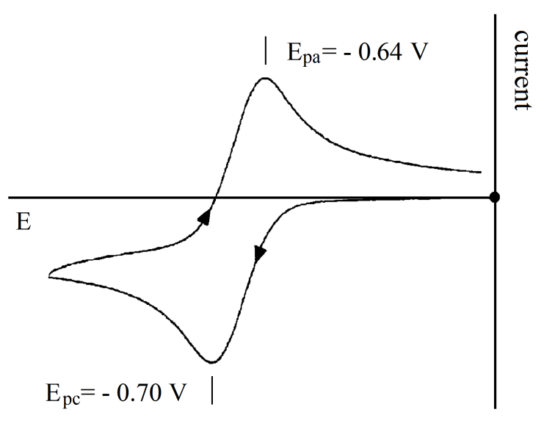
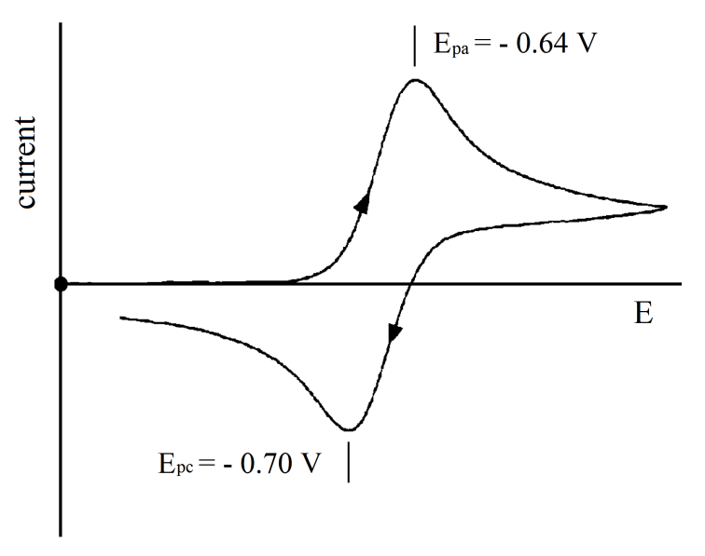
How to perform?
recording a cyclic voltammogram
(fig 46)
a solution of known concentration
of Ox in the electrolysis cell
applying a potential slightly more
negative (here -0.9v) under stirring (accelerate mass transport to the electrode)
electrolysis current decreases(fig 45a), when the current drops to about 1/10 -1/100 of the initial current, calculating with previous relations
Using controlled potential electrolysis in ascertaining the stability of every electro generated species (determining the chemical reversibility of a redox process – fig 47)
Fig 46
Fig 47

Slide 22
electrode poisoning processes
don’t allow the measurement to be completed
changing the electrode material(passing from platinum to gold or mercury or carbon, and vice versa)
fragmentation processes of the primary electro generated species
consumption of a number of electrons higher than the effective one (except for ECE processes, where the coulometric determination is essential for their definition)
catalytic regeneration of the initial species
means that the electrolysis continues indefinitely
When could not? (n n_{app})

Slide 23

Other application:
Generation of a certain species not easily obtained by means of common redox agents
Electro crystallization techniques

