Slide 1
The five basic lattice types
There are 17 space groups in the plane, but their unit cells fall into one of five basic shapes as follows:

Slide 2
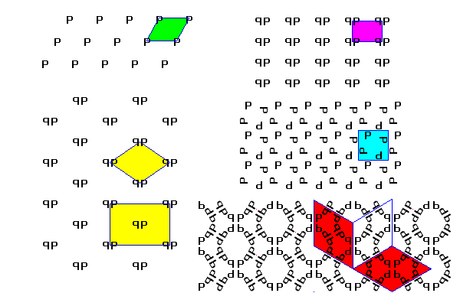
There are 17 space groups in the plane, but their unit cells fall into one of five basic shapes as follows:
General Parallelogram lattice (Green) General Rectangular Lattice (magenta) General Rhombic (Centered) Lattice (yellow) The simplest unit cell for this pattern is a rhombus, but the pattern also has a rectangular structure. To bring out the rectangular pattern, this lattice is often described as a rectangle with an extra point in the center. Such a lattice is called centered. Square Lattice (blue) The lattice of a checkerboard or graph paper. Hexagonal Lattice (red) Note that there are three equivalent ways to orient the unit cells. This is the lattice for honeycombs.

Slide 3
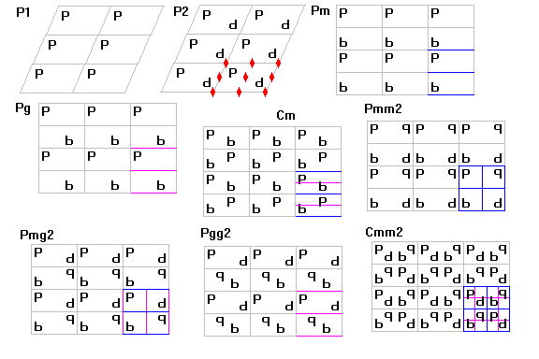
Parallelogram and Rectangular Lattices
Simple Parallelogram LatticesP1 has no symmetry. Note, if the parallelogram happens to be a rectangle or even a square, but the motif has no symmetry, the pattern is still P1. P2 has 2-fold axes.
Rectangular Latticespm has Parallel mirror planes
pg has Parallel glide planes
pmm has Perpendicular mirror planes
pmg has Perpendicular mirror and glide planes
pgg has Perpendicular glide planes. (p,b) and (d,q) are related by horizontal glides, (p,q) and (b,d) by vertical glides. Note that the intersections of the glide planes and the centers of the boxes outlined by the glide planes are also two-fold symmetry axes.

Slide 4
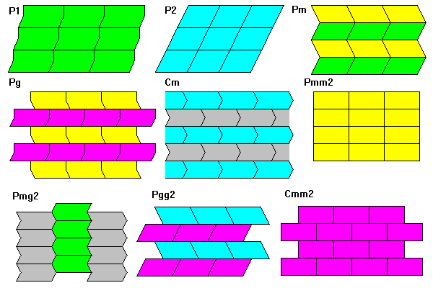
Centered Lattices cm has Parallel alternating mirror and glide planes. The pattern of stars on a 50-star flag has this symmetry. cmm has Alternating mirror and glide planes in both directions. All intersections are also two-fold symmetry axes. Bricks in a wall have this symmetry.
The figure below gives examples of each pattern.

Slide 5
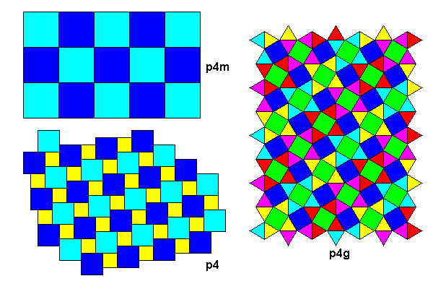
Examples of each symmetry are shown below.

Slide 6
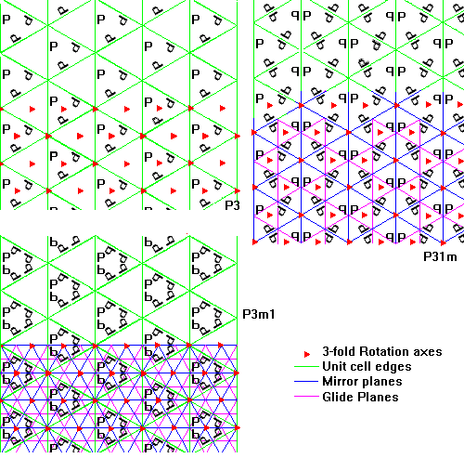
Trigonal Lattices

Slide 7
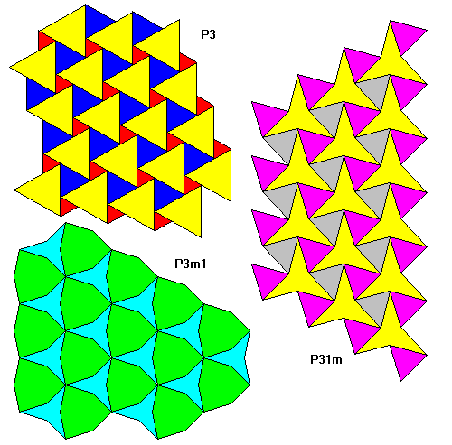
Examples of each symmetry are shown below.

Slide 8
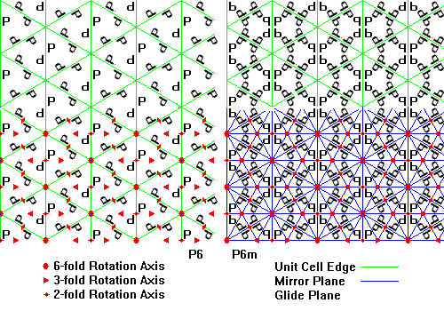
Hexagonal Lattices

Slide 9
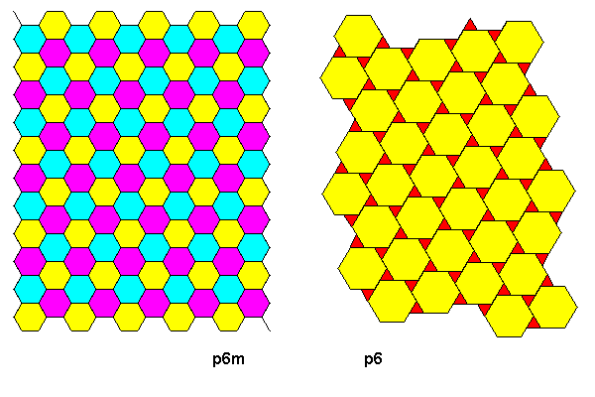
Examples of each symmetry are shown below.

Slide 10
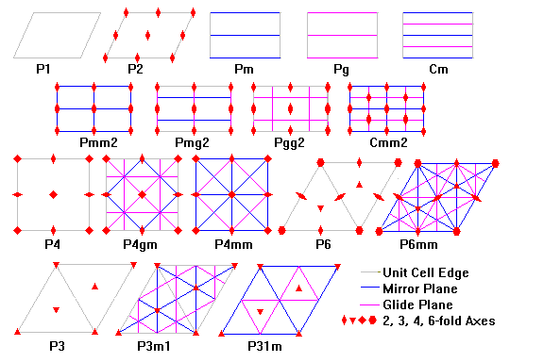
Symmetry Elements of the Two-Dimensional Space Groups

Slide 11
Three-Dimensional Space Groups
Start by considering the point groups and lattice types in two dimensions:
Symmetry | Lattice Type
1 | Parallelogram
m | Rectangle
2 | Parallelogram
2m = mm | Rectangle, Rhombus
3, 3m | Hexagonal
4, 4m | Square
6, 6m | Hexagonal

Slide 12
Similarly, in three dimensions we can combine the 14 Bravais lattices and the 32 point groups as shown here:
Crystal Class | Bravais Lattices | Point Groups
Triclinic | P | 1, 1*
Monoclinic | P, C | 2, m, 2/m
Orthorhombic | P, C, F, I | 222, mm2, 2/m 2/m 2/m
Trigonal | P, R | 3, 3*, 32, 3m, 3*2/m
Hexagonal | P | 6, 6*, 6/m, 622, 6mm, 6*m2, 6/m 2/m 2/m
Tetragonal | P, I | 4, 4*, 4/m, 422, 4mm, 4*2m, 4/m 2/m 2/m
Isometric | P, F, I | 23, 2/m3* 432, 4*3m, 4/m 3* 2/m

Slide 13
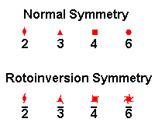
Symbols
Rotation Axes
 | Rotation axes are represented with conventional crystallographic symbols. Rotation axes parallel to the plane of the diagram are indicated by a symbol and a line showing the axis orientation. Apart from isometric space groups, only 2-fold axes ever have this orientation.

Slide 14
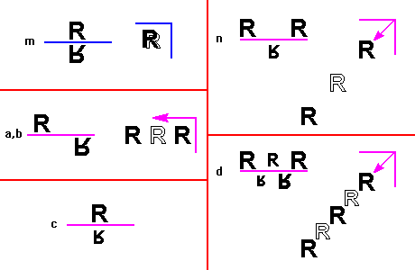
Mirror and Glide Planes
In all diagrams, the letter R is used as a motif, with larger letters closer and smaller ones more distant. Outlined R's mean we are viewing the back side of the motif. Overlapping solid and outlined R's are used to indicate a motif and its reflection in a mirror plane in the plane of the diagram.
m is a conventional mirror plane. Objects are reflected across the plane. Looking perpendicular to the plane we see the object and the reflection of its reverse side.
a, b are glides parallel to the unit cell edges. We see the object alternating with its translated reflection.
c is a glide parallel to the third edge of the unit cell. Since all the figures (except isometric classes) view down this direction, there is no view perpendicular to the plane. The object and its reflection are translated along the line of sight, so we see the object, then its reflection translated away from us (hence smaller). More distant translations are hidden behind (beneath) the two images shown.
n is a diagonal glide, half a unit cell edge in each direction. In the view along the plane, additional images would continue to step down and to the left, but they are hidden behind neare images of the object.
d is like n in being a diagonal glide, but here the step is one quarter unit cell edge in each direction. Viewing along the plane we see four progressively more distant images of the object before the series in the neighboring unit cell begins.
 | On the left in each diagram is the symbol and appearance of a mirror or glide plane seen edge-on. On the right is the symbol and appearance viewed perpendicular to the plane. Arrows show translation directions.

Slide 15
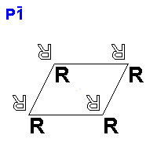
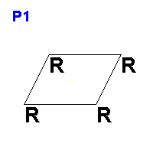
Triclinic Space Groups
 | 1. P1 (x,y,z)
 | 2. P1' (x,y,z); (-x,-y,-z)
Triclinic Space Groups

Slide 16
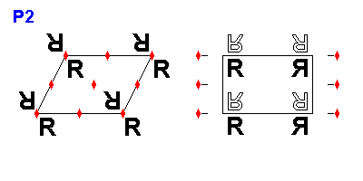
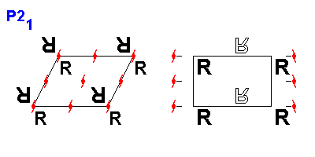
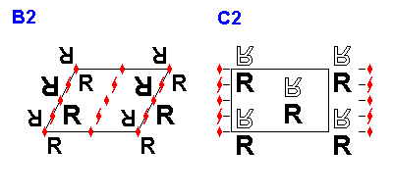
Monoclinic (2) Space Groups
The monoclinic space groups shown here are shown from two vantage points: one along the two-fold axes and one perpendicular to them. Coordinates are listed for both orientations.
 | 3. P2 (x,y,z); (-x,-y,z) P2 (x,y,z); (-x,y,-z)
 | 4. P2₁ (x,y,z); (-x,-y,1/2+z) P2₁ (x,y,z); (-x,1/2+y,-z)
 | 5. B2 (x,y,z); (-x,-y,z); Origins: (0,0,0); (1/2,0,1/2) C2 (x,y,z); (-x,y,-z); Origins: (0,0,0); (1/2,1/2,0)

Slide 17
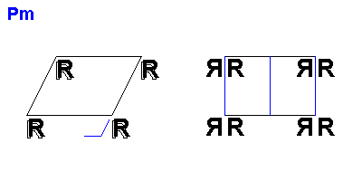
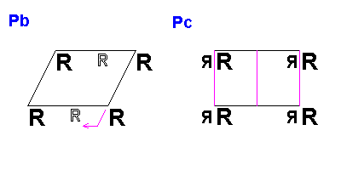
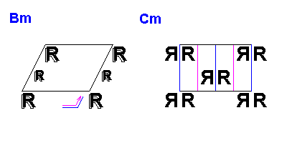
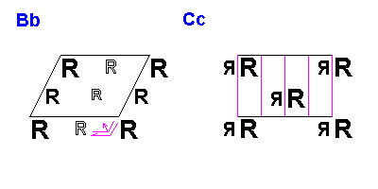
Monoclinic (m) Space Groups
The monoclinic space groups shown here are shown from two vantage points: one along the two-fold axes and one perpendicular to them. Coordinates are listed for both orientations.
 | 6. Pm (x,y,z); (x,y,-z) Pm (x,y,z); (x,-y,z)
 | 7. Pb (x,y,z); (x,1/2+y,-z) Pc (x,y,z); (x,-y,1/2+z)
 | 8. Bm (x,y,z); (x,y,-z); Origins:(0,0,0); (1/2,0,1/2) Cm (x,y,z); (x,-y,z); Origins:(0,0,0),(1/2,1/2,0)
 | 9. Bb (x,y,z); (x,1/2+y,-z); Origins:(0,0,0); (1/2,0,1/2) Cc (x,y,z); (x,-y,1/2+z); Origins:(0,0,0); (1/2,1/2,0)

Slide 18
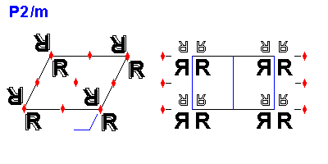
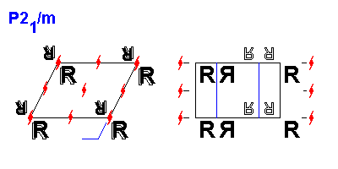
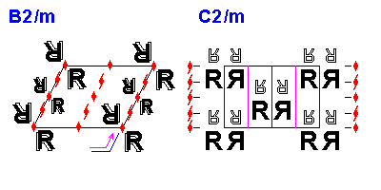
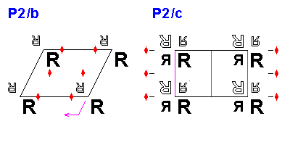
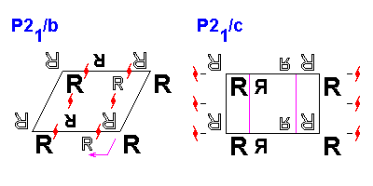
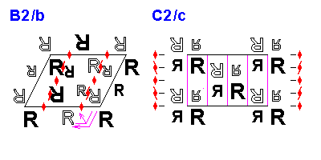
Monoclinic (2/m) Space Groups
 | 10. P2/m (x,y,z); (x,y,-z); (-x,-y,z); (-x,-y,-z) P2/m (x,y,z); (x,-y,z); (-x,y,-z); (-x,-y,-z)
 | 11. P2₁/m (x,y,z); (-x,-y,-z); (-x,-y,1/2+z); (x,y,1/2-z) P2₁/m (x,y,z); (-x,-y,-z); (-x,1/2+y,-z); (x,1/2-y,z)
 | 12. B2/m (x,y,z); (x,y,-z); (-x,-y,z); (-x,-y,-z); Origins: (0,0,0); (1/2,0,1/2) C2/m (x,y,z); (x,-y,z); (-x,y,-z); (-x,-y,-z); Origins: (0,0,0); (1/2,0,1/2)
 | 13. P2/b (x,y,z); (-x,-y,-z); (-x,1/2-y,z); (x,1/2+y,-z) P2/c (x,y,z); (-x,-y,-z); (-x,y,1/2-z); (x,-y,1/2+z)
 | 14. P2₁/b (x,y,z); (-x,-y,-z); (-x,1/2-y,1/2+z); (x,1/2+y,1/2-z) P2₁/c (x,y,z); (-x,-y,-z); (-x,1/2+y,1/2-z); (x,1/2-y,1/2+z)
 | 15. B2/b (x,y,z); (-x,-y,-z); (-x,1/2-y,z); (x,1/2+y,-z); Origins: (0,0,0); (1/2,0,1/2) C2/c (x,y,z); (-x,-y,-z); (-x,y,1/2-z); (x,-y,1/2+z); Origins: (0,0,0); (1/2,0,1/2)

Slide 19
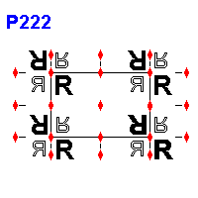
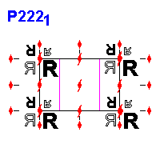
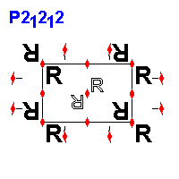
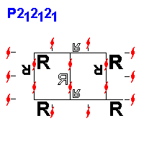
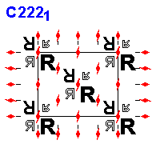
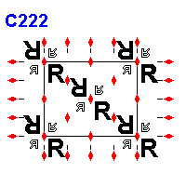
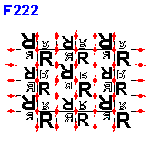
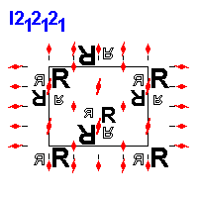
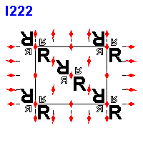
Orthorhombic (222) Space Groups
 | 16. P222 (x,y,z); (-x,-y,z); (x,-y,-z); (-x,y,-z)
 | 17. P222₁ (x,y,z); (x,-y,-z); (-x,-y,1/2+z); (-x,y,1/2-z)
 | 18. P2₁2₁2 (x,y,z); (-x,-y,z); (1/2+x,1/2-y,z); (1/2-1/2+y,-z)
 | 19. p2₁2₁2₁ (x,y,z); (1/2-x,-y,1/2+z); (1/2+x,1/2-y,-z); (-x,1/2+1/2-z)
 | 20. C222₁ (x,y,z); (x,-y,-z); (-x,-y,1/2+z); (-x,y,1/2-z); Origins: (0,0,0); (1/2,1/2,0)
 | 21. C222 (x,y,z); (-x,-y,z); (x,-y,-z); (-x,y,-z); Origins: (0,0,0); (1/2,1/2,0)
 | 22. F222 (x,y,z); (-x,-y,z); (x,-y,-z); (-x,y,-z); Origins: (0,0,0); (0,1/2,1/2); (1/2,0,1/2); (1/2,1/2,0)
 | 23. I222 (x,y,z); (-x,-y,z); (x,-y,-z); (-x,y,-z); Origins: (0,0,0); (1/2,1/2,1/2)
 | 24. I2₁2₁2₁ (x,y,z); (1/2-x,-y,1/2+z); (1/2+x,1/2-y,z); (-x,1/2+y,1/2-z); Origins: (0,0,0); (1/2,1/2,1/2)

Slide 20
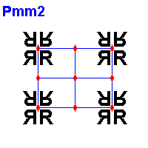
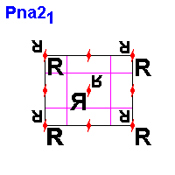
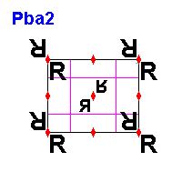
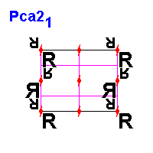
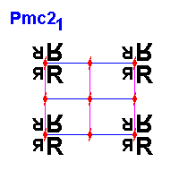
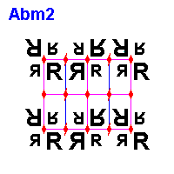
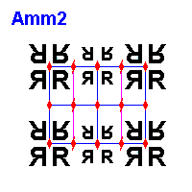
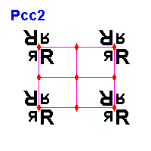
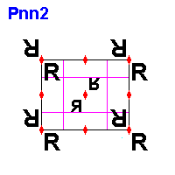
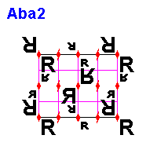
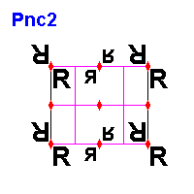
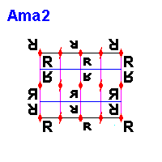
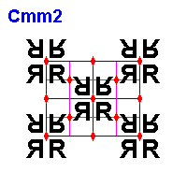
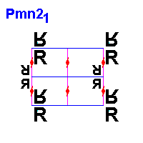
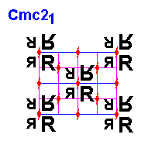






Orthorhombic (mm) Space Groups
 | 25. Pmm2 (x,y,z); (-x,-y,z); (x,-y,-z); (-x,y,z)
 | 26. Pmc2₁ (x,y,z); (-x,y,z); (-x,-y,1/2+z); (x,-y,1/2+z)
 | 27. Pcc2 (x,y,z); (-x,-y,z); (-x,y,1/2+z); (x,-y,1/2+z)
 | 28. Pma2 (x,y,z); (-x,-y,z); (1/2-x,y,z); (1/2+x,-y,z)
 | 29. Pca2₁ (x,y,z); (-x,-y,1/2+z); (1/2-x,y,1/2+z); (1/2+x,-y,z)
 | 30. Pnc2 (x,y,z); (-x,-y,z); (-x,1/2+y,1/2+z); (x,1/2-y,1/2+z)
 | 31. Pmn2₁ (x,y,z); (-x,y,z); (1/2-x,-y,1/2+z); (1/2+x,-y,1/2+z)
 | 32. Pba2 (x,y,z); (-x,y,z); (1/2-x,1/2+y,z); (1/2+x,1/2-y,z)
 | 33. Pna2₁ (x,y,z); (-x,-y,1/2+z); (1/2-x,1/2+y,1/2+z); (1/2+x,1/2-y,z)
 | 34. Pnn2 (x,y,z); (-x,-y,z); (1/2-x,1/2+y,1/2+z); (1/2+x,1/2-y,1/2+z)
 | 35. Cmm2 (x,y,z); (-x,-y,z); (x,-y,-z); (-x,y,z); Origins: (0,0,0); (1/2,1/2,0)
 | 36. Cmc2₁ (x,y,z); (-x,y,z); (-x,-y,1/2+z); (x,-y,1/2+z); Origins: (0,0,0); (1/2,1/2,1/2)
 | 37. Ccc2 (x,y,z); (-x,-y,z); (-x,y,1/2+z); (-x,y,1/2+z); Origins: (0,0,0); (1/2,1/2,1/2)
 | 38. Amm2 (x,y,z); (-x,-y,z); (x,-y,-z); (x,-y,z); Origins: (0,0,0); (0,1/2,1/2)
 | 39. Abm2 (x,y,z); (-x,-y,z); (-x,1/2+y,z); (x,1/2-y,z); Origins: (0,0,0); (0,1/2,1/2)
 | 40. Ama2 (x,y,z); (-x,-y,z); (1/2-x,y,z); (1/2+x,-y,z); Origins: (0,0,0); (0,1/2,1/2)
 | 41. Aba2 (x,y,z); (-x,-y,z); (1/2-x,1/2+y,z); (1/2+x,1/2-y,z); Origins: (0,0,0); (0,1/2,1/2)
 | 42. Fmm2 (x,y,z); (-x,-y,z); (-x,y,z); (x,-y,z); Origins: (0,0,0); (0,1/2,1/2); (1/2,0,1/2); (1/2,1/2,1/2)
 | 43. Fdd2 (x,y,z); (-x,-y,z); (1/4-x,1/4+y,1/4+z); (1/4+x,1/4-y,1/4+z); Origins: (0,0,0); (0,1/2,1/2); (1/2,0,1/2); (1/2,1/2,0)
 | 44. Imm2 (x,y,z); (-x,-y,z); (-x,y,z); (x,-y,z); Origins: (0,0,0); (1/2,1/2,1/2)
 | 45. Iba2 (x,y,z); (-x,-y,z); (-x,y,1/2+z); (x,-y,1/2+z); Origins: (0,0,0); (1/2,1/2,1/2)
 | 46. Ima2 (x,y,z); (-x,-y,z); (1/2-x,y,z); (1/2+x,-y,z); Origins: (0,0,0); (1/2,1/2,1/2)

Slide 21








Tetragonal (4 and 4*) Space Groups
 | 75 P4 (+x,+y,+z); (-x,-y,+z); (+y,-x,+z); ( +y,+x,+z)
 | 76 P4₁ (+x,+y,+z); (-x,-y,1/2+z); (+y,-x,3/4+z); (-y,+x,1/4+z)
 | 77 P4₂ (+x,+y,+z); (-x,-y,+z); (+y,-x, 1/2+z); (-y,+x,1/2+z)
 | 78 P4₃ (+x,+y,+z); (-x,-y,1/2+z); ( +y,-x,1/4+z); (-y,+x,3/4+z)
 | 79 I4 Origins: (0,0,0 1/2.1/2,1/2) (+x,+y,+z); (-x,-y,+z); (+y,-x,+z); (-y,+x,+z)
 | 80 I4₁ Origins: (0,0,0 1/2.1/2,1/2) (+x,+y,+z); (-x,-y,+z); (+y,1/2-x,1/4+z); (-y,1/2+x,1/4+z)
 | 81 P4* (+x,+y,+z); (-x,-y,+z); (+y,-x,-z); (-y,+x,-z)
 | 82 I4* Origins: (0,0,0 1/2.1/2,1/2) (+x,+y,+z); (-x,-y,+z); (+y,-x,-z); (-y,+x,-z)

Slide 22






Tetragonal (4/m) Space Groups
 | 83 P4/m (+x,+y,+z); (-x,-y,+z); (+y,-x,+z); (-y,+x,+z) (+x,+y,-z); (-x,-y,-z); (+y,-x,-z); ( -y,+x,-z)
 | 84 P4₂/m (+x,+y,+z); (-x,-y,+z); (+y,-x, 1/2+z); (-y,+x, 1/2+z) (+x,+y,-z); (-x,-y,-z); (+y,-x, 1/2-z); (-y,+x, 1/2-z)
 | 85 P4/n (+x,+y,+z); (-x,-y,+z); (+y,-x,-z); ( -y,+x,-z) (1/2+y, 1/2-x,+z); (1/2-y, 1/2+x,+z); (1/2+x, 1/2+y,-z); (1/2-x, 1/2-y,-z)
 | 86 P4₂/n (+x,+y,+z); (-x,-y,+z); (+y,-x,-z); (-y,+x,-z) (1/2+y, 1/2-x, 1/2+z); ( 1/2-y, 1/2+x, 1/2+z); (1/2+x, 1/2+y, 1/2-z); (1/2-x,1/2-y, 1/2-z)
 | 87 I4/m Origins: (0,0,0 1/2.1/2,1/2) +x,+y,+z); (-x,-y,+z); (+y,-x,+z); (-y,+x,+z) (+x,+y,-z); (-x,-y,-z); (+y,-x,-z); ( -y,+x,-z)
 | 88 I4₁/a Origins: (0,0,0 1/2.1/2,1/2) (+x,+y,+z); (-x,-y,+z); (+y,1/2-x,1/4+z); ( -y,1/2+x,1/4+z) (+x,1/2+y,1/4-z); ( -x,1/2-y,1/4-z); ( +y,-x,-z); ( -y,+x,-z)

Slide 23










Tetragonal (422) Space Groups
 | 89 P422) (+x,+y,+z); (-x,-y,+z); (-x,+y,-z); (+x,-y,-z) (+y,-x,+z); (-y,+x,+z); ( +y,+x,-z); (-y,-x,-z)
 | 90 P42₁2) (+x,+y,+z); (-x,-y,+z); (1/2-x, 1/2+y,-z); (1/2+x, 1/2-y,-z) (+y,-x,+z); (-y,+x,+z 1/2+y, 1/2+x,-z); (1/2-y, 1/2-x,-z)
 | 91 P4₁22) (+x,+y,+z); (-x,-y,1/2+z -y,+x,1/4+z); (+y,-x,3/4+z) (-x,+y,-z); (+x,-y,1/2-z -y,-x,1/4-z); (+y,+x,3/4-z); ()
 | 92 P4₁2₁2) (+x,+y,+z); (-x,-y, 1/2+z); (1/2-y, 1/2+x, 1/4+z); (1/2+y, 1/2-x,3/4+z); (+y,+x,-z); (-y,-x, 1/2-z); (1/2-x, 1/2+y, 1/4-z); (1/2+x, 1/2-y, 3/4-z)
 | 93 P42 22) (+x,+y,+z); (-x,-y,+z); (+y,-x, 1/2+z); (-y,+x, 1/2+z) (-x,+y,-z); (+x,-y,-z); (+y,+x, 1/2-z); (-y,-x, 1/2-z)
 | 94 P42 2₁2) (+x,+y,+z); (-x,-y,+z); (1/2-x, 1/2+y, 1/2-z); (1/2+x, 1/2-y, 1/2-z) (+y,+x,-z); (-y,-x,-z); (1/2+y, 1/2-x, 1/2+z); (1/2-y, 1/2+x, 1/2+z)
 | 95 P4₃ 22) (+x,+y,+z); (-x,-y,1/2+z); (+y,-x,1/4+z); (-y,+x,3/4+z ) (-x,+y,-z); (+x,-y,1/2-z); (+y,+x,1/4-z); (-y,-x,3/4-z)
 | 96 P4₃ 2₁2) (+x,+y,+z); (-x,-y,1/2+z); (1/2+y, 1/2-x,1/4+z); (1/2-y, 1/2+x, 3/4+z); (-x,+y,-z); (+x,-y,1/2-z); (1/2+y, 1/2+x,1/4-z); (1/2-y, 1/2-x,3/4-z)
 | 97 I422 Origins: (0,0,0); (1/2.1/2,1/2) (+x,+y,+z); (-x,-y,+z); (-x,+y,-z); (+x,-y,-z) (+y,-x,+z); (-y,+x,+z); (+y,+x,-z); (-y,-x,-z)
 | 98 I4₁22 Origins: (0,0,0); (1/2.1/2,1/2) (+x,+y,+z); (-x,-y,+z); (-x,1/2+y,1/4-z); (+x,1/2-y,1/4-z); (+y,+x,-z); (-y,-x,-z); (-y,1/2+x,1/4+z); (+y,1/2-x,1/4+z)

Slide 24






Trigonal (3 and 3*) Space Groups
 | 143 P3 (+x,+y,+z); (-y,+x-y,+z); (+y-x,-x,+z);
 | 144 P31 (+x,+y,+z); (-y,+x-y,1/3+z); (+y-x,-x,2/3+z);
 | 145 P32 (+x,+y,+z); (-y,+x-y,2/3+z); (+y-x,-x,1/3+z);
 | 146 R3 Origins: (0,0,0); (1/3,2/3,2/3); (2/3,1/3,1/3) (+x,+y,+z); (-y,+x-y,+z); (+y-x,-x,+z);
 | 147 P3i (+x,+y,+z); (-y,+x-y,+z); (+y-x,-x,+z); (-x,-y,-z); (+y,+y-x,-z); (+x-y,+x,-z);
 | 148 R3i Origins: (0,0,0); (1/3,2/3,2/3); (2/3,1/3,1/3) (+x,+y,+z); (-y,+x-y,+z); (+y-x,-x,+z); (-x,-y,-z); (+y,+y-x,-z); (+x-y,+x,-z);

Slide 25






Trigonal (32) Space Groups
 | 149 P312 (+x,+y,+z); (-y,+x-y,+z); (+y-x,-x,+z); (-y,-x,-z); (+x,+x-y,-z);(+y-x,+y,-z);
 | 150 P321 (+x,+y,+z); (-y,+x-y,+z); (+y-x,-x,+z); (+y,+x,-z); (-x,+y-x,-z);(+x-y,-y,-z);
 | 151 P3₁12 (+x,+y,+z); (-y,+x-y,1/3+z);(+y-x,-x,2/3+z); (+x,+x-y,-z); (+y-x,+y,1/3-z);(-y,-x,2/3-z);
 | 152 P3₁21 (+x,+y,+z); (-y,+x-y,1/3+z);(+y-x,-x,2/3+z); (+y,+x,-z); (-x,+y-x,1/3-z);(+x-y,-y,2/3-z);
 | 153 P3₂12 (+x,+y,+z); (-y,+x-y,2/3+z);(+y-x,-x,1/3+z); (+x,+x-y,-z); (+y-x,+y,2/3-z);(-y,-x,1/3-z);
 | 154 P3₂21 (+x,+y,+z); (-y,+x-y,2/3+z);(+y-x,-x,1/3+z); (+y,+x,-z); (-x,+y-x,2/3-z);(+x-y,-y,1/3-z);

Slide 26






Hexagonal (6) Space Groups
 | 168 P6 (+x, +y, +z); (-y, +x-y, +z); (+y-x, -x, +z); (-x, -y, +z); (+y, +y-x, +z); (+x-y, +x, +z);
 | 169 P6₁ (+x, +y, +z); (-y, +x-y, 1/3+z); (+y-x, -x, 2/3+z); (-x, -y, 1/2+z); (+y, +y-x, 5/6+z); (+x-y, +x, 1/6+z);
 | 170 P6₅ (+x, +y, +z); (-y, +x-y, 2/3+z); (+y-x, -x, 1/3+z); (-x, -y, 1/2+z); (+y, +y-x, 1/6+z); (+x-y, +x, 5/6+z);
 | 171 P6₂ (+x, +y, +z); (-y, +x-y, 2/3+z); (+y-x, -x, 1/3+z); (-x, -y, +z); (+y, +y-x, 2/3+z); (+x-y, +x, 1/3+z);
 | 172 P6₄ (+x, +y, +z); (-y, +x-y, 1/3+z); (+y-x, -x, 2/3+z); (-x, -y, +z); (+y, +y-x, 1/3+z); (+x-y, +x, 2/3+z);
 | 173 P6₃ (+x, +y, +z); (-y, +x-y, +z); (+y-x, -x, +z); (-x, -y, 1/2+z); (+y, +y-x, 1/2+z); (+x-y, +x, 1/2+z);

