Slide 2
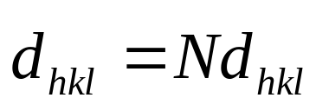
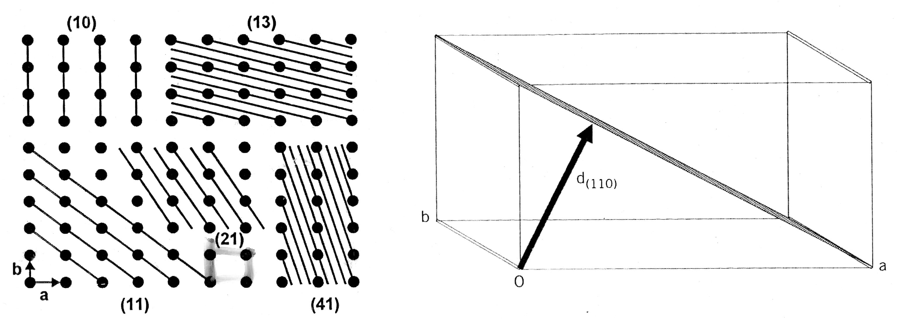
RECIPROCAL LATTICE
The orientation of a plane is defined by the direction of a normal to the plane:

Slide 3
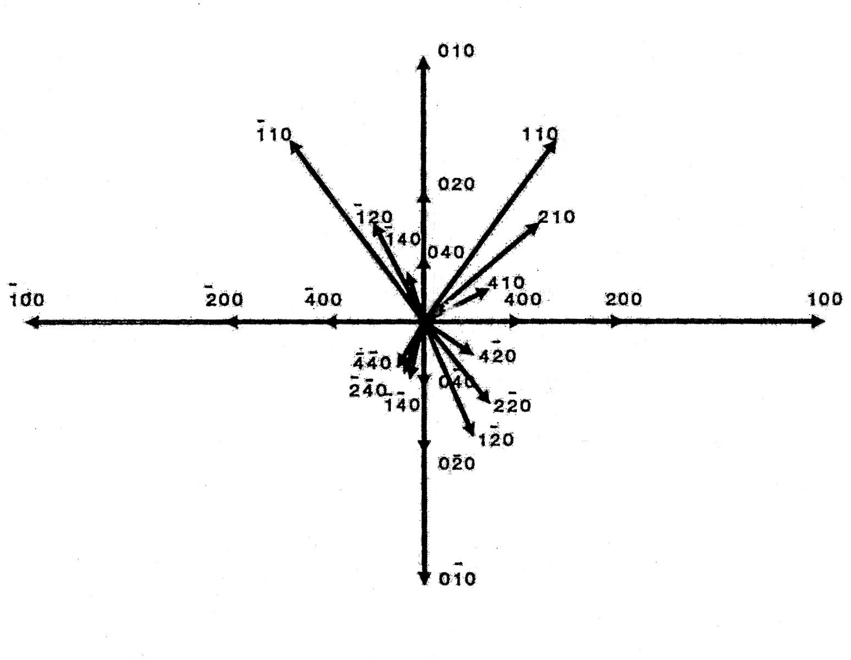
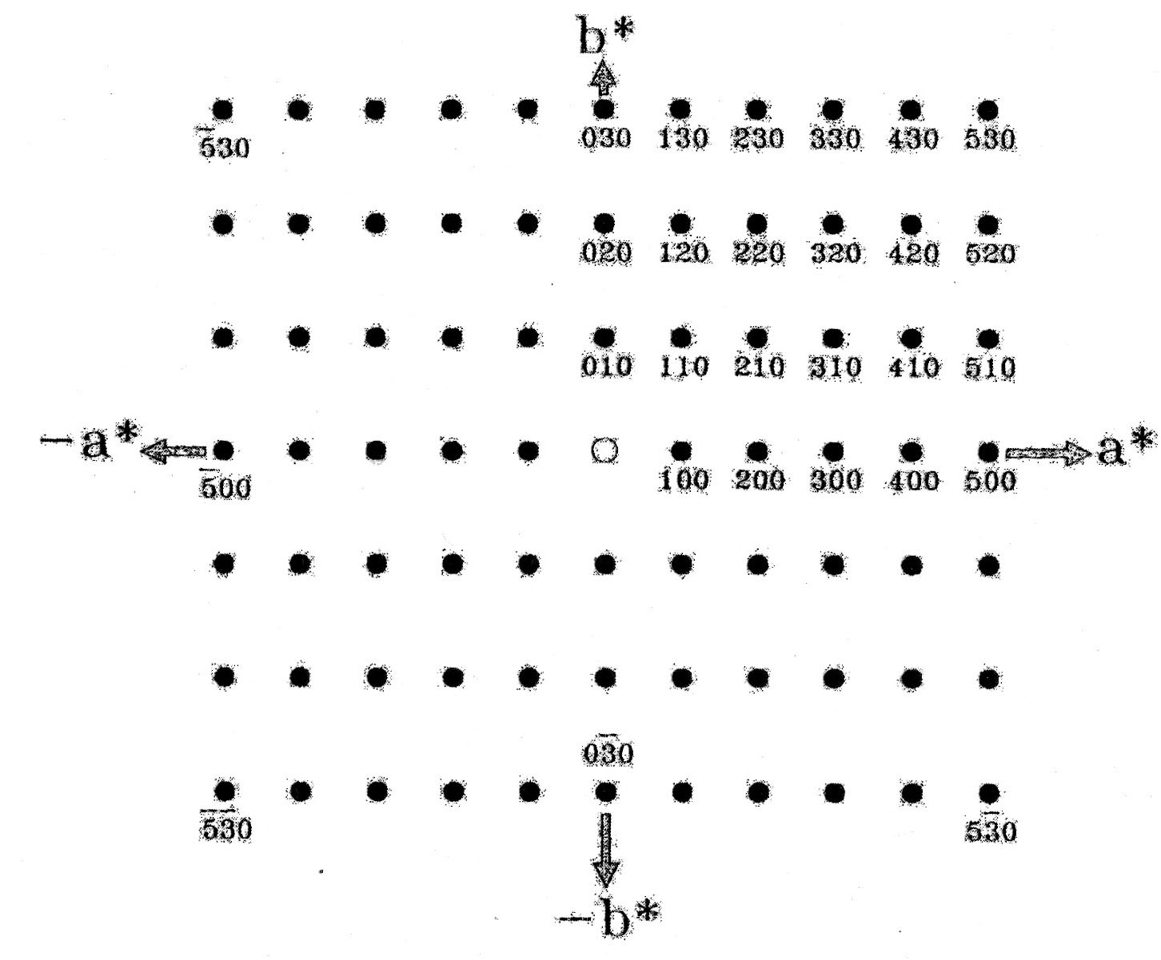
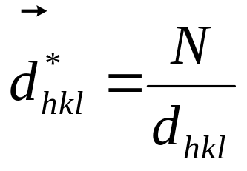
RECIPROCAL LATTICE
d_{hkl} vectors in the direct space
[Å]
d*_{hkl} vectors in the reciprocal space
[1/Å]

Slide 4
RECIPROCAL LATTICE
The reciprocal lattice is periodic.
Therefore, we should be able to define the reciprocal unit cell:
(a*, b*, c*)
such that any vector in the lattice can be described as
d*_{hkl} = ha* + kb* + lc*
Now let’s see how the reciprocal lattice
is related to the diffraction pattern

Slide 5
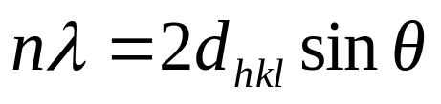
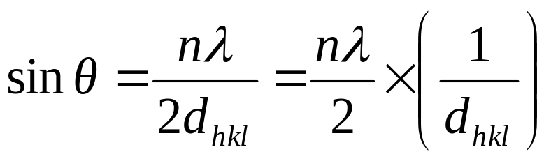
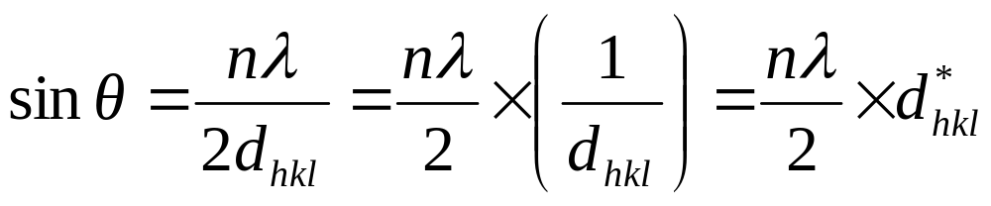
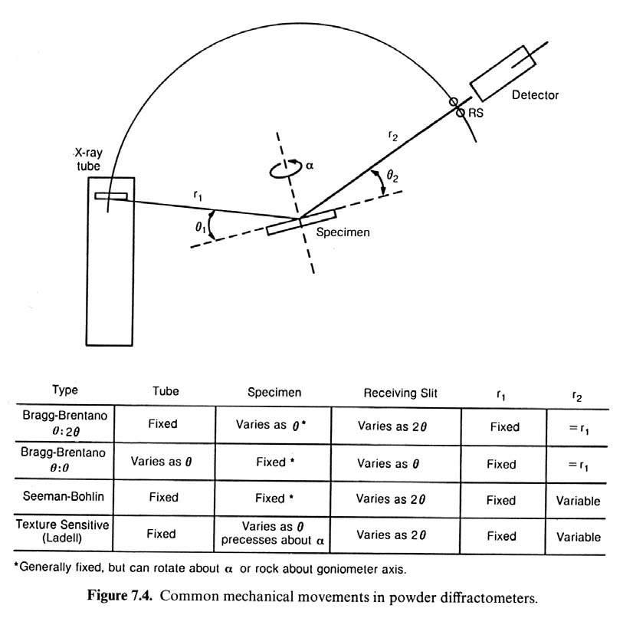
Why Use The Reciprocal Space?
Think about the Bragg law:
What do we measure experimentally?
Angles at which diffraction
maxima are observed

Slide 6
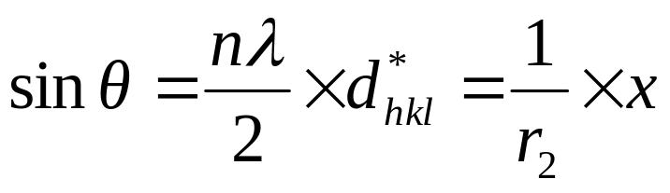
Why Use The Reciprocal Space?
r₁
r₂
x
θ
The experimental measurement is directly related to d*_{hkl} OR
The detector is scanning for the reciprocal lattice points d*_{hkl}

Slide 7
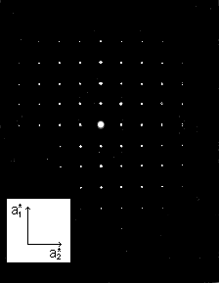
Why Use The Reciprocal Space?
A diffraction pattern is not a direct representation of the crystal lattice
The diffraction pattern is a representation of the reciprocal lattice
In order to find the reciprocal lattice,
the diffraction pattern can be indexed
Diffraction from a single Xtal

Slide 8
INDEXING PROCEDURE
To index a diffraction pattern means:
to find such a basis (a*,b*,c*) that
all the diffraction spots (or lines)
can be described (indexed) as
d*_{hkl} = ha* + kb* + lc*
with only integer (hkl) values allowed.
All we need to do is to find the value of d* for each spot and then let software find the unit cell.
Basically, we deal with a system of linear equations.
The more reflections we have,
the more reliably the unit cell will be determined.

Slide 9
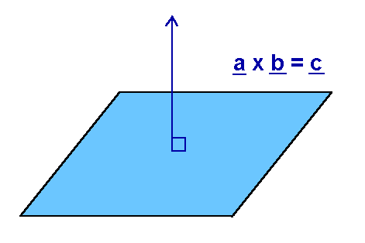
THE RECIPROCAL UNIT CELL
The reciprocal UC is related to the direct UC:
By definition
a*·a = 1 b*·a = 0 c*·a = 0
a*·b = 0 b*·b = 1 c*·b = 0
a*·c = 0 b*·c = 0 c*·c = 1
which means that
a* ⊥ (bc) b* ⊥ (ac) c* ⊥ (ab)
If we can index the diffraction pattern
and find the reciprocal UC,
then we will be able to find the direct UC.
a*
b
θ
c

Slide 10
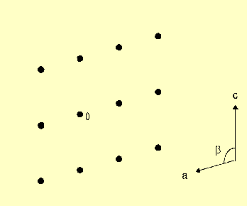
Draw the reciprocal unit cell
(b axis is ⊥ to the plane of the paper)
THE RECIPROCAL UNIT CELL

Slide 11
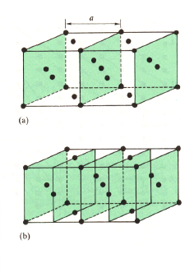
diffraction crystal planes -
(100), (200), …
(100) (200) (300)
Families of planes
Lattice plane directions-(100)
(100)
(200)

Slide 12
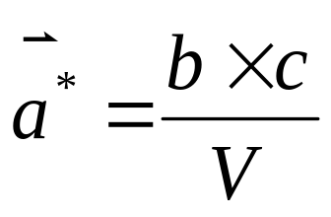
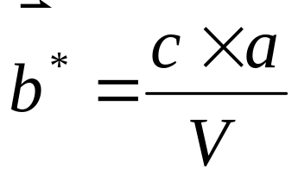
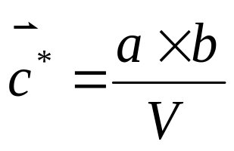
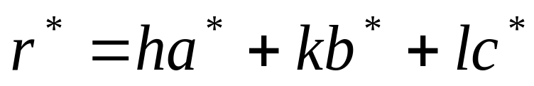
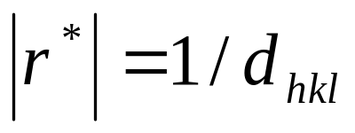
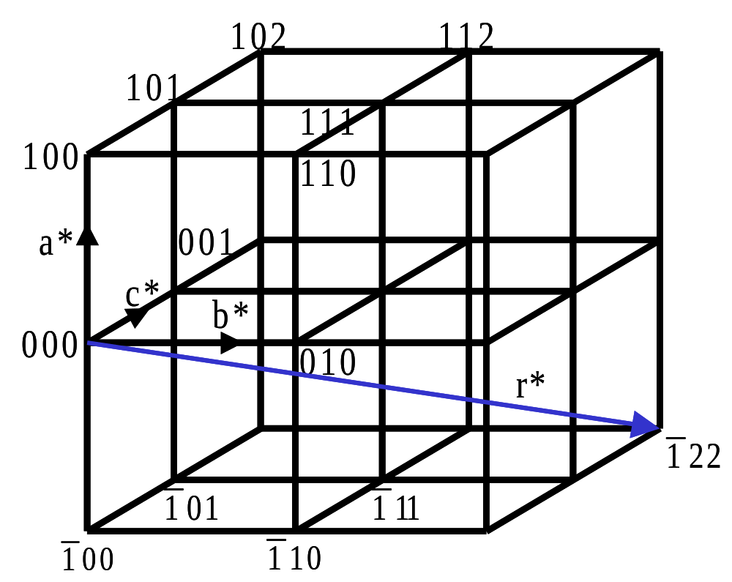
3. Reciprocal lattice
A reciprocal lattice point corresponds to a diffraction (lattice) plane of its original lattice.
A reciprocal vector r* is perpendicular to a lattice plane with the indices (hkl).

