Slide 1

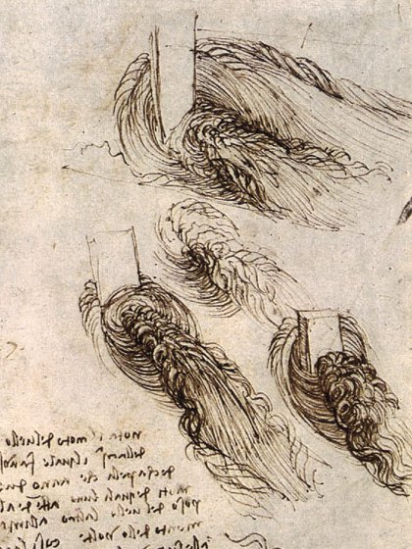
Turbulence Models
Dr. B. Pirzadeh
Department of Civil Engineering, University of Sistan & Baluchestan
References:
TURBULENT FLOWS ; Pope; Cambridge University Press (2000)
A First Course in Turbulence; Tennekes & Lumley ; The MIT Press (1972)
Turbulence Modeling for CFD; David C. Wilcox; DCW Industries (2006)

Slide 2

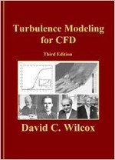

Turbulence Modeling for CFD
ByDavid C. Wilcox
A First Course in Turbulence
Henk Tennekes and John L. Lumley
Turbulent Flows
Stephen B. Pope

