Slide 2
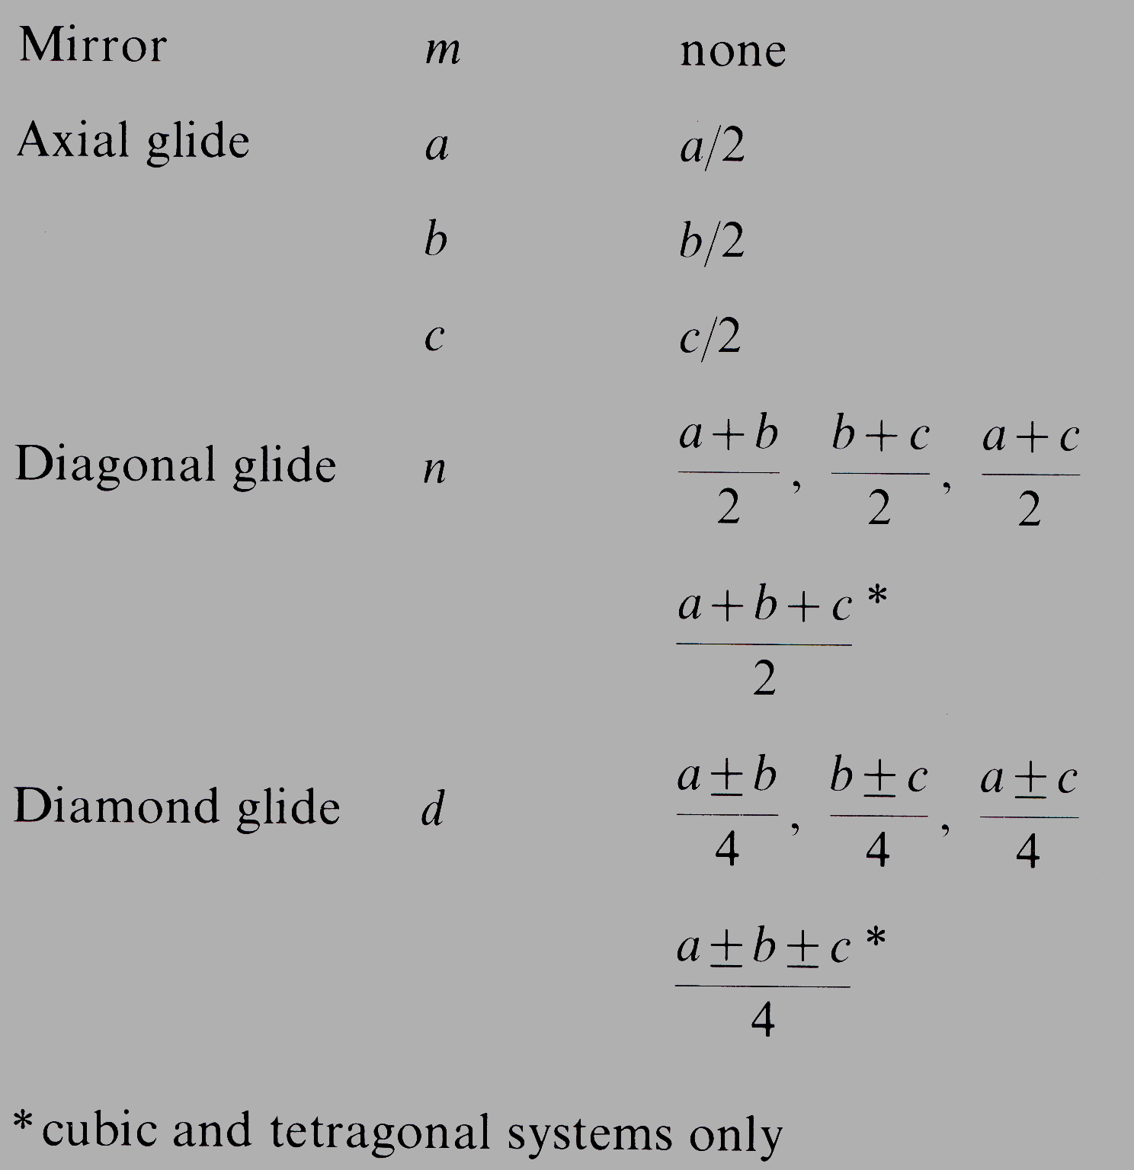

Slide 3
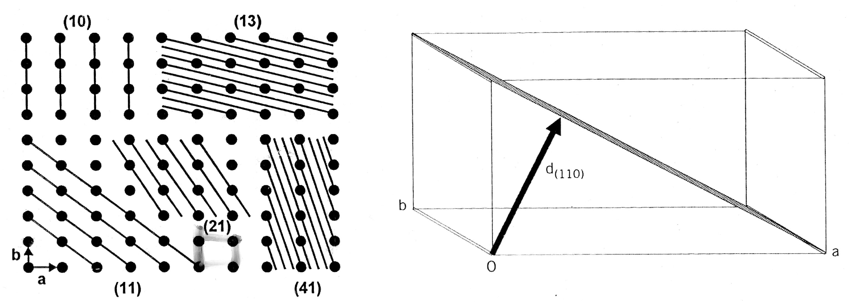
MILLER PLANES
Atoms form periodically arranged planes
Any set of planes is characterized by:
(1) their orientation in the crystal (hkl) – Miller indices
(2) their d-spacing (d_{hkl}) – distance between the planes
h, k, l correspond to the number of segments in which the a, b, c axes, respectively, are cut by the set of planes
On average, the higher (hkl),
the closer is the interplanar distance, d_{hkl}
2-D Examples

Slide 4
Crystallographic Planes
We want to examine the atomic packing of crystallographic planes
Iron foil can be used as a catalyst. The atomic packing of the exposed planes is important.
  Draw (100) and (111) crystallographic planes
  for Fe.
  b) Calculate the planar density for each of these planes.

Slide 5
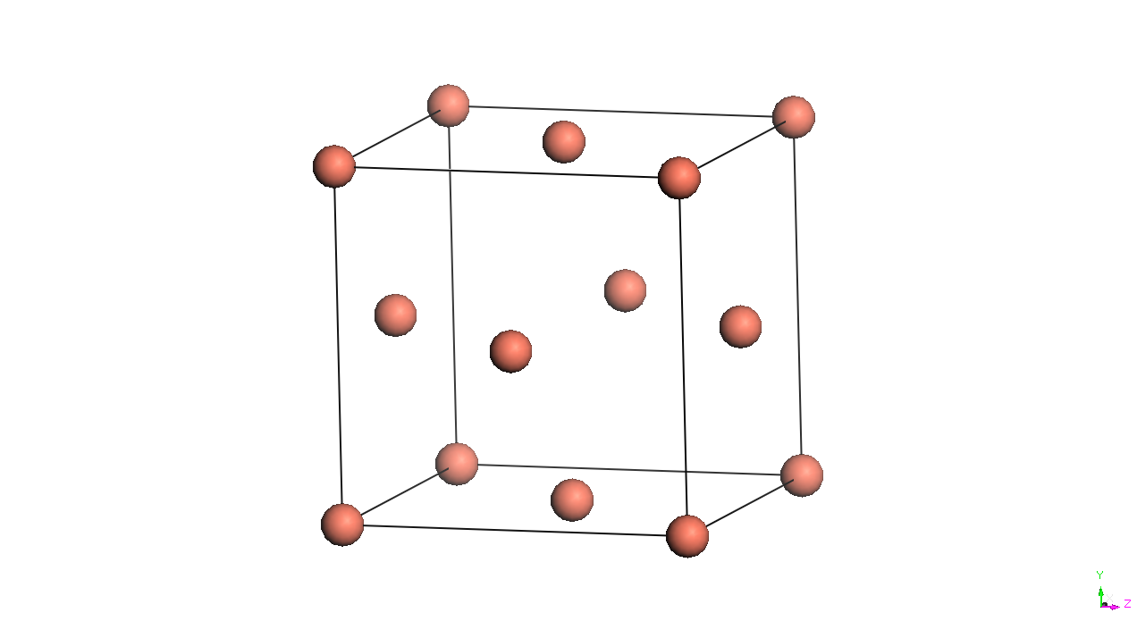
MILLER PLANES
c
b
a

Slide 6
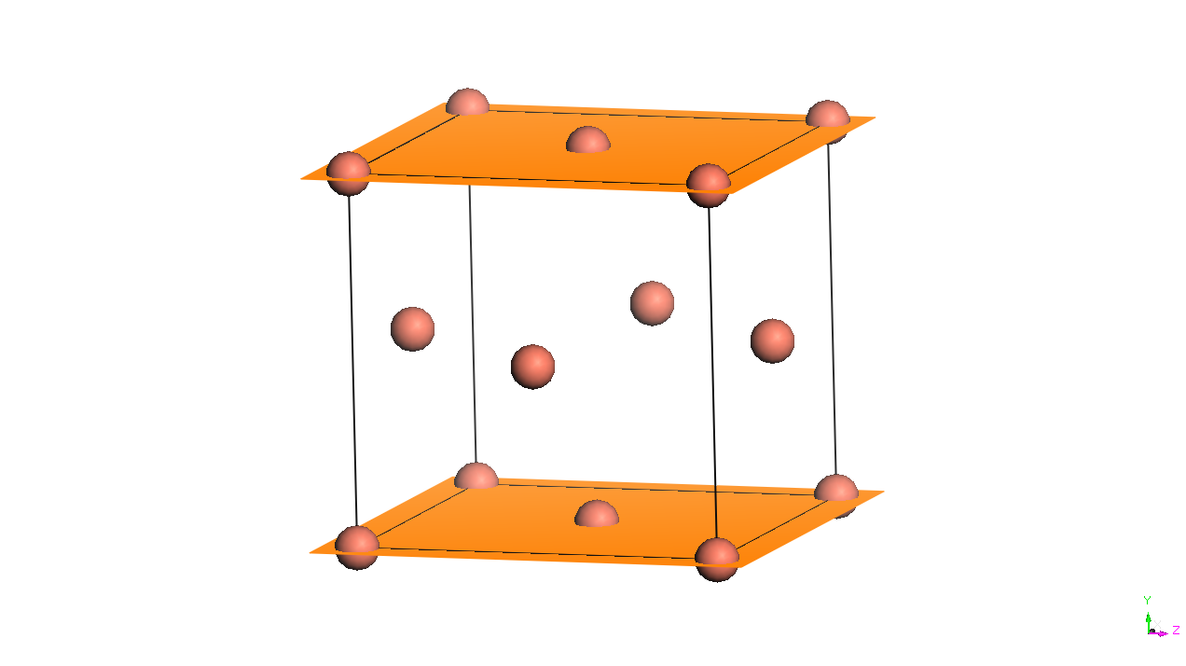
MILLER PLANES
c
b
a

Slide 7
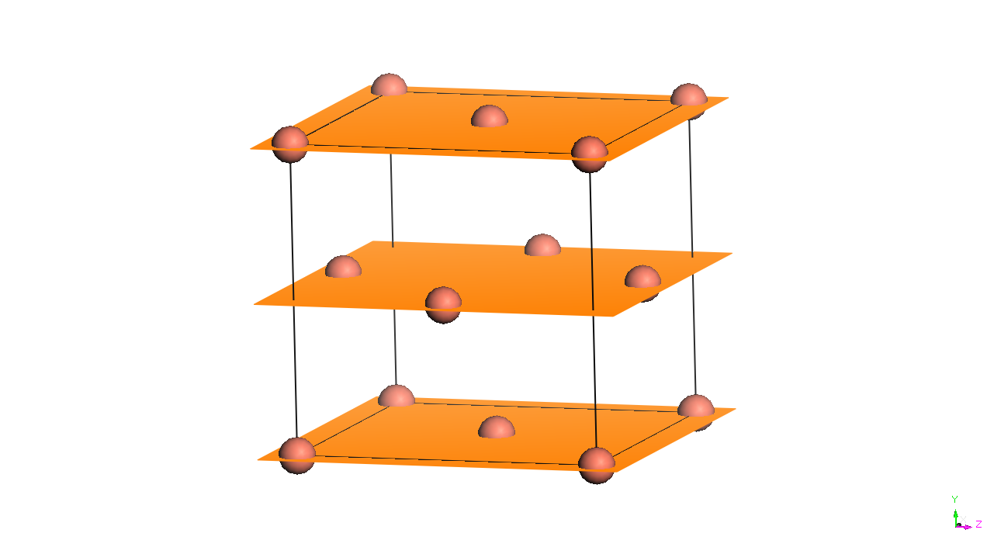
MILLER PLANES
c
b
a

Slide 8
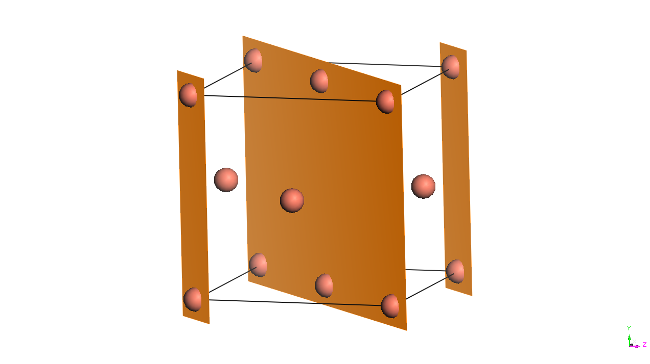
MILLER PLANES
c
b
a

Slide 9
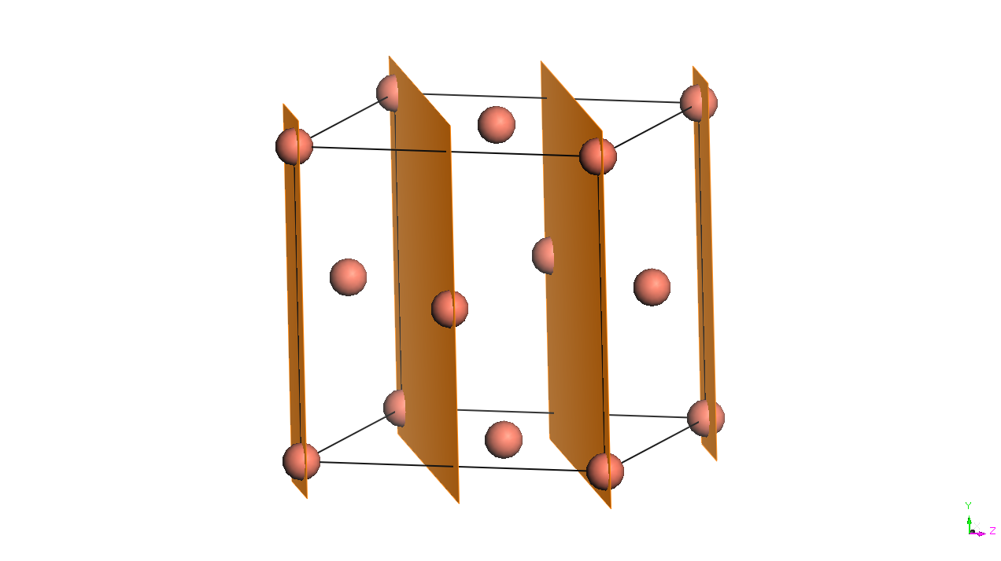
MILLER PLANES
c
b
a

Slide 10
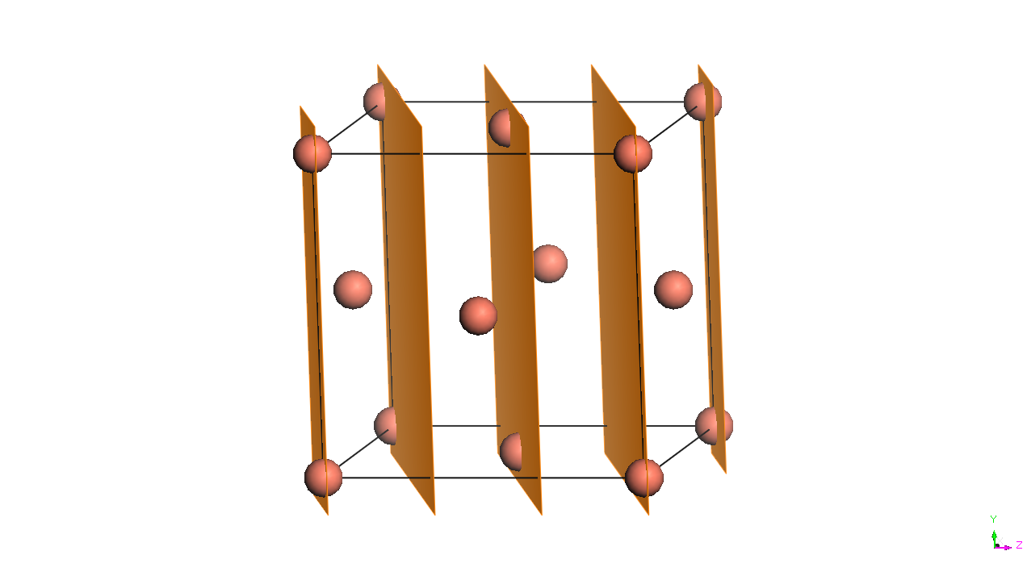
MILLER PLANES
c
b
a

Slide 11
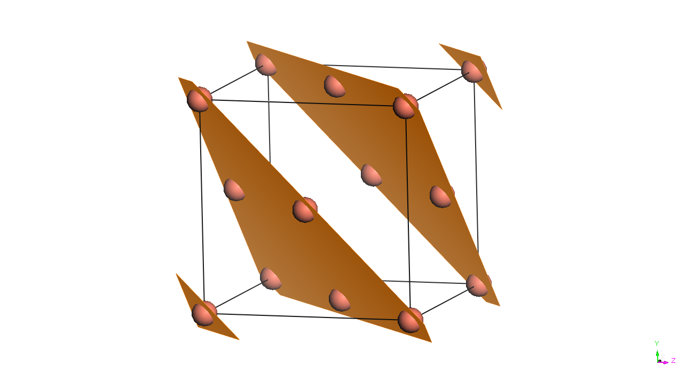
MILLER PLANES
c
b
a

Slide 12
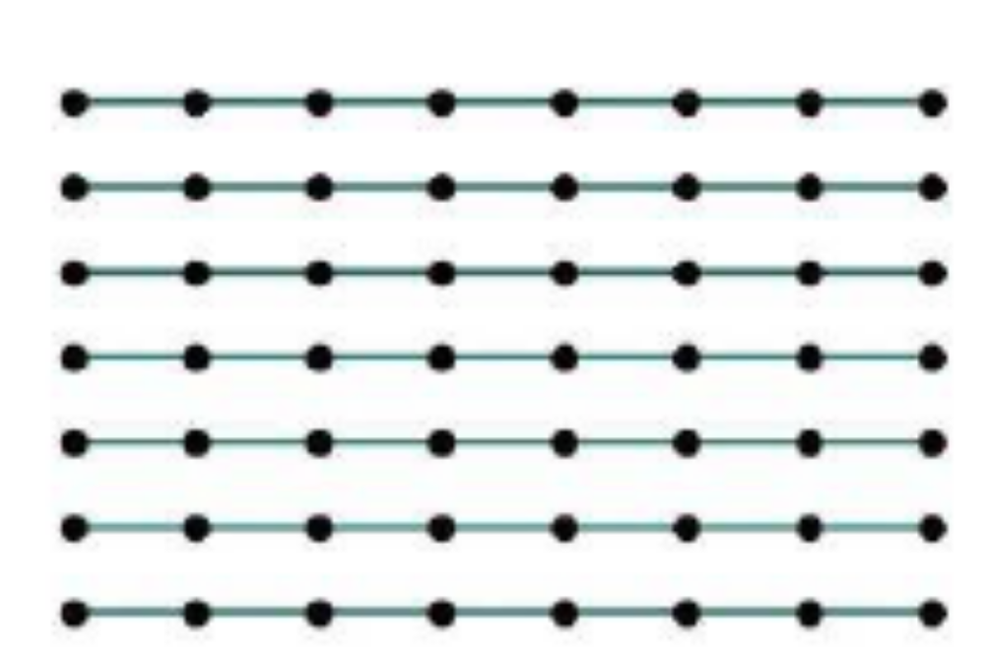
- Crystal planes
Considering 2D lattice
-1a
y
1b
b
x
a
1b
∞
2b
1b
1a
3a
There are many ways connecting lattice points

Slide 13
Crystallographic Planes
Miller Indices: Reciprocals of the (three) axial intercepts for a plane, cleared of fractions & common multiples. All parallel planes have same Miller indices.
Algorithm
  1. Read off intercepts of plane with axes in
  terms of a, b, c
  2. Take reciprocals of intercepts
  3. Reduce to smallest integer values
  4. Enclose in parentheses, no
  commas i.e., (hkl)

Slide 14
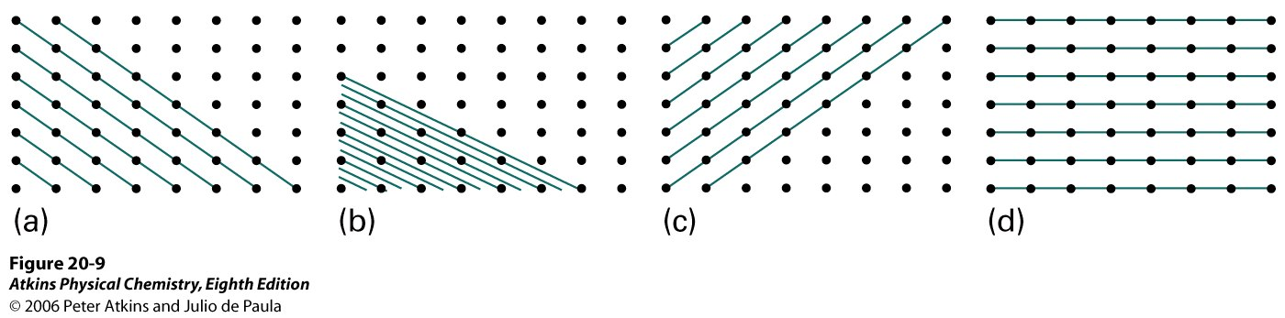
Connecting points 1a and 1b denoted as (1a, 1b) or (1, 1)
3a and 2b (3a, 2b) or (3, 2)
-1a and 1b (-1a, 1b) or (-1, 1)
∞a and 1b (+∞a, 2b) or (+∞, 2)
(1,1)
(3,2)
(-1,1)
(+∞, 2)

Slide 15
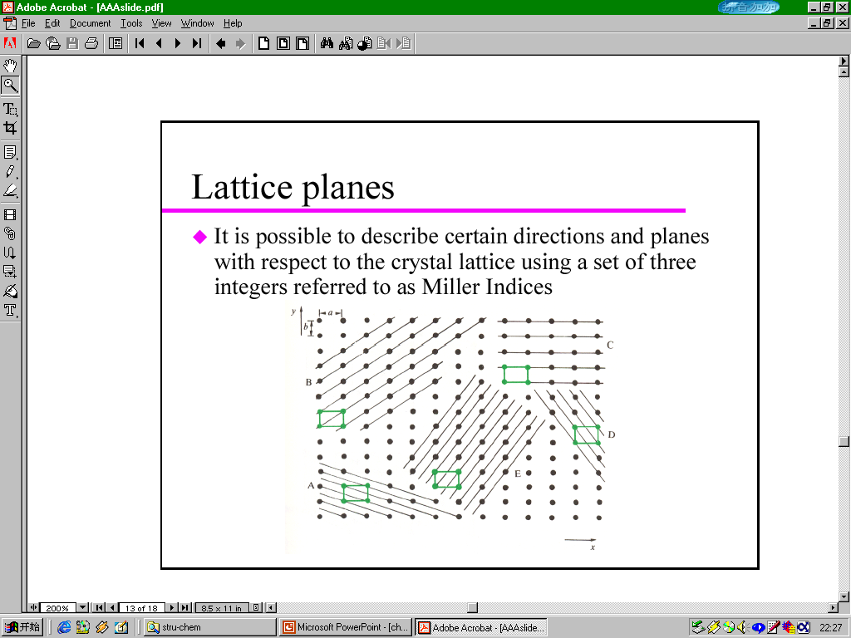
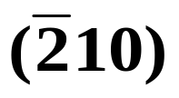
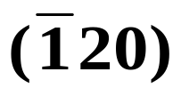
d. d-spacing d_{hkl}
(010)
d₀₁₀
(110)
d₁₁₀
(210)

Slide 16
Extending to 3D lattice
lines connecting points extend to z-direction (c) forming plane
1a-1b designate (1a, 1b, ∞c) or (1, 1, ∞)
3a-2b designate (3a, 2b, ∞c) or (3, 2, ∞)
-1a-1b designate (-1a, 1b, ∞c) or (-1, 1, ∞)
+∞a-1b designate (+∞a, 1b, ∞c) or (∞, 1, ∞)
It is not convenient to represent plane coordinates as ∞, a reciprocal representation called “Miller indices, (h k l)” is rather used.
(1, 1, ∞) (1/1, 1/1, 1/∞) ≡ (1 1 0)
(3, 2, ∞) (1/3, 1/2, 1/∞) ≡ (2 3 0)
(-1, 1, ∞) (-1/1, 1/1, 1/∞) ≡ (1 1 0)
(∞, 1, ∞) (1/∞, 1/1, 1/∞) ≡ (0 1 0)

Slide 17
Crystallographic Planes
z
example
a b c
c
1. Intercepts
1 1 ∞
2. Reciprocals
1/1 1/1 1/∞
1 1 0
3. Reduction
1 1 0
y
a
b
4. Miller Indices (110)
x
z
example
a b c
1. Intercepts
1/2 ∞ ∞
c
2. Reciprocals
1/½ 1/∞ 1/∞
2 0 0
3. Reduction
2 0 0
y
4. Miller Indices (100)
a
b
x

Slide 18

Crystallographic Planes
z
example
a b c
c
1. Intercepts
1/2 1 3/4
2. Reciprocals
1/½ 1/1 1/¾
2 1 4/3
y
3. Reduction
6 3 4
a
b
x
4. Miller Indices (634)
Family of Planes {hkl}
Ex: {100} = (100),
(010),
(001),
(100),
(010),
(001)

Slide 19
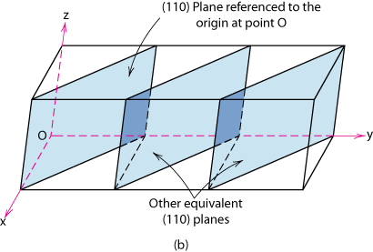
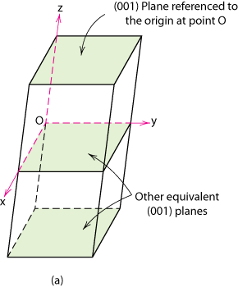
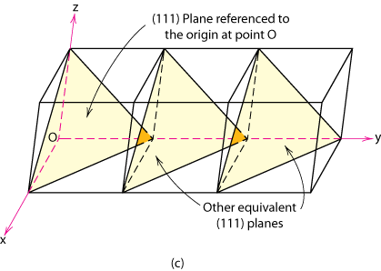
Crystallographic Planes
Adapted from Fig. 3.9, Callister 7e.

Slide 20
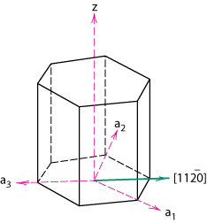
HCP Crystallographic Directions
z
Algorithm
1. Vector repositioned (if necessary) to pass
through origin.
2. Read off projections in terms of unit
cell dimensions a₁, a₂, a₃, or c
3. Adjust to smallest integer values
4. Enclose in square brackets, no commas
[uvtw]
a₂
-
a₃
a₂
a₁
a
-a₃
Adapted from Fig. 3.8(a), Callister 7e.
2
2
ex: ½, ½, -1, 0 =>
[ 1120 ]
a₃
a
1
dashed red lines indicate
projections onto a₁ and a₂ axes
2
a₁

Slide 21
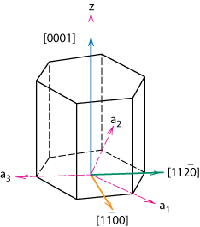
HCP Crystallographic Directions
Hexagonal Crystals
  4 parameter Miller-Bravais lattice coordinates are related to the direction indices (i.e., u'v'w') as follows.
z
[
u
'
v
'
w
'
]
→
[
uvtw
]
1
u
=
(
2
u
'
-
v
'
)
3
a₂
1
v
=
(
2
v
'
-
u
'
)
-
3
a₃
t
=
-
(
u
+
v
)
a₁
w
=
w
'
Fig. 3.8(a), Callister 7e.

Slide 22
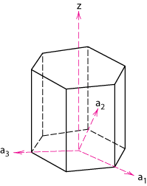
Crystallographic Planes (HCP)
In hexagonal unit cells the same idea is used
z
example
a₁ a₂ a₃ c
1. Intercepts
1 ∞
-1
1
2. Reciprocals
1 1/∞
-1
1
1 0
-1
1
a₂
3. Reduction
1 0
-1
1
a₃
4. Miller-Bravais Indices
(1011)
a₁
Adapted from Fig. 3.8(a), Callister 7e.

Slide 23
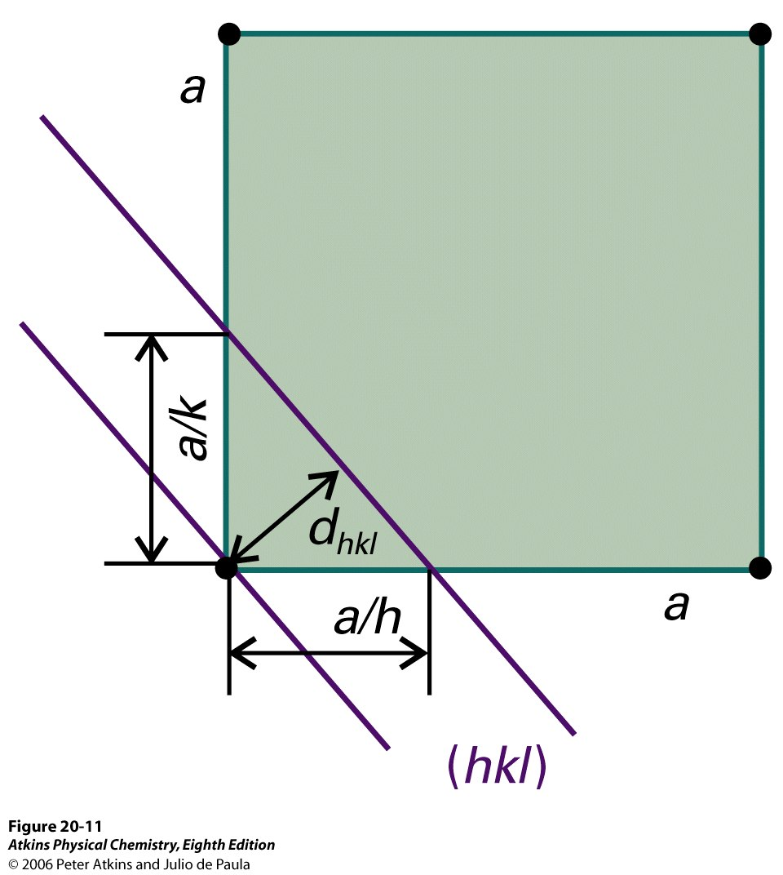
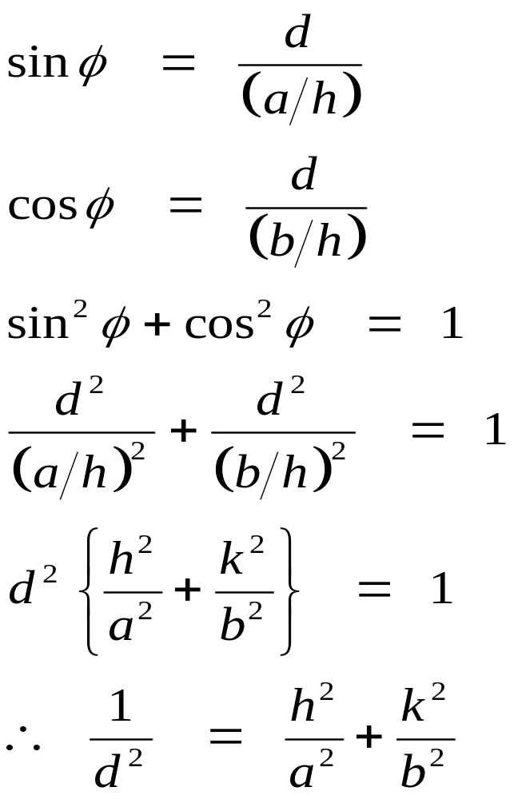
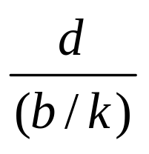
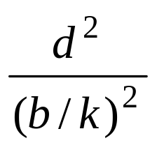
The distance between each plane can be calculated
For 2 (h k 0) planes
Ф
Ф

Slide 24
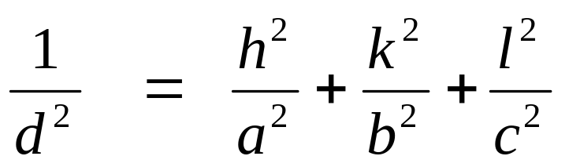
Similarly for 2 (h k l) planes
If a, b, c and h, k, l are known , d can be computed

Slide 25
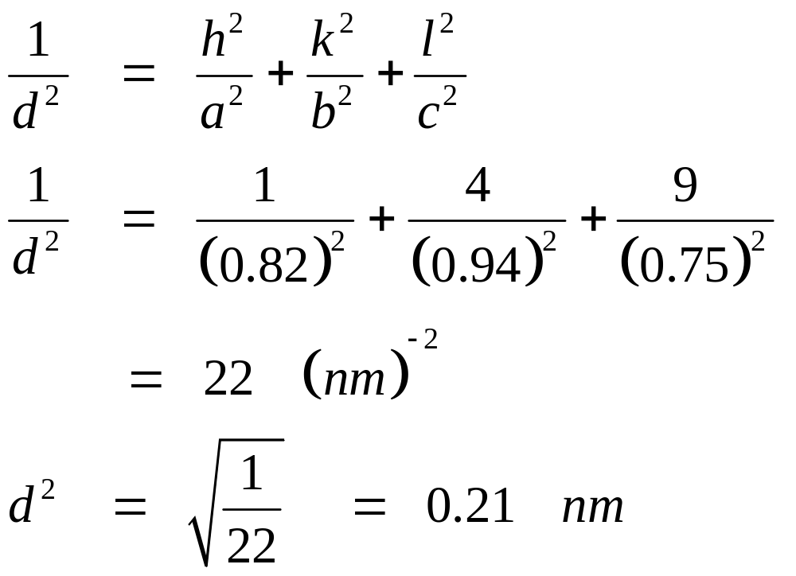
Example 7.1 Calculate the separation of (a) the (123) planes and (b) the (246) planes of an orthorhombic cell with a = 0.82 nm, b = 0.94 nm, and c = 0.75 nm
From
(a)

Slide 26
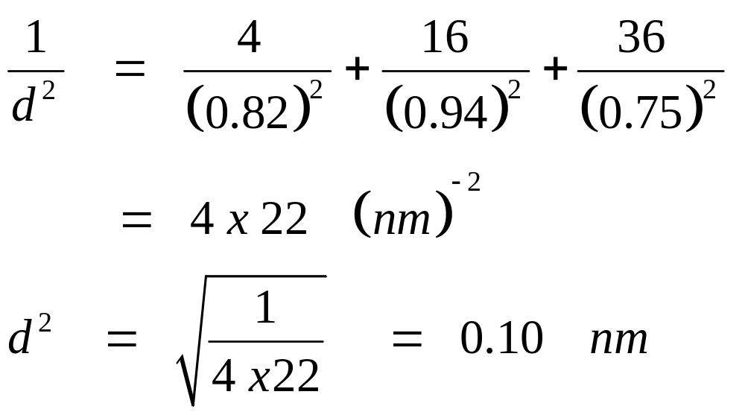
(b)

Slide 27
Miller Indices of Directions
Miller Indices 2
1. Choose a point on the direction as the origin.
z
2. Choose a coordinate system with axes parallel to the unit cell edges.
y
3. Find the coordinates of another point on the direction in terms of a, b and c
1a+0b+0c
1, 0, 0
x
4. Reduce the coordinates to smallest integers.
1, 0, 0
5. Put in square brackets
[100]

Slide 28
Miller Indices 3
z
Miller indices of a direction represents only the orientation of the line corresponding to the direction and not its position or sense
y
[100]
x
All parallel directions have the same Miller indices

Slide 29
Miller Indices of
Directions (contd.)
z
OA=1/2 a + 1/2 b + 1 c
Q
z
1/2, 1/2, 1
A
[1 1 2]
y
PQ = -1 a -1 b + 1 c
y
O
-1, -1, 1
P
_
_
x
[ 1 1 1 ]
x
-ve steps are shown as bar over the number

Slide 30
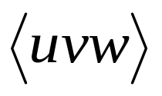
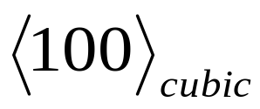
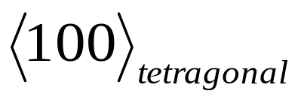
Miller Indices 4
Miller indices of a family of symmetry related directions
= [uvw] and all other directions related to [uvw] by the symmetry of the crystal
[001]
Tetragonal
Cubic
[010]
[010]
[100]
[100]
= [100], [010],
[001]
= [100], [010]

Slide 31
Miller Indices for planes
z
1. Select a crystallographic coordinate system with origin not on the plane
2. Find intercepts along axes in terms of respective lattice parameters
1 1 1
y
3. Take reciprocal
1 1 1
O
4. Convert to smallest integers in the same ratio
x
1 1 1
5. Enclose in parenthesis
(111)

Slide 32
Miller Indices for planes (contd.)
Plane
ABCD
OCBE
origin
O
O*
z
z
intercepts
1 ∞ ∞
1 -1 ∞
E
reciprocals
1 0 0
1 -1 0
A
Miller Indices
_
B
(1 0 0)
(1 1 0)
O
O*
y
Zero represents that the plane is parallel to the corresponding axis
Bar represents a negative intercept
D
C
x
x

Slide 33
Miller indices of a plane specifies only its orientation in space not its position
All parallel planes have the same Miller Indices
z
E
_ _ _
(h k l ) ≡ (h k l )
A
B
O
_
y
(100) ≡ (100)
D
C
x
(100)

Slide 34
Miller indices of a family of symmetry related planes
{hkl }
= (hkl ) and all other planes related to
(hkl ) by the symmetry of the crystal
All the faces of the cube are equivalent to each other by symmetry
Front & back faces: (100)
Left and right faces: (010)
Top and bottom faces: (001)
{100} = (100), (010), (001)

Slide 35
Miller indices of a family of symmetry related planes
z
Tetragonal
z
Cubic
y
y
x
x
{100}_{tetragonal} = (100), (010)
{100}_{cubic} = (100), (010), (001)
(001)

Slide 36
Some IMPORTANT Results
Weiss zone law
Not in the textbook
Condition for a direction [uvw] to be parallel to a plane or lie in the plane (hkl):
h u + k v + l w = 0
True for ALL crystal systems

Slide 37
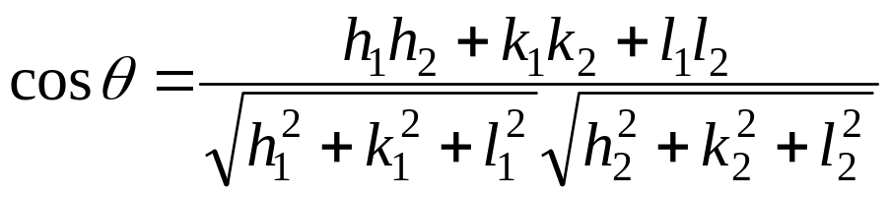
CUBIC CRYSTALS
[111]
[hkl] ⊥ (hkl)
C
(111)
Angle between two directions [h₁k₁l₁] and [h₂k₂l₂]:

Slide 38
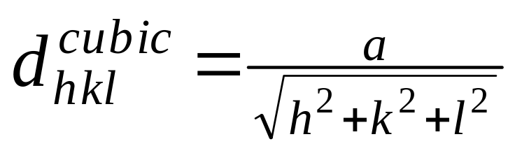

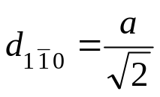
d_{hkl}
Interplanar spacing between ‘successive’ (hkl) planes passing through the corners of the unit cell
z
E
B
O
O
(100)
x
x

Slide 39
Summary of Notation convention for Indices
[uvw] Miller indices of a direction (i.e. a set of parallel directions)
(hkl) Miller Indices of a plane (i.e. a set of parallel planes)
<uvw> Miller indices of a family of symmetry related directions
{hkl} Miller indices of a family of symmetry related planes

Slide 40
7.1.4 Crystal Planes and Miller Indices
a.Lattice planes
It is possible to describe certain directions and planes with respect to the crystal lattice using a set of three integers referred to as Miller Indices. Miller indices describe the orientation and spacing of a family of planes.
(010)
Simple Tetragonal Lattices:
projections of crystals planes (parallel to the c-axis) on the (001) plane.
(110)
(210)

Slide 41
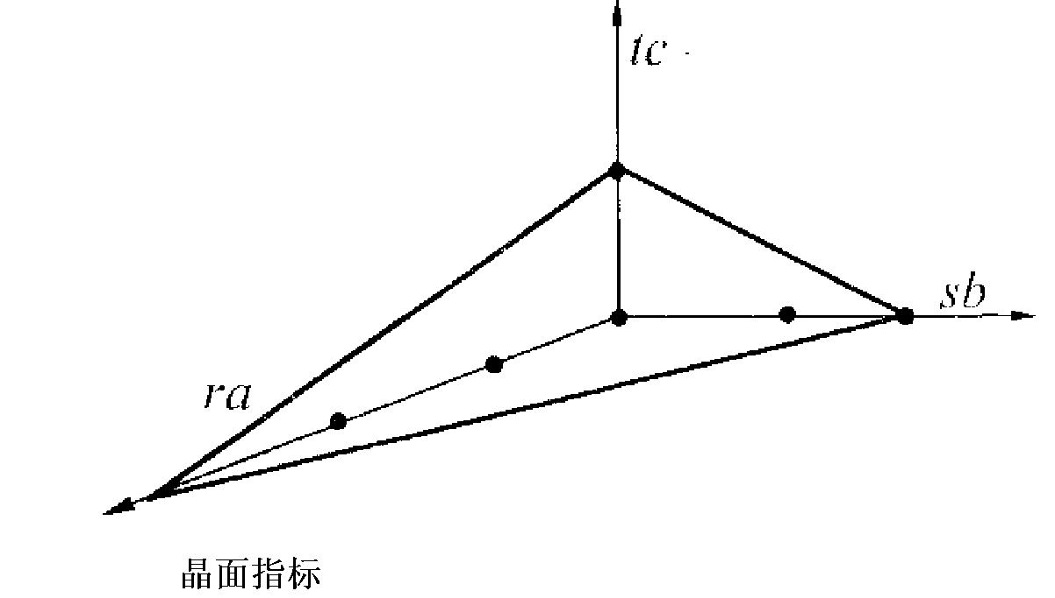
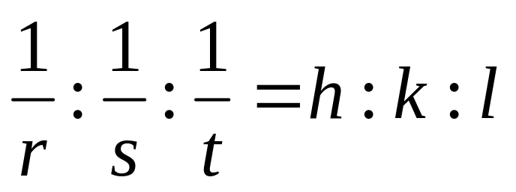
b.Miller indices (hkl)
Miller indices are the reciprocal intercepts of the plane on the unit cell axes.
Example: 1/3:1/2:1/1 = 2:3:6
The Miller index is (236)

Slide 42

Examples of Miller indices
(110)
c
b
(111)
a
c
(100)
(010)
b
c
a
b
a
origin

Slide 43
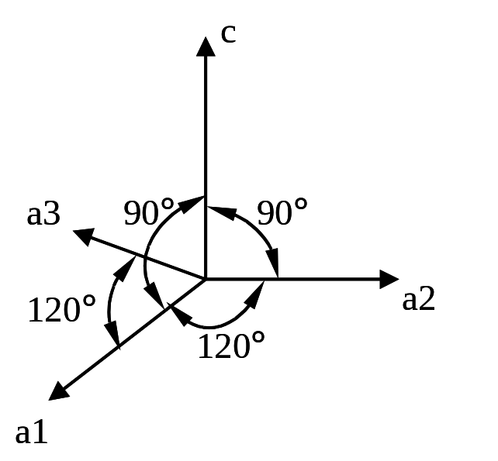



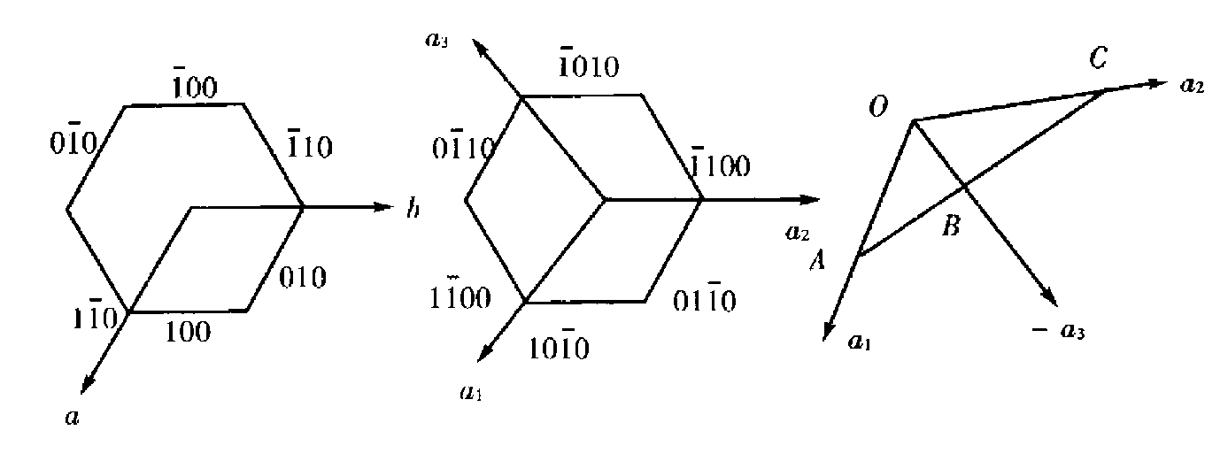
hexagonal, four axis (a1,a2,a3,c)
(hkil), i=-(h+k)
(0001)
c
b
a
hexagonal, four axis (a1,a2,-(a1+a2),c)

Slide 44
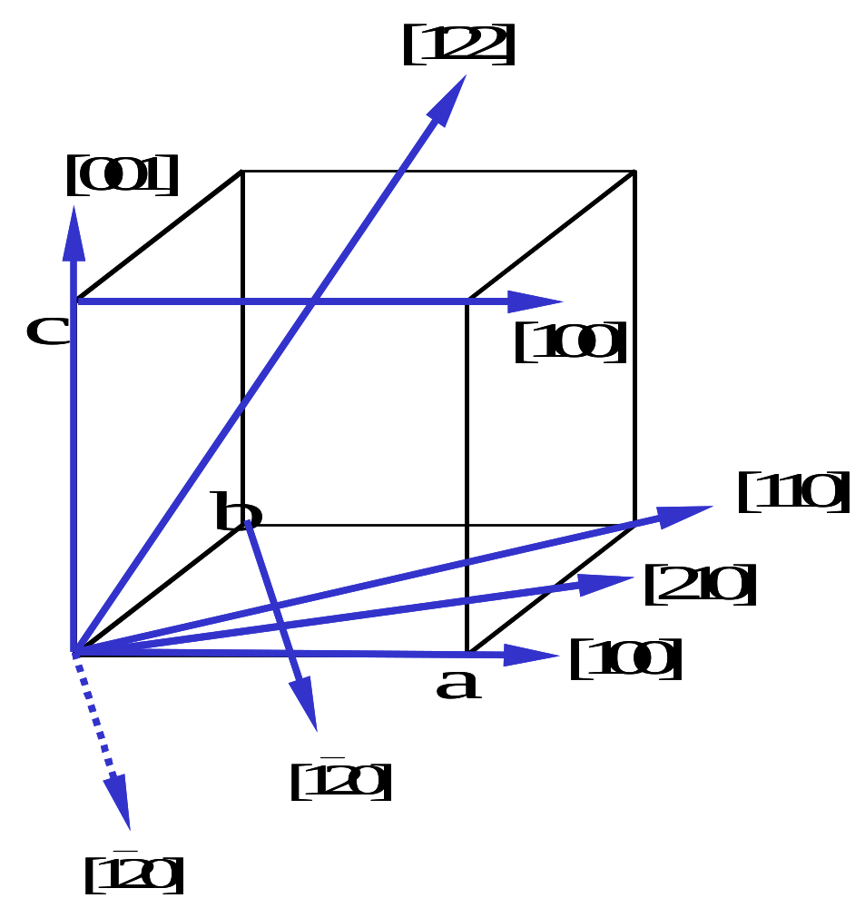
C. Directions in lattice

Slide 45
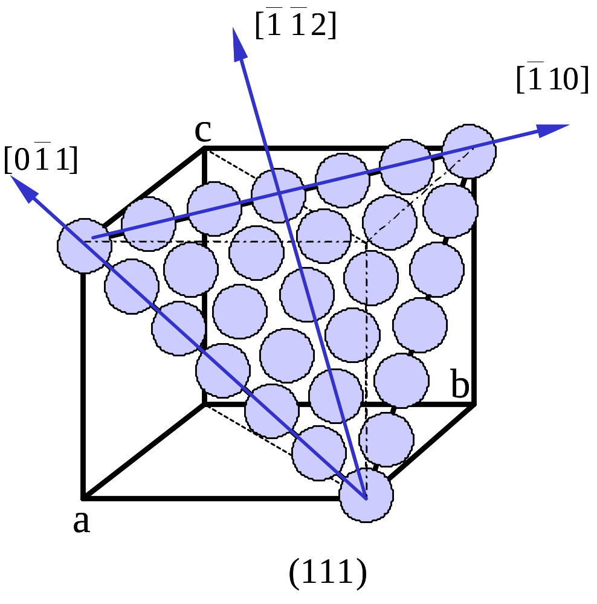
Example: Directions on the (111) plane.

Slide 46
Miller indices (hkl) are used to specify the orientation and spacing of a family of planes.
{hkl} are used to specify all symmetry- equivalent sets of planes
Miller indices [hkl] are used to specify a direction in space with respect of the unit cell axes.
<hkl> are used to specify a set of symmetry- equivalent directions.
[uvw] zone axis
Direction Vector = ua + vb + wc
Notes:
晶向: 晶面的法线方向

Slide 47
The spacing between adjacent planes in a family is referred to as a “d-spacing”
Cubic : 1/d² = (h²+k²+l²)/a² or d² = a²/(h²+k²+l²)
Tetragonal: 1/d² = (h²+k²)/a² + l²/c²
Orthorhombic: 1/d² = h²/a²+k²/b² + l²/c²
Hexagonal: 1/d² = (4/3)(h²+hk+k²)/a² + l²/c²
Monoclinic: 1/d² = [(h/a )² + (k/b )²sin²β + (l/c )²- (2hl/ac)cosβ]/sin²β
Triclinic:

