Slide 1


Slide 2
Lithostratigraphy
By:Mohammad Nabi Gorgij
University of Sistan and Baluchestan
2009

Slide 3
Lithostratigraphy
􀂄 Formation
􀂄 Fundamental unit of lithostratigraphic
classification
􀂄 A body of rock identified by lithic
characteristics (composition, colour,
sedimentary structures, fossils,

Slide 4
Lithostratigraphy
􀂄 Formation
􀂄 Generally considered to be tabular in
geometry
􀂄 Large enough to be mappable at the Earth’s
surface or traceable in the subsurface
􀂄 Existing formations range from a few m to
several 1000s of m thick
􀂄 Traceable for a few km or several 1000 km

Slide 5
Lithostratigraphy
􀂄 Members
􀂄 Subdivisions of formations
􀂄 Possess characteristics that distinguish it from
other parts of the formation
􀂄 Not all formations are subdivided into members

Slide 6
Lithostratigraphy
􀂄 Groups
􀂄 Two or more formations related lithologically
􀂄 Component formations may change laterally
(e.g., due to facies changes)
􀂄 Supergroups
􀂄 Assemblage of related or superimposed groups
􀂄 Sometimes useful for regional synt

Slide 7
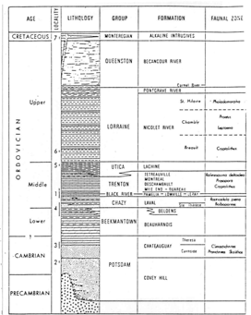

Slide 8
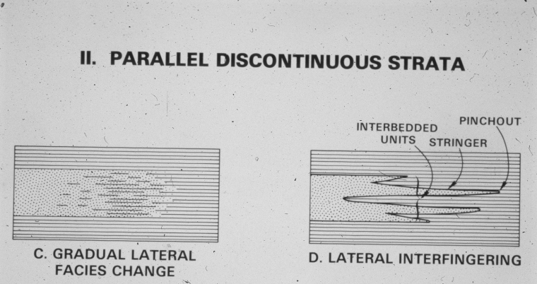
Lateral Contacts
Types of Contacts (Depositional)

Slide 9
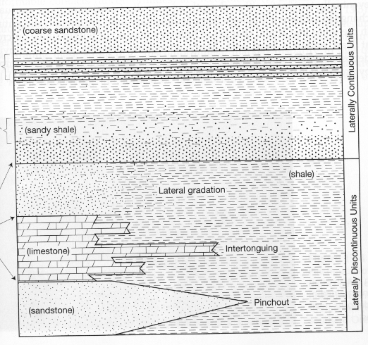
Lateral Contacts
Types of Contacts (Depositional)
Vertical Contacts
intercalated
gradual
gradation
abrupt
intertonguing
pinchout
(Boggs, p. 453)

Slide 10
Types of Contacts
Intrusive
Fault
Depositional
  Conformable Contact
  Unconformity

Slide 11
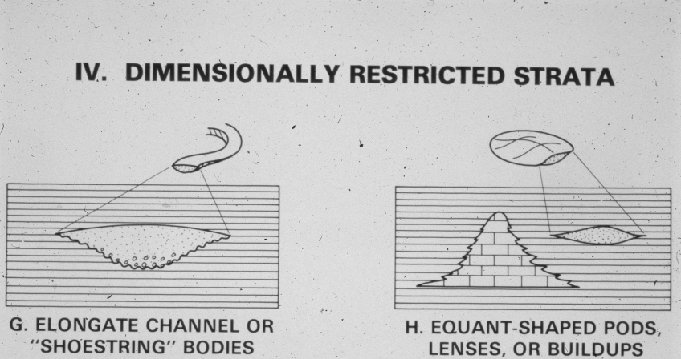
Types of Stratigraphy
Lithostratigraphic Units
lens / lentil
(E. McBride)

Slide 12




Principles of Stratigraphy
4. Cross-Cutting Relationships
Rock that are cut by another geologic feature are older than the feature that cuts them.
Igneous
Intrusion
Fault
Erosion
Notes:
Our third tool is that the rock layers that are cut by another geologic feature formed before the the feature that cuts through them.
For example, 1) an igneous intrusion (which is when an underground body of molten rock pushes its way up through hard rock) would have to be younger than the hard rock that was already there.
2) Or another example, if a rock is cut by a fault, that fault had to be there first and then cut later,
3) Or third, erosion into a rock layer (like erosion of a valley or gulley) would have to occur after the rock layers the erosion cuts into had been formed.

Slide 13
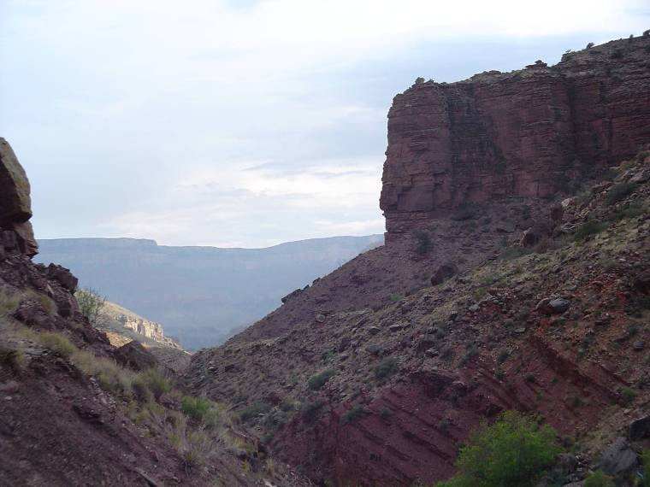
Principles of Stratigraphy
Notes:
For example, in the Grand Canyon, about ¾ of the way below the rim, towards the river, we find a series of tilted rock layers, you can see these tilted rock layers at view points like point Imperial and Cape royal.
Well, this rule of original horizontality says that those layers were first deposited flat, and later tilted.

Slide 14
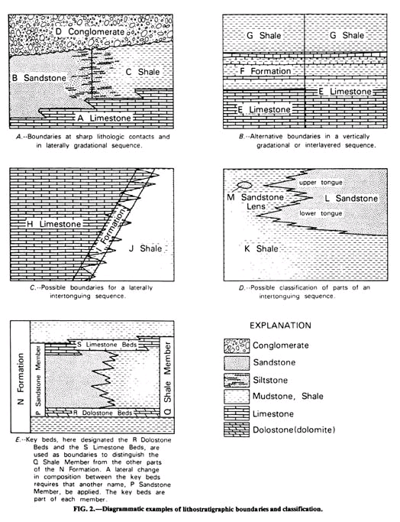
Boundaries between Lithostratigraphic Units
Boundaries of lithostratigraphic units are placed at positions of lithic change. Boundaries are placed at distinct contacts or may be selected at some arbitrary level within zones of gradation. Both vertical and lateral boundaries are based on the lithic criteria that provide the greatest unity and utility.
From NASC, 2005
Notes:
14

Slide 15
Lithostratigraphic Units
A lithostratigraphic unit is a defined body of sedimentary, extrusive igneous, metasedimentary, or metavolcanic strata which is distinguished and delimited on the basis of lithic characteristics and stratigraphic position. A lithostratigraphic unit generally conforms to the Law of Superposition and commonly is stratified and tabular in form.
Supergroup. A supergroup is a formal assemblage of related or superposed groups, or of groups and formations. Such units have proved useful in regional and provincial syntheses. Supergroups should be named only where their recognition serves a clear purpose.
Group. A group is the lithostratigraphic unit next higher in rank to formation; a group may consist entirely of named formations, or alternatively, need not be composed entirely of named formations.
Formation. The formation is the fundamental unit in lithostratigraphic classification. A formation is a body of rock identified by lithic characteristics and stratigraphic position; it is prevailingly but not necessarily tabular and is mappable at the Earth's surface or traceable in the subsurface.
Member. A member is the formal lithostratigraphic unit next in rank below a formation and is always a part of some formation. It is recognized as a named entity within a formation because it possesses characteristics distinguishing it from adjacent parts of the formation. A formation need not be divided into members unless a useful purpose is served by doing so. Some formations may be divided completely into members; others may have only certain parts designated as members; still others may have no members.
Bed(s). A bed, or beds, is the smallest formal lithostratigraphic unit of sedimentary rocks.
Flow. A flow is the smallest formal lithostratigraphic unit of volcanic flow rocks. A flow is a discrete, extrusive, volcanic body distinguishable by texture, composition, order of superposition, paleomagnetism, or other objective criteria.
From NASC, 2005
Notes:
15

Slide 16
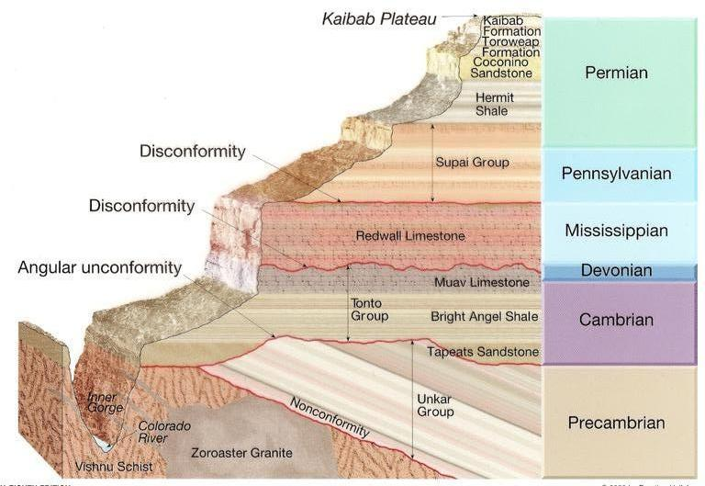
Classes of Geologic Units
Units based on content or physical limits
Lithostratigraphic
Lithodemic
Magnetopolarity
Biostratigraphic
Pedostratigraphic
Allostratigraphic
An allostratigraphic unit is a mappable body of rock that is defined and identified on the basis of its bounding discontinuities
Notes:
16

Slide 17
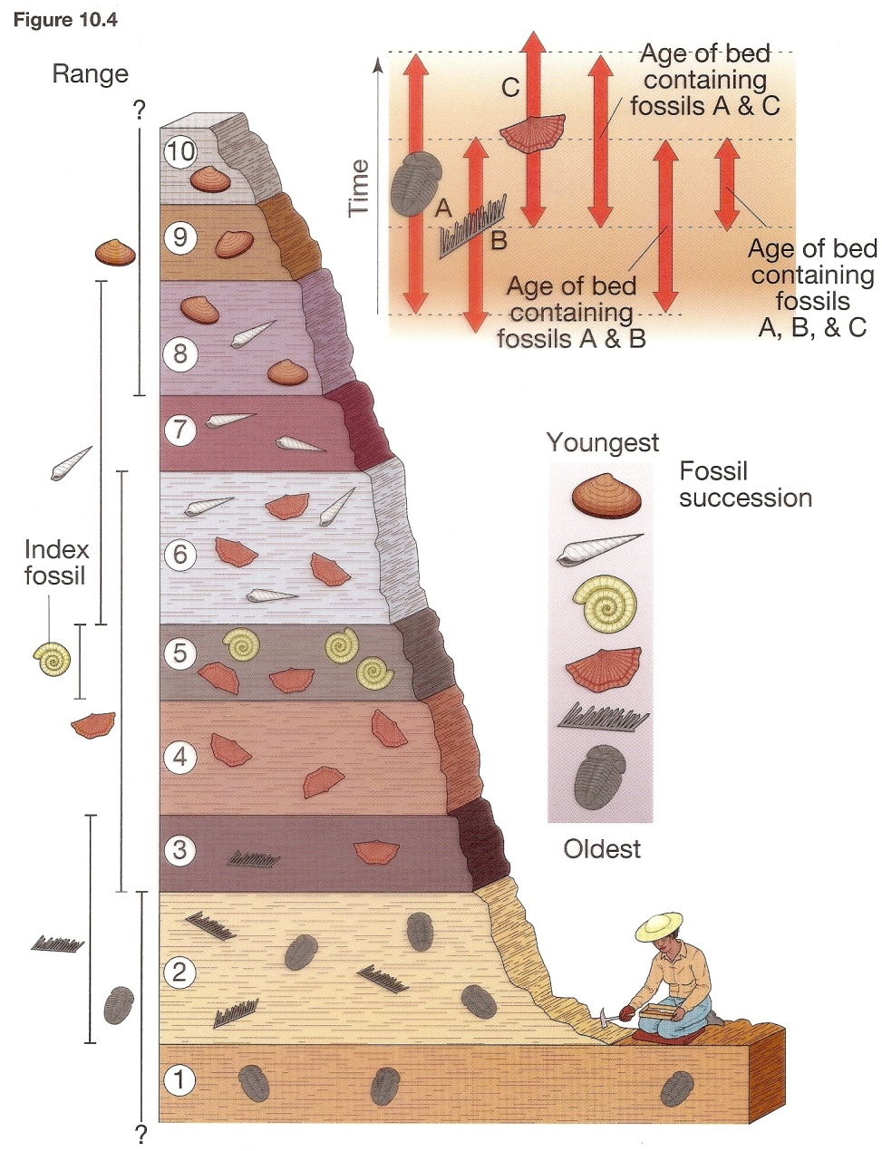
Classes of Geologic Units
Units based on content or physical limits
Lithostratigraphic
Lithodemic
Magnetopolarity
Biostratigraphic – based on the principles of faunal succession and superposition
Pedostratigraphic
Allostratigraphic
A biostratigraphic unit is a body of rock that is defined or characterized by its fossil content.
Notes:
17

Slide 18
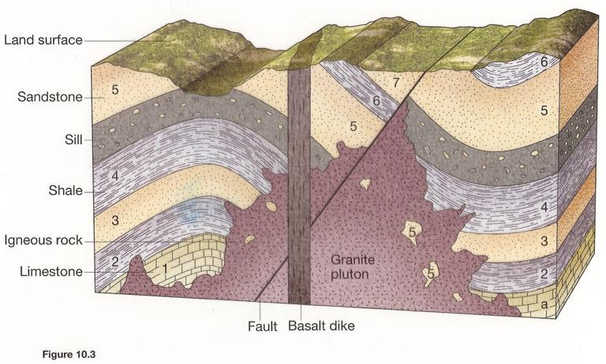
Categories of Geologic Rock Units
Units based on content or physical limits
Lithostratigraphic
Lithodemic
Magnetopolarity
Biostratigraphic
Pedostratigraphic
Allostratigraphic
A lithodemic unit is a defined body of predominantly intrusive, highly deformed, and/or highly metamorphosed rock, distinguished and delimited on the basis of rock characteristics. In contrast to lithostratigraphic units, a lithodemic unit generally does not conform to the Law of Superposition.
Notes:
18

Slide 19
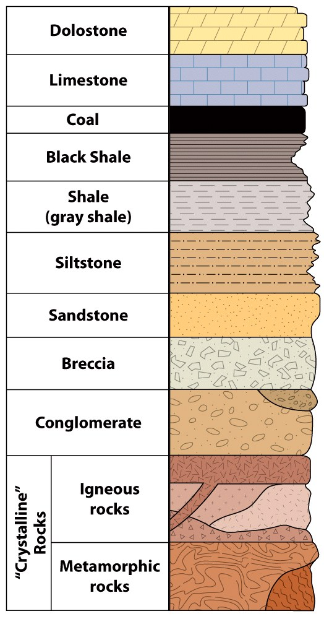
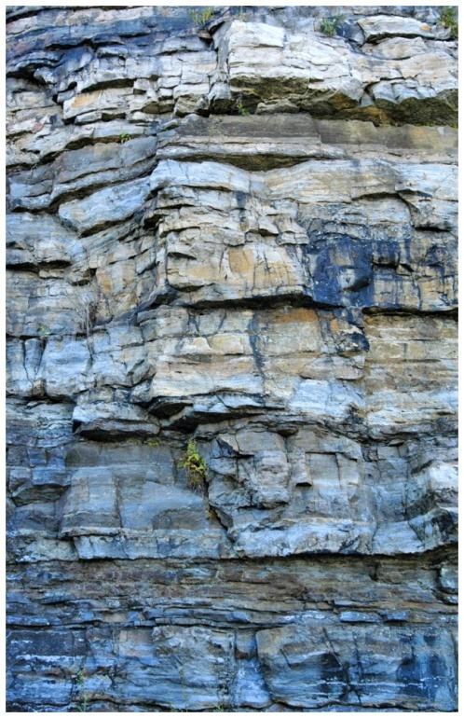
LITHOSTRATIGRAPHY
Lithostratigraphy — Stratigraphic correlation on the basis
of rock type.
Formation — Fundamental unit of lithostratigraphy; it has a
definable top and bottom, and is mappable across
geographic space.

Slide 20
Types of Depositional Systems
Marine → ocean, sea
Transitional → part land, part ocean
Terrestrial → land

Slide 21
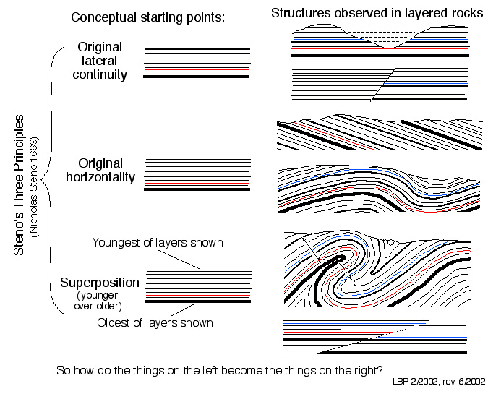
After Bruce Railsback, 2002

Slide 22
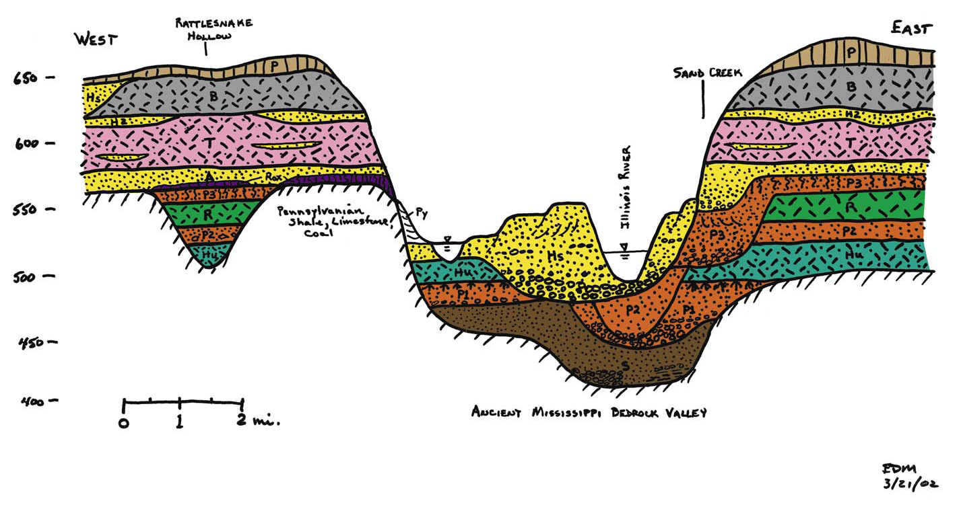

Slide 23
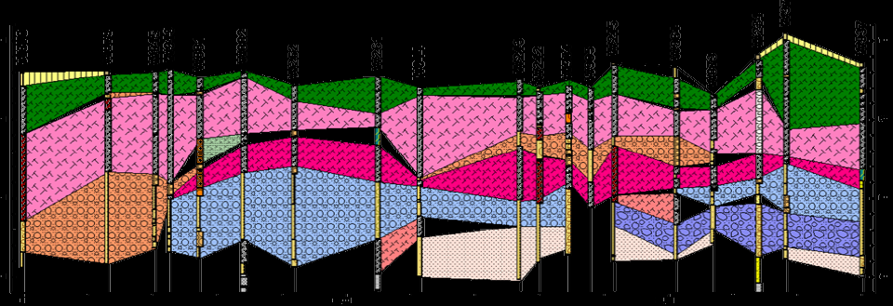

Slide 24
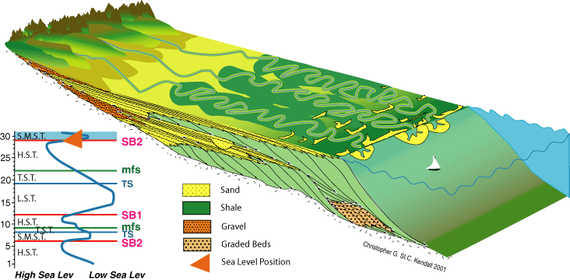
Clastic Depositional Systems
Terrestrial
Transitional
Marine

Slide 25
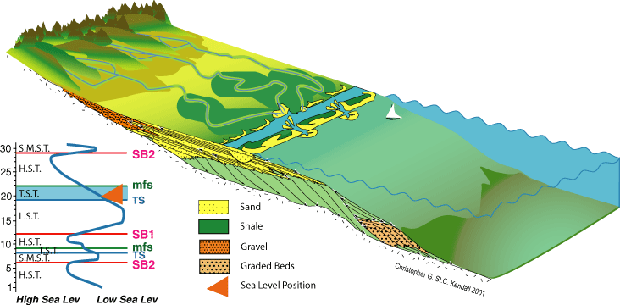
Clastic Depositional Systems
Terrestrial
Transitional
Marine

Slide 26
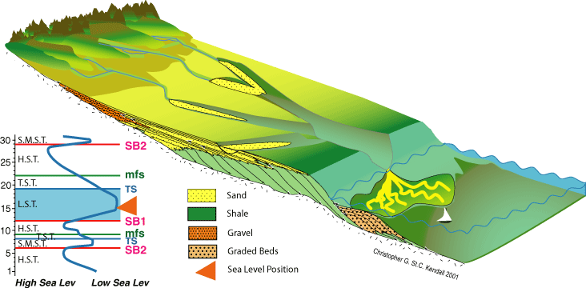
Clastic Depositional Systems
Terrestrial
Transitional
Marine

Slide 27
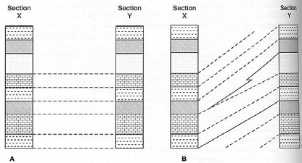

Slide 28
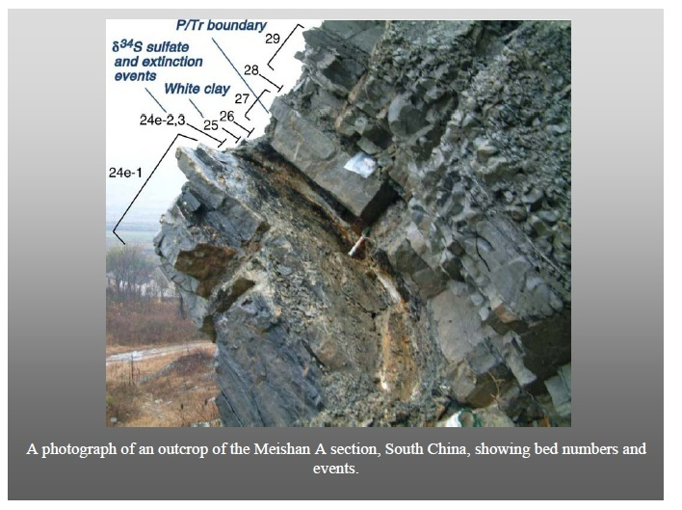

Slide 29
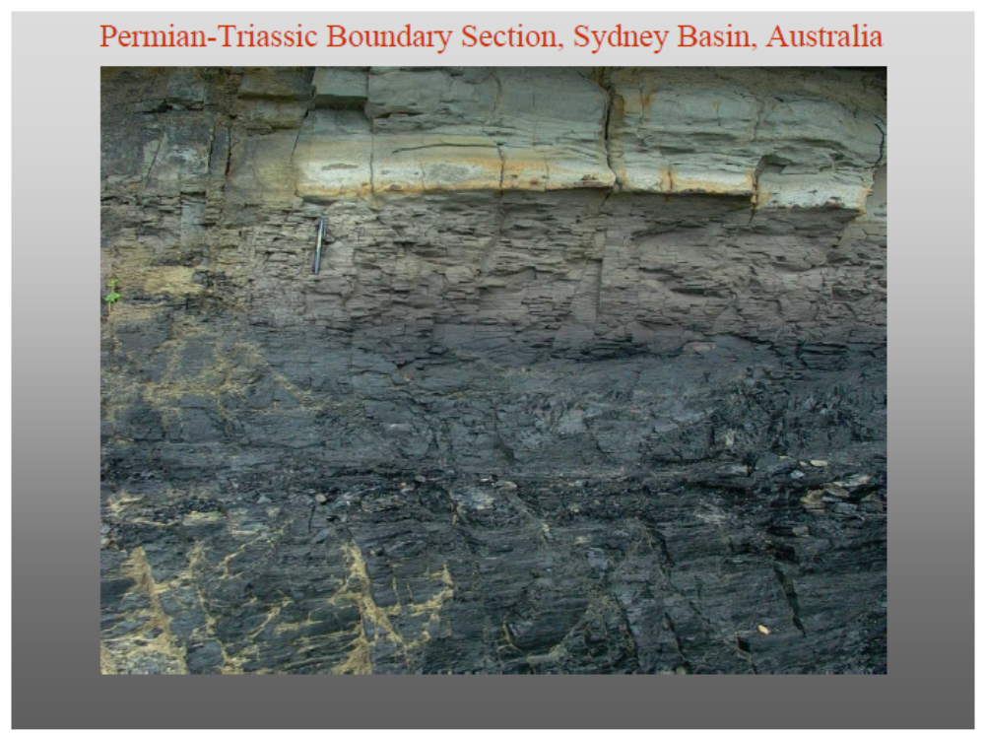

Slide 30
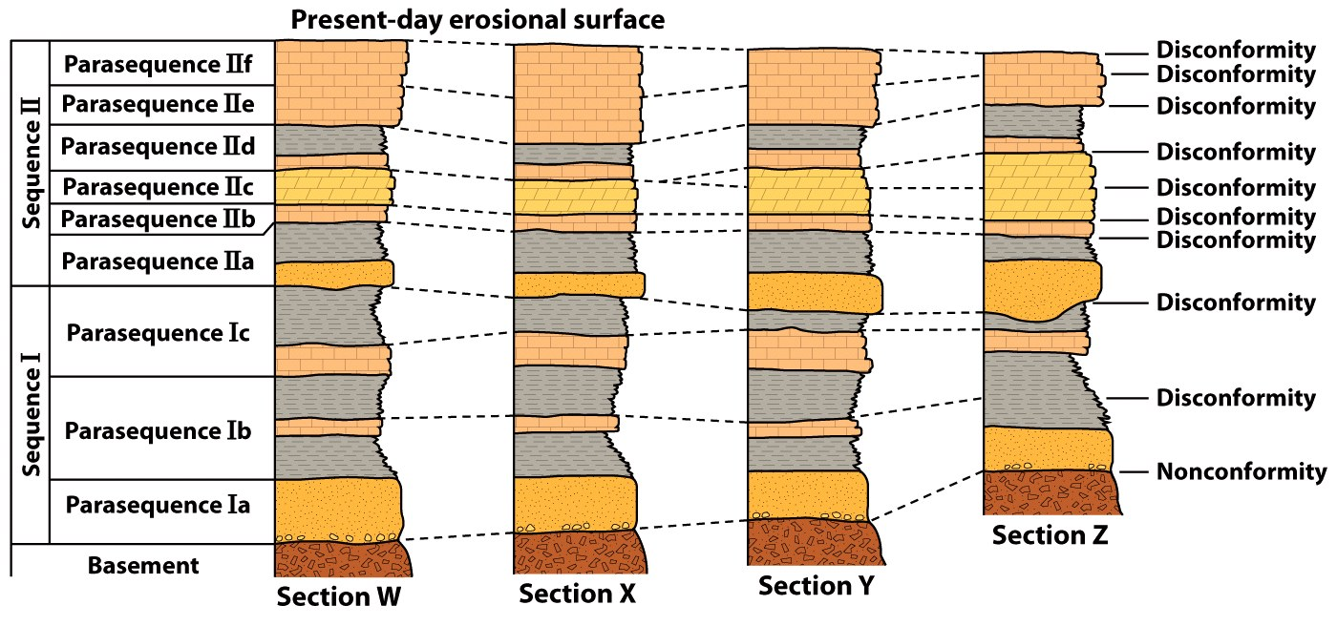
Geologic Time Scale
Understand the various techniques of stratigraphic correlation.

Slide 31
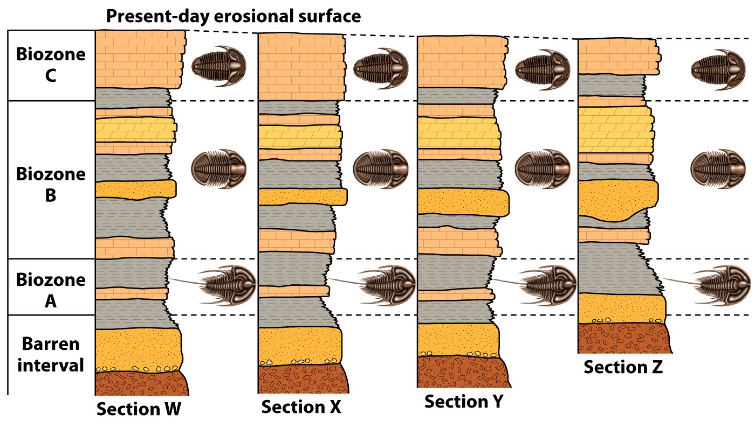
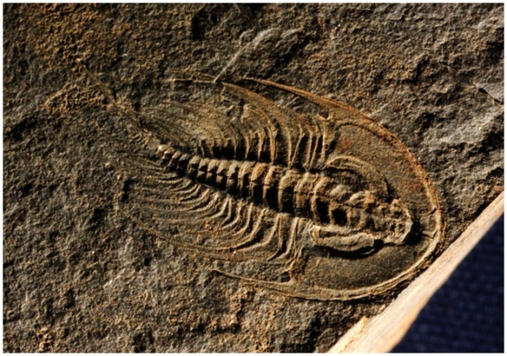
Geologic Time Scale
Understand the various techniques of stratigraphic correlation.

Slide 32
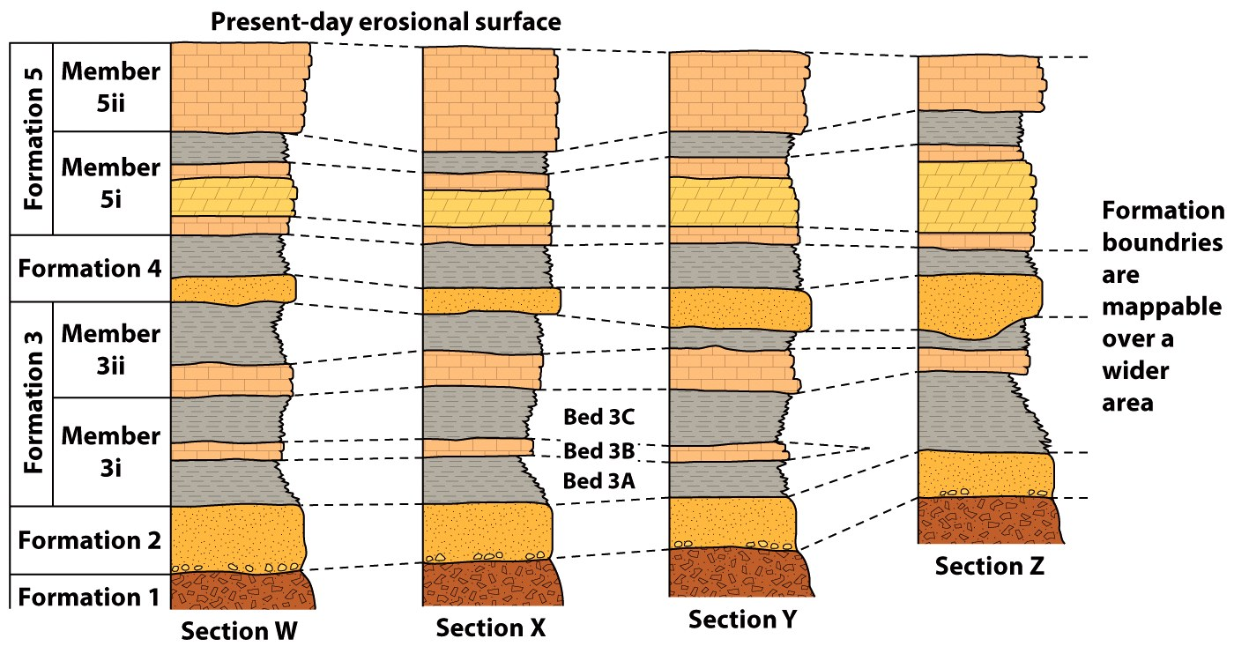
Geologic Time Scale
Understand the various techniques of stratigraphic correlation.

Slide 33
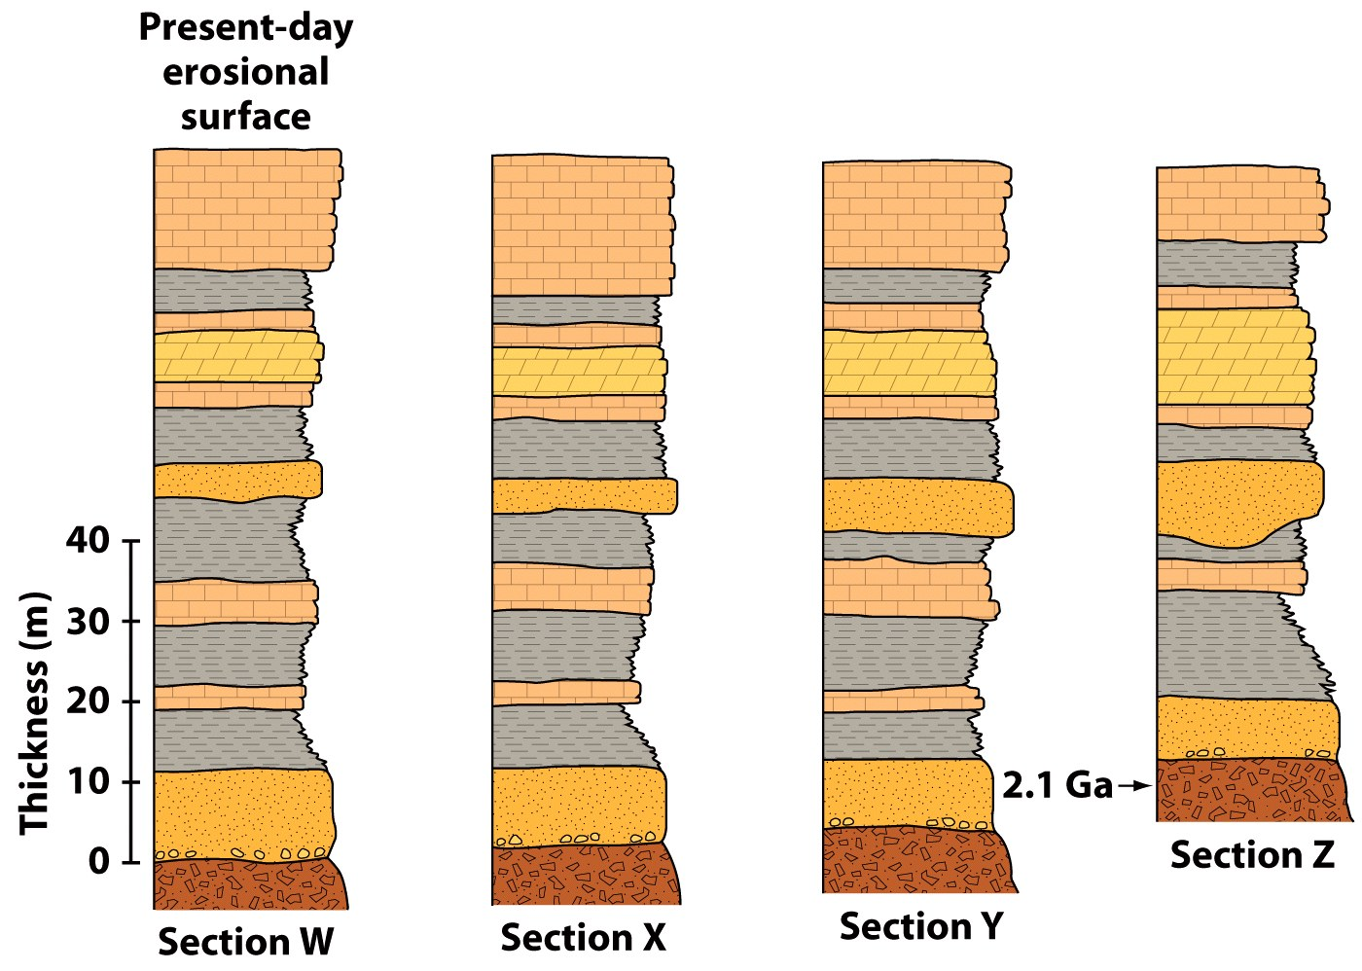
Geologic Time Scale
Understand the various techniques of stratigraphic correlation.

Slide 34
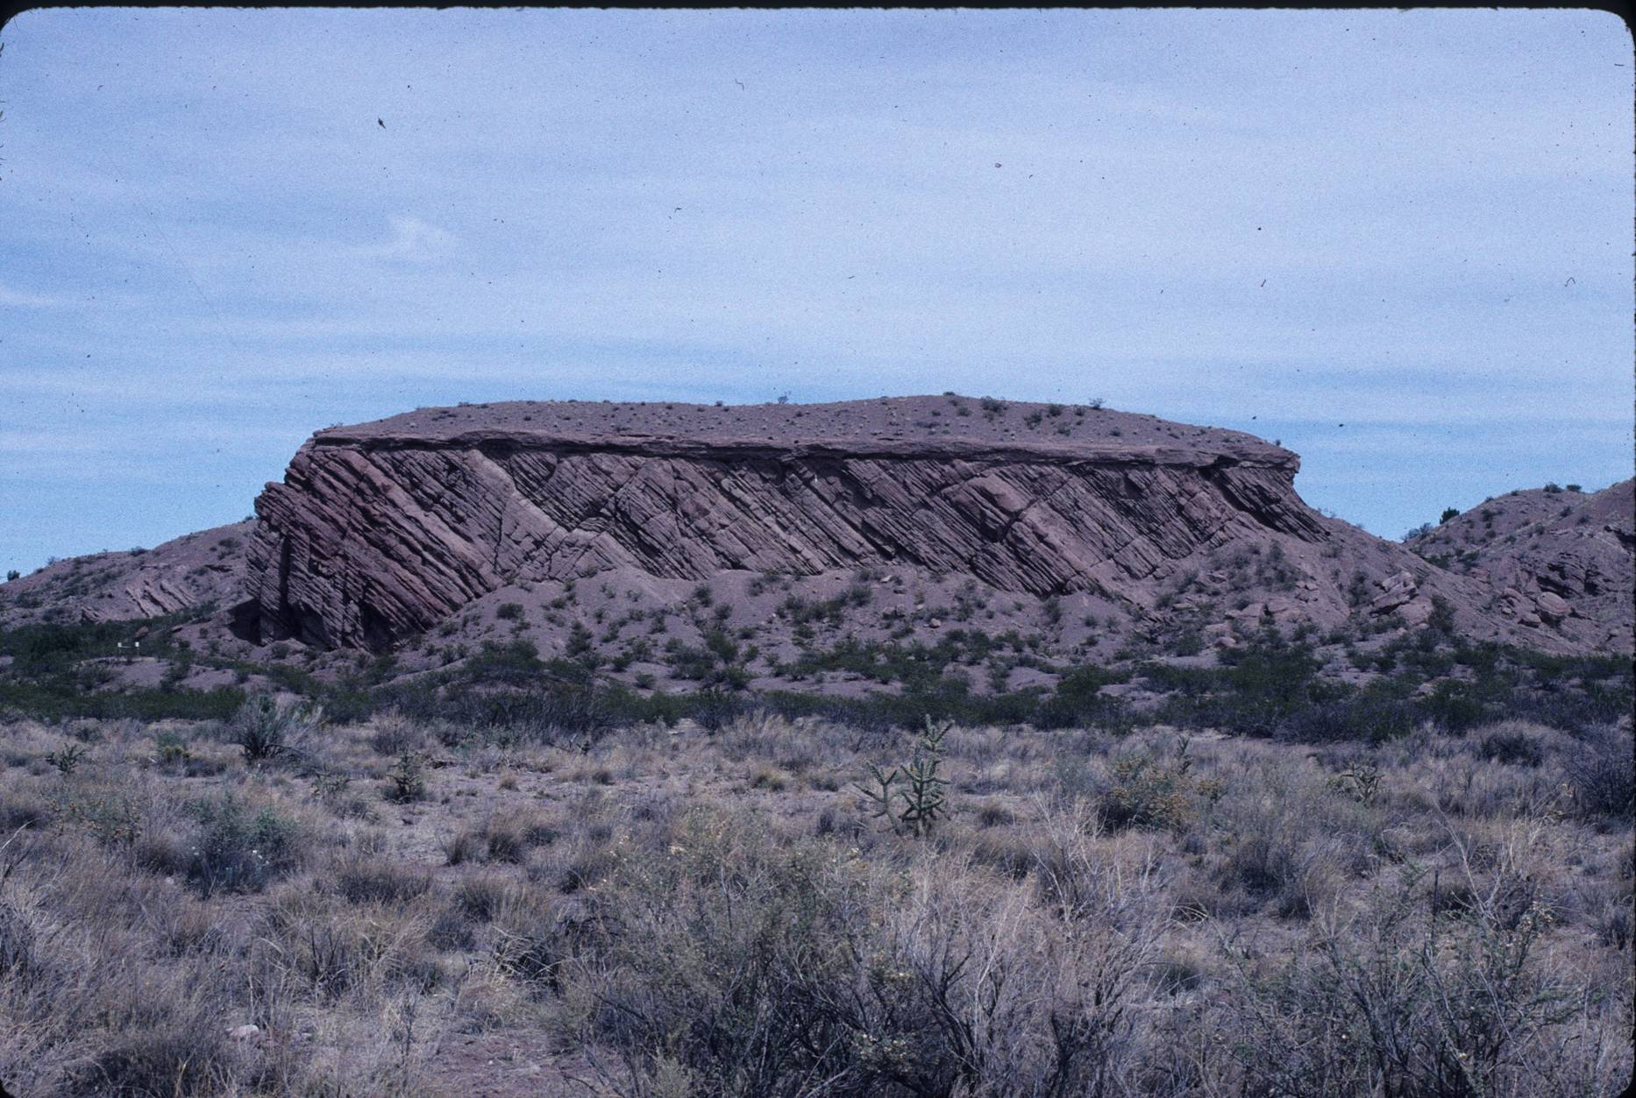
Unconformities
Angular Unconformity
(E. McBride)

Slide 35
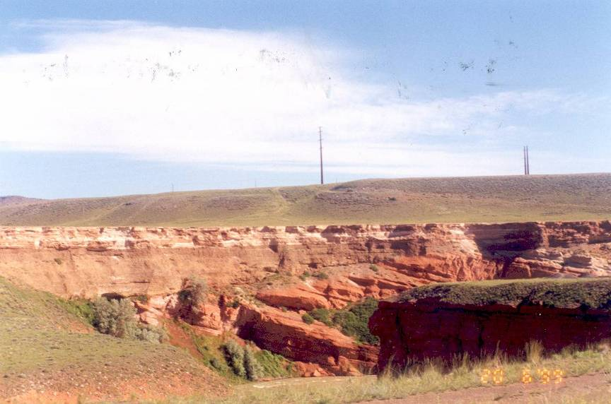
Unconformities
Angular Unconformity
Wyoming

Slide 36
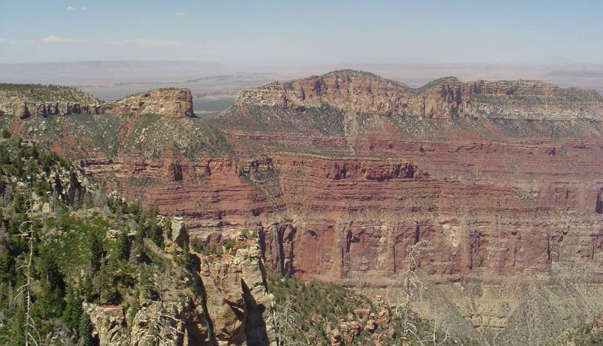
Unconformities
Disconformity
Supai Group
20 million years
Redwall Limestone
150 million years
Muav Limestone
Notes:
Here you can the flat layers of rock that at first glance look like continuous layering of sediment. We would not guess that there is a 20 million year gap between the Redwall and the Supai and a 150 million year gap between the Muav and the Redwall.
It’s not until we look closely at the fossils that allow us to determine the ages of the rocks do we see that there is a big gap in time between the layers.

Slide 37
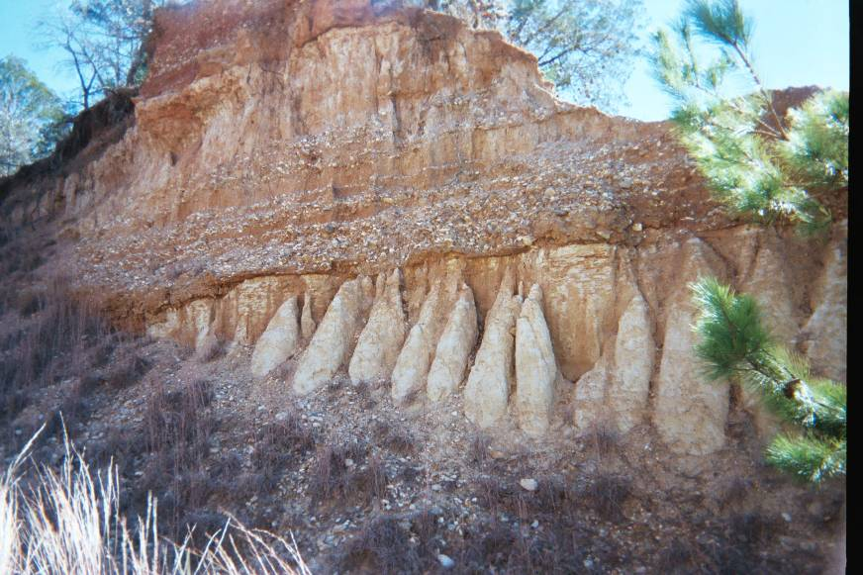
Unconformities
Calvert Bluff / Alluvium Contact (Field Trip 1)

Slide 38
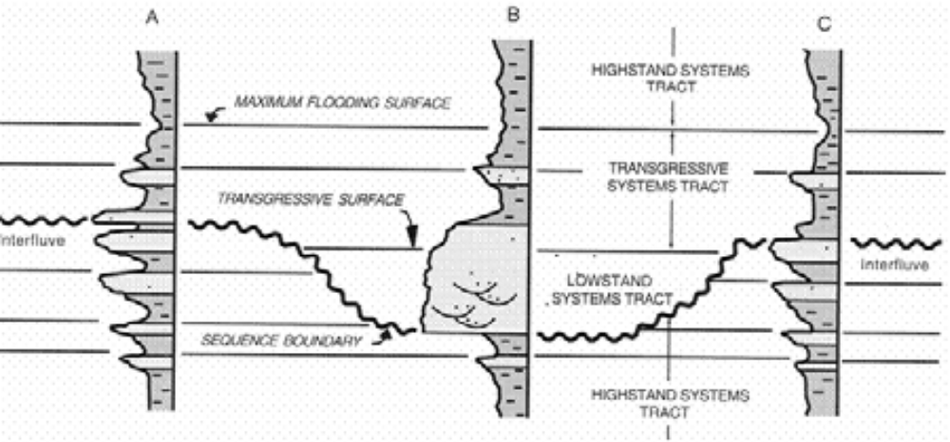

Slide 39
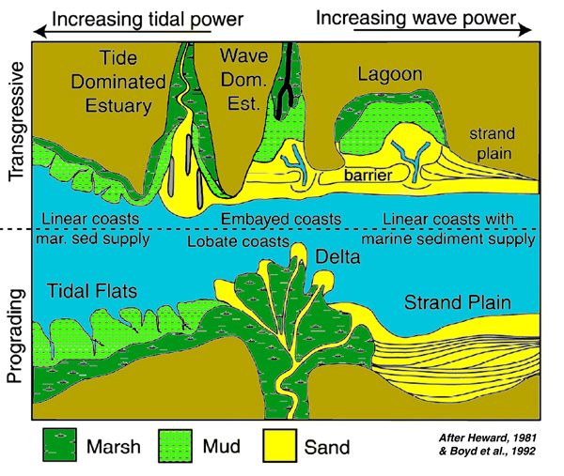
Coast
Types

Slide 40
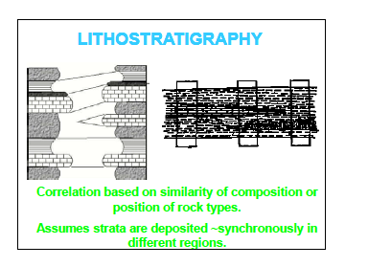

Slide 41
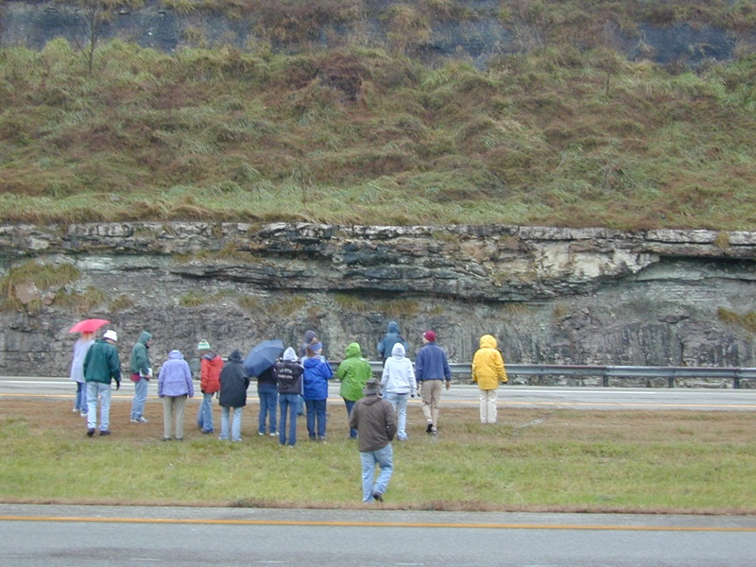
Tidal Channel
Note Incised Surface Beneath Channel

Slide 42
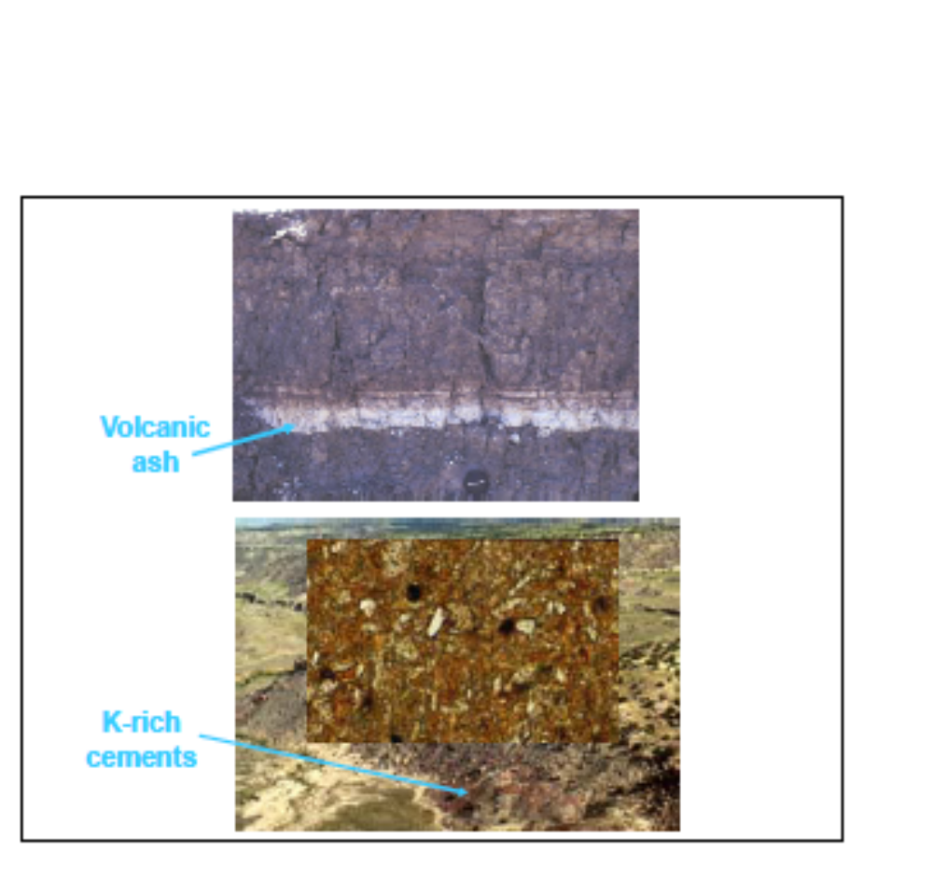

Slide 43
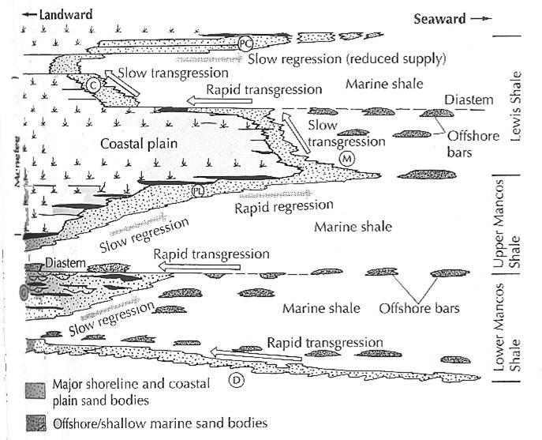
Sea-Level Changes
Reading, 1986

Slide 44
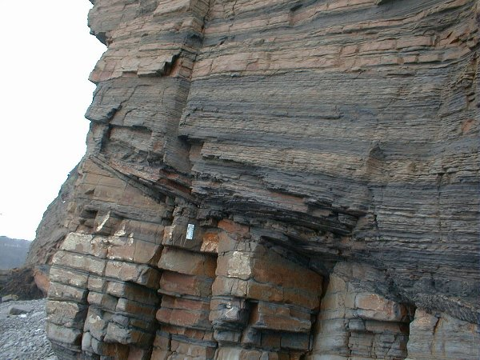
Deltaic Succession

Slide 45
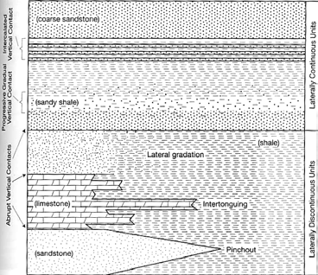

Slide 46
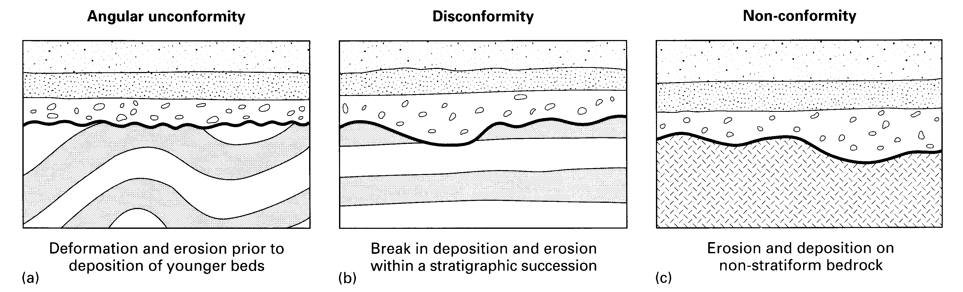

Slide 47
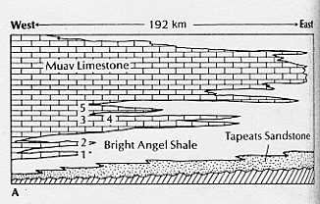
Transgressions and regressions, progradations

Slide 48
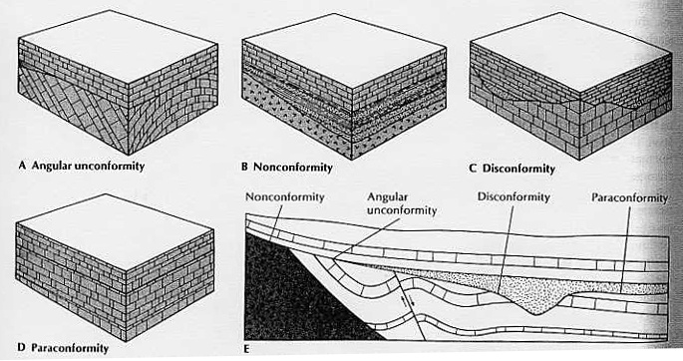

Slide 49
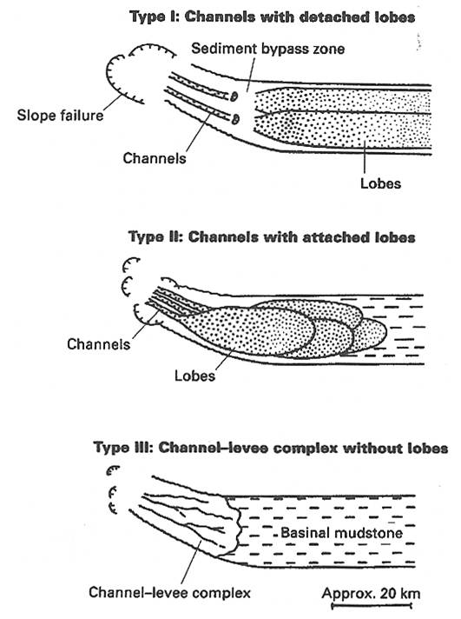
Submarine
Fan Types

Slide 50
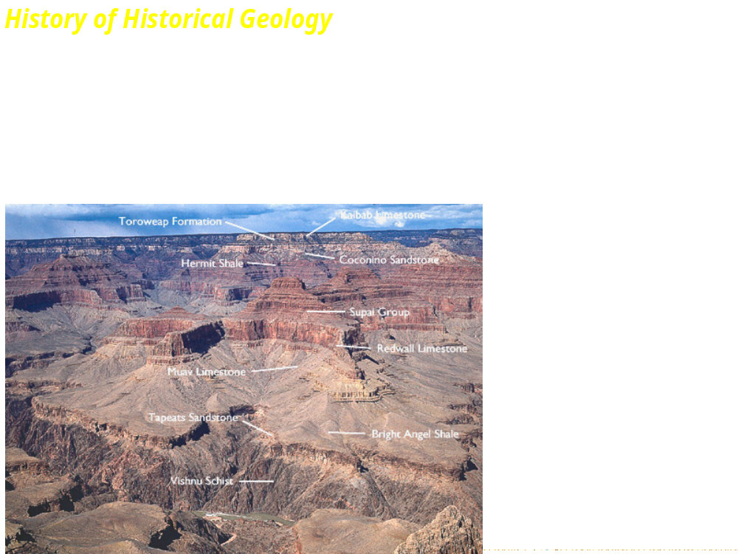

Slide 51
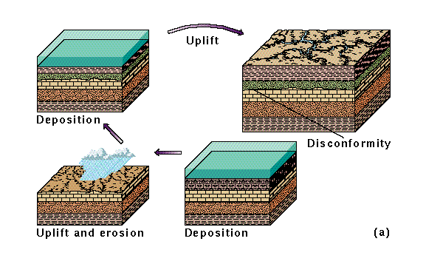
Disconformities
A surface of erosion or non-deposition between
Parallel sedimentary rock beds
of differing ages.

Slide 52
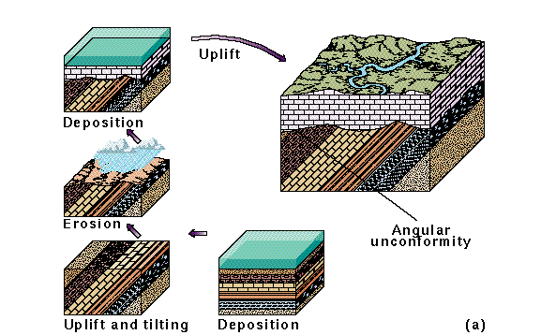
Angular Unconformities
Angular Unconformities
•
An
angular unconformity
is an erosional surface on tilted
or folded strata, over which younger strata have been deposited.

Slide 53
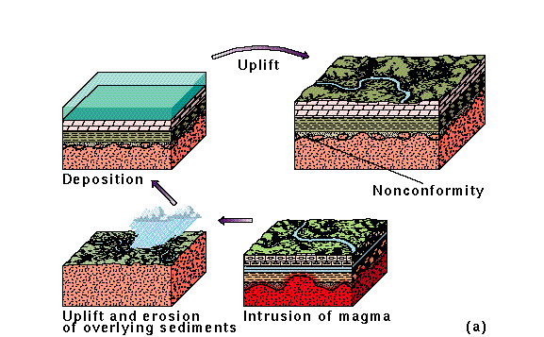
A
nonconformity
is an erosional surface on igneous or
metamorphic rocks which are overlain by sedimentary rocks.

Slide 54
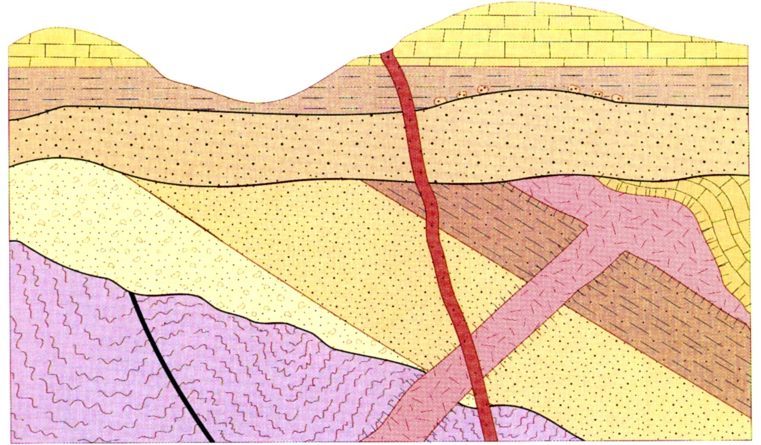
Breakout in to groups and discuss the sequence observed here

Slide 55
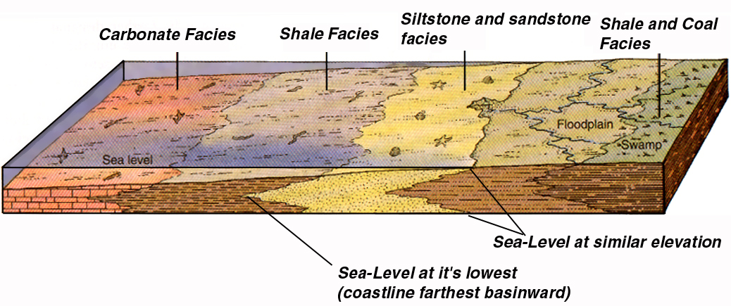
Facies Diagram
•
distribution of lithofacies (rock-types)
-
these are associated with their respective EOD
•
biofacies are similar but refer to fossils rather than
rock types

Slide 56
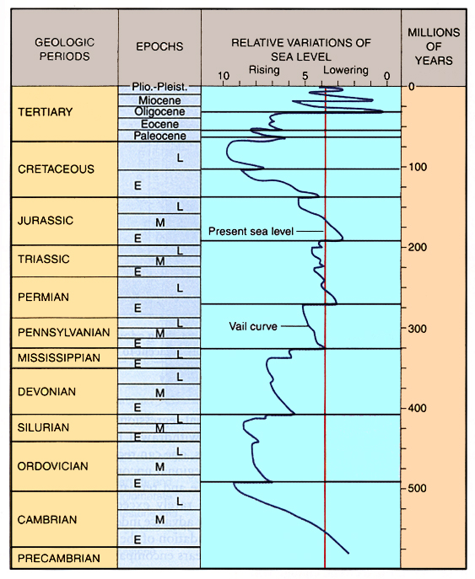
Eustasy, relative sea-level, and relative position
of lithofacies
•
Eustasy= changes in volume of water in ocean
•
lithofacies depend on
-
sea-level
-
land level
-
geometry of coast
-
sediment supply
Vail Curve
•
an attempt at global
•
correlation of
lithologies
-
-

Slide 57
Rock designations
Rock designations
•
•
Rock units called Lithostratigraphic units
Rock units called Lithostratigraphic units
-
described in terms of Group, Formation, & Member
-
described in terms of Group, Formation, & Member
>
each term has specific meanings in geological parlance
>
each term has specific meanings in geological parlance
•
•
Formation
Formation
-
a mappable lithostratigraphic unit
-
a mappable lithostratigraphic unit
>
has a location for identifying the type-section
>
has a location for identifying the type-section
>
has a rock designation describing the lithology
>
has a rock designation describing the lithology
-
sometimes not all the same lithology
-
sometimes not all the same lithology
>
in which case the term "Formation" takes the place of lithologic
>
in which case the term "Formation" takes the place of lithologic
type
type
•
•
Groups are composed of several formations
Groups are composed of several formations
•
•
Members are distinctive units within a formation
Members are distinctive units within a formation
-
group is largest and contains formations and members
-
group is largest and contains formations and members
-
formations are next and contain members
-
formations are next and contain members

Slide 58
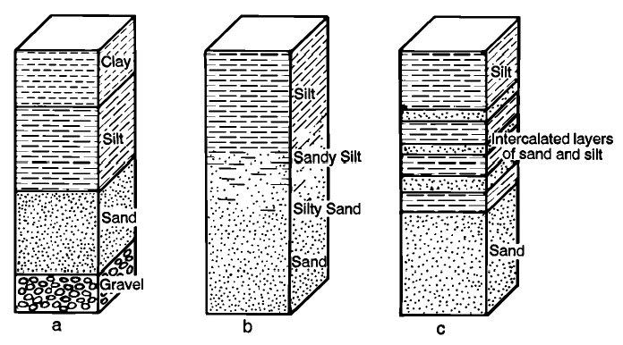

Slide 59
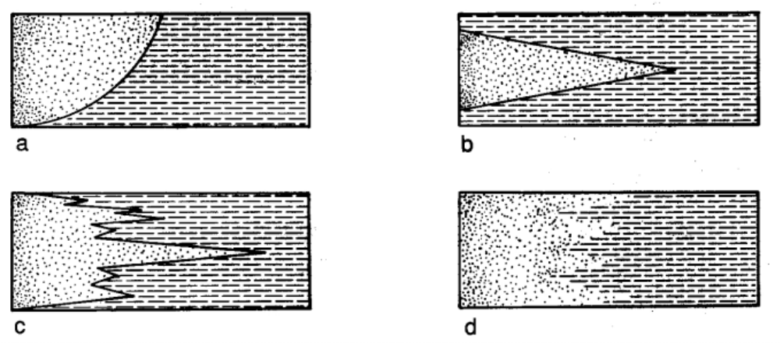
Contacts Between Laterally Adjacent
Lithostratigraphic Units
Lithostratigraphic units do not extend indefinitely laterally,
they eventually terminate against other units.

Slide 60



The sandstone of Delicate Arch started as a sand dune (note bedding, top-right picture).

Slide 61

Double Arch. The dark streaks down the rock are desert varnish, mineral deposits formed partly by microorganisms that grow briefly when rainwater runs down the rock.

Slide 62


Slide 63


Slide 64


Slide 65


Slide 66

FACIES – DEFINITION & RELATIONSHIPS
Sedimentary Facies
Overall lithology (rock-type) reflecting or diagnostic of depositional environment
Examples:
  Sandstone facies
  Mud facies
  Carbonate facies
  Salt facies
General rule: adjective describing depositional environment + “facies”
Note: metamorphic petrologists use facies concept in a similar fashion, e.g. kyanite facies.
Relations between Old Red Sandstone in Wales and marine facies in Devonshire. Intertonguing relationships established Devonian age of the Old Red Sandstone.

Slide 67

Fig. 4.6
ROCK UNITS (LEFT) AND TIME CHART (RIGHT)
Observed rock unit (left) and interpreted time chart on right. Note hiatus corresponding to unconformities. (Hiatus is a time of non-deposition and/or erosion.)

Slide 68

FORMATION – a mappable unit either in the field or by well logs
A GROUP consists of 2 or more FORMATIONS.
A formation is the basic rock unit in geology. IT IS NOT A TIME UNIT. It is defined by its properties: type (sandstone, limestone, etc. e.g. (Bell Shale), color (Brown Niagrian), texture, geometry. The choice is fairly obvious in A, but more difficult in B. In B and C the choice of subdivisions is somewhat arbitrary.

Slide 69


Restored cross section showing facies, thicknesses & unconformities
Time-stratigraphic chart showing time gaps represented by unconformities in B

Slide 70

Two basic types of facies patterns: transgressive and regressive
Recent marine transgression (sea-level rise) on Netherlands coast showing landward shift of facies. Absolute ages from radiocarbon dating. Note shift in facies patterns as sea transgresses. Note how time-lines cross facies boundaries.

Slide 71

Significance of different
rates of evolution and changes in
environment (due to transgression). The
brachiopod evolved slowly and stayed in/on sand facies. It is a poor index fossil. The cephalopods evolved rapidly and are free swimmers. They were changing and widely distributed and thus excellent index fossils.

Slide 72

SLOSS SEQUENCES (6)
Six unconformity bounded sequences from which a world-wide sea-level fluctuation curve has been inferred (the “Vail” curve).
Note two maxima (highs) at about 500 and 75 million years and three minima at 600, 200 and the present.
Max +350 to -150 m above and below present.

