Slide 2
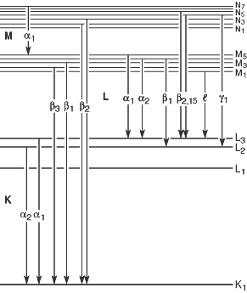
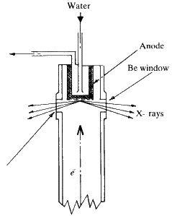
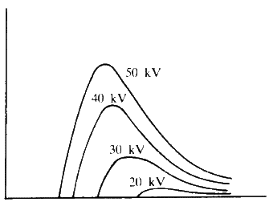
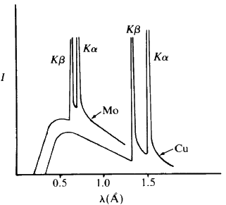
X-ray sources
X-rays have the proper wavelength (in the Ångström range, ~10⁻¹⁰ m) to be scattered by the electron cloud of an atom of comparable size (we will look at this in much more detail later).
White radiation
X-rays are produced by accelerating electrons into a metal target. This produces mostly heat (cooling is essential) and “white” radiation (Bremsstrahlung). If enough energy is provided, some of the incoming electrons will collide with and eject core (K shell, 1s) electrons. Higher energy electrons release energy characteristic of the target to fill the hole – if Δn = 1, the transition is called α, if Δn = 2, the transition is called β.

Slide 3
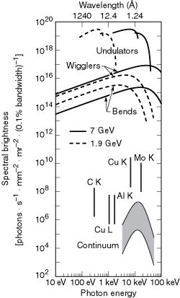
X-ray sources
Selected X-Ray Wavelengths and Excitation Potentials.
 | Cr | Fe | Cu | Mo
Z | 24 | 26 | 29 | 42
Kα₁, Å | 2.28962 | 1.93597 | 1.54051 | 0.70932
Kα₂, Å | 2.29351 | 1.93991 | 1.54433 | 0.71354
Kα_{ave}, Å | 2.29092 | 1.93728 | 1.54178 | 0.71073
Kβ, Å | 2.08480 | 1.75653 | 1.39217 | 0.63225
β filter | Ti | Cr | Ni | Nb
Resolution, Å | 1.15 | 0.95 | 0.75 | 0.35
Excit. Pot. (kV) | 5.99 | 7.11 | 8.98 | 20.0
There are several other sources of X-rays, such some radioactive materials and synchrotrons. Synchrotrons produce a significantly higher flux (particles area⁻¹ time⁻¹) of X-rays and the wavelength of the radiation may changed, as necessary. A high-flux source offers many advantages including reduced experimental time and smaller allowable crystal sizes.
An excellent site for information about X-rays and Synchrotrons: http://xdb.lbl.gov/

Slide 4
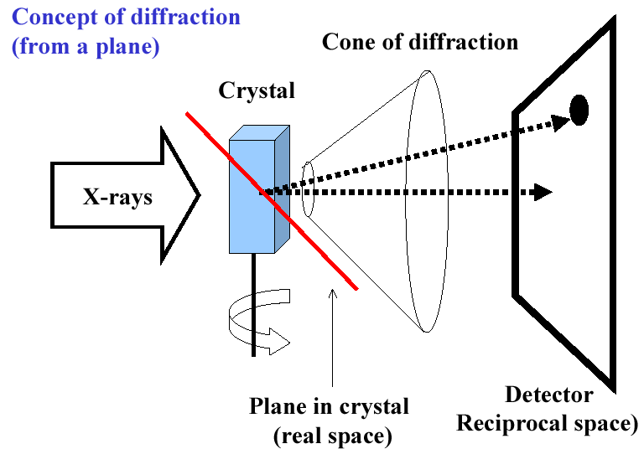
7.3 X-ray diffraction of crystals

Slide 5
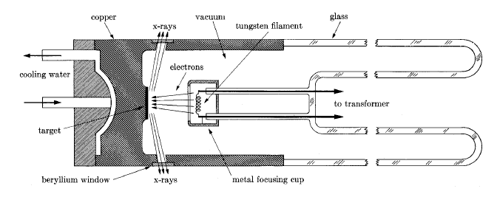
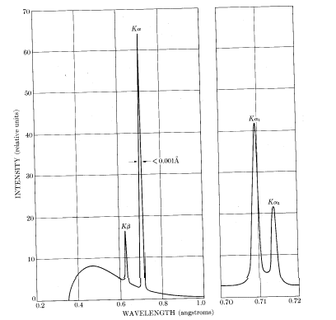
7.3.1 The source and property of X-ray
X-ray tube
the wavelengths of X-ray are in the range
of 100-0.01Å
1-0.01Å: hard x-ray
100～1Å：soft x-ray
2.5-0.5Å: used in crystal structure analysis
1-0.05Å: used in medical perspective, detection of materials wound

Slide 6
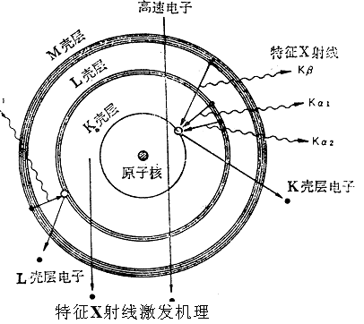
X-rays produced by electronic transition between atomic energy levels
High energy electron beam
A part of the electrons are blocked; their kinetic energies giving rise to “white” x-ray.
M
L radiation
L
K
As for Cu:
K_{α1}=1.540594Å
K_{α2}=1.544422Å
e
1.54056Å
e
I_{Kα1} ≈ 2I_{Kα2}
Notes:
K_{α1}、K_{α2}因其副量子数不同而稍有差异
连续X射线谱
高能电子受靶原子电场减速, 发射连续X射线
特征X射线谱
当具有足够能量的电子(大于或等于壳层电子的结合能)轰击阳极靶时,可能将原子内层的电子逐出,使电子电离而处于激发态,空位将被高能量壳层的电子来填充,能量差则以X射线光子的形式辐射出来,结果得到具有固有能量,固定频率或固定波长的X射线.
如果是K壳层的电子被逐出, 有其它较高能级的外层电子填充而产生的X射线称为K系X射线.由L层电子填充者为K_{α}射线,有M层电子填充的称为K_{β}射线.其它类推. En-E_{k}=hν=hc/λ_{k}
原子间各壳层的能量差随原子序数的增加而增加, 故特征X射线的波长随原子序数的增加而变短.

Slide 7
K_{α1}
K_{α2}
Notice: K_{α2} can not be striped by the monochromator.

Slide 8
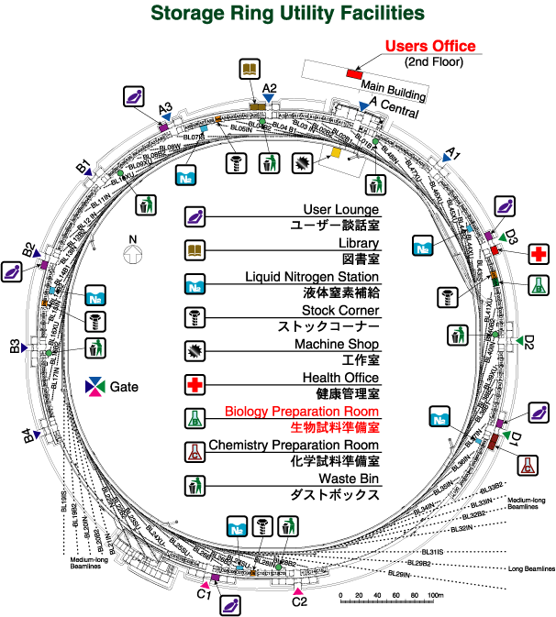
Synchrotron Radiation X ray Source

Slide 9
