Slide 1
Q1: How do we determine the crystal structure?

Slide 2
X-Ray Diffraction
Diffracted Beam
Sample
Incident Beam
Transmitted Beam
Diffracted
Beam

Slide 3
X-Ray Diffraction
Diffracted Beam
Sample
≡ Bragg Reflection
Incident Beam
Transmitted Beam
Braggs Law (Part 1): For every diffracted beam there exists a set of crystal lattice planes such that the diffracted beam appears to be specularly reflected from this set of planes.

Slide 4
X-Ray Diffraction
Braggs’ recipe for Nobel prize?
Call the diffraction a reflection!!!

Slide 5
X-Ray Diffraction
Braggs Law (Part 1): the diffracted beam appears to be specularly reflected from a set of crystal lattice planes.
Specular reflection:
Angle of incidence
=Angle of reflection
(both measured from the
plane and not from
the normal)
The incident beam, the reflected beam and the plane normal lie in one plane
i
r
θ
θ
plane

Slide 6
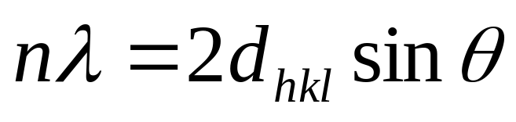
X-Ray Diffraction
i
r
θ
θ
d_{hkl}
Bragg’s law (Part 2):

Slide 7
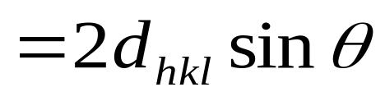
i
r
θ
θ
θ
θ
d_{hkl}
P
R
Q
Path Difference =PQ+QR

Slide 8
i
r
θ
θ
P
R
Q
Path Difference =PQ+QR
Constructive inteference
Bragg’s law

Slide 9
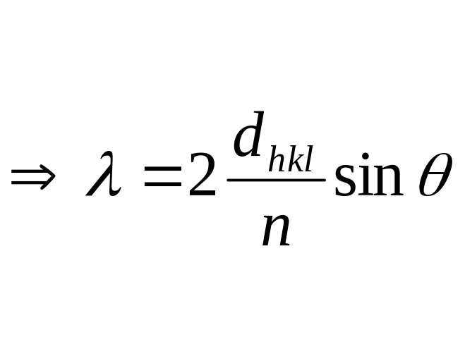
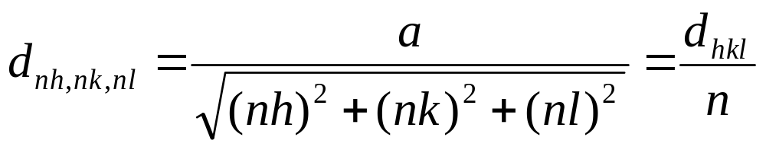

Two equivalent ways of stating Bragg’s Law
1st Form
2nd Form

Slide 10
Two equivalent ways of stating Bragg’s Law
n^{th} order reflection from (hkl) plane
1st order reflection from (nh nk nl) plane
≡
e.g. a 2nd order reflection from (111) plane can be described as 1st order reflection from (222) plane

Slide 11
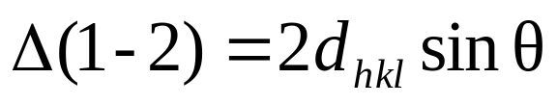
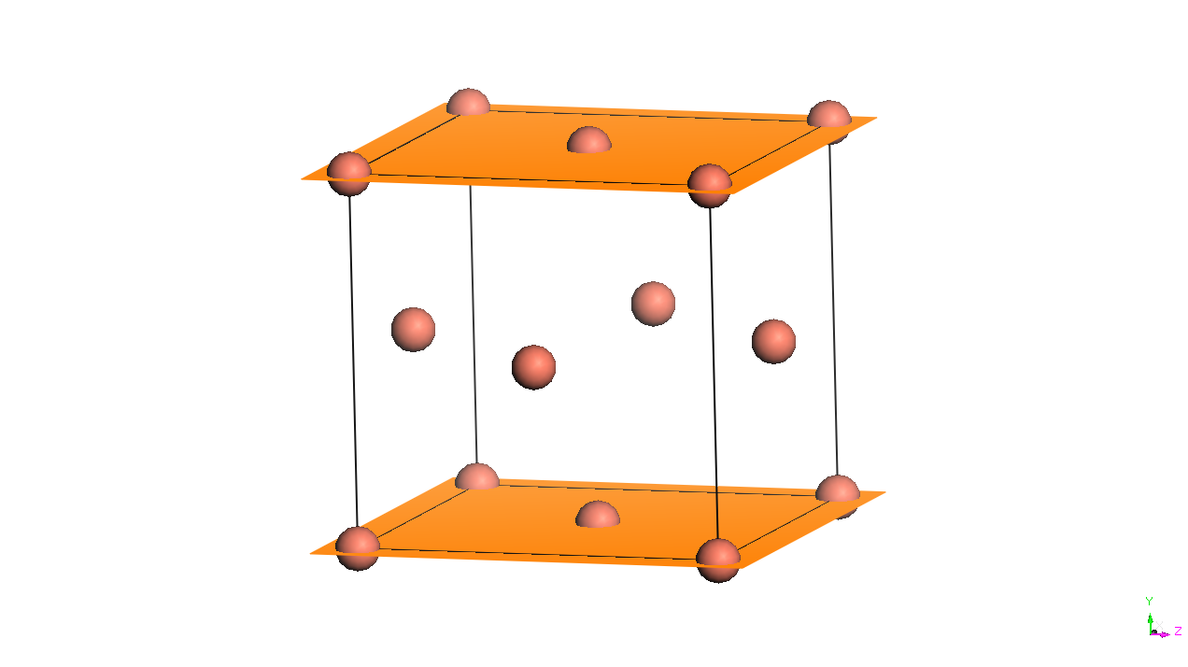
BRAGG VIEW OF DIFFRACTION
X-rays that hit the crystal are elastically scattered by the sets of (hkl) planes
The path difference for rays 1 and 2 equals to the length of two blue lines:
1
1′
θ
θ
2
θ
θ
2′
d_{hkl}
θ
θ

Slide 12
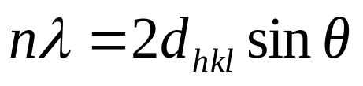
BRAGG LAW
The diffraction maxima will be created by reflection from a set of planes at angle θ that results in the integer wavelength difference in the path of the rays:
Consequence 1:
Each set of planes (hkl) is characterized by its own value θ_{hkl} at which the diffraction maximum is observed
Consequence 2:
Each crystalline compound is characterized by a set of reflections at characteristic d_{hkl} , or θ_{hkl} (diffraction “fingerprint” of the compound)

Slide 13
BRAGG VIEW OF DIFFRACTION
1
1′
θ
θ
2θ
d_{hkl}
The deviation of the ray from its initial path equals 2θ

Slide 14
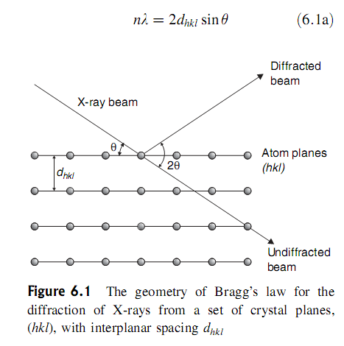

Slide 15
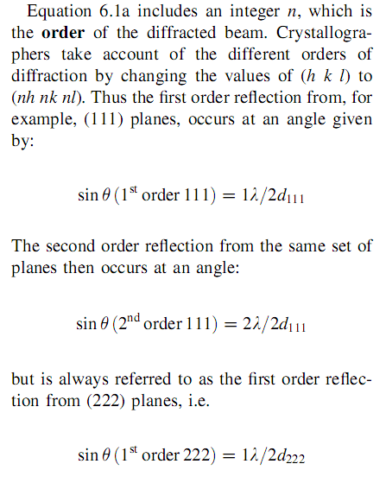

Slide 16
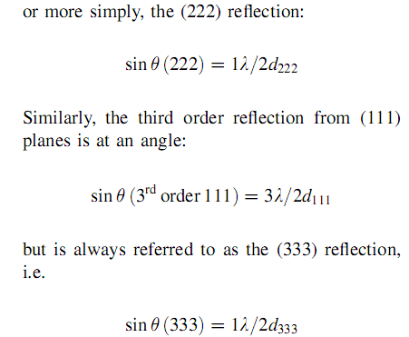

Slide 17

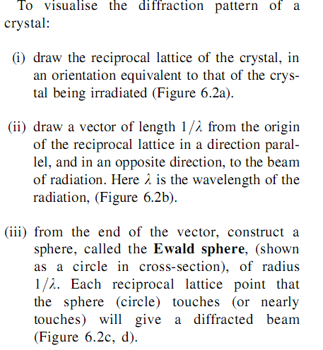

Slide 18
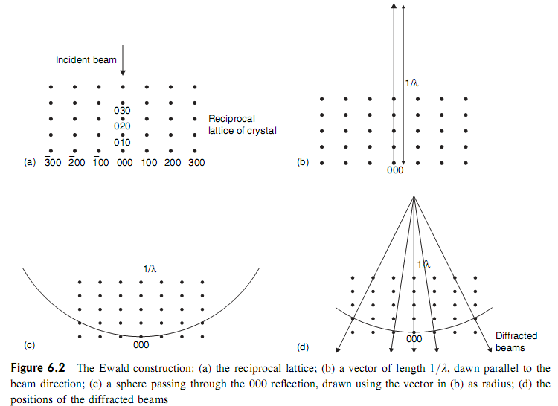

Slide 19
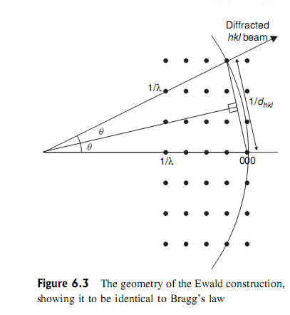

Slide 20
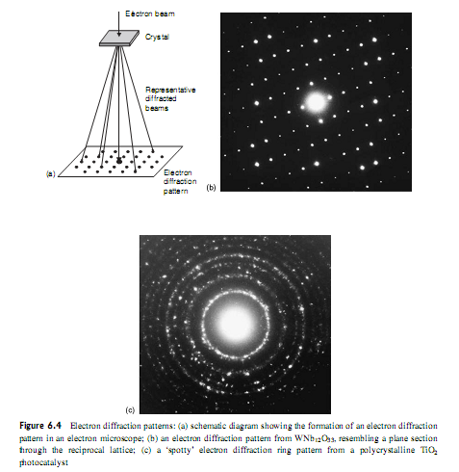

Slide 21
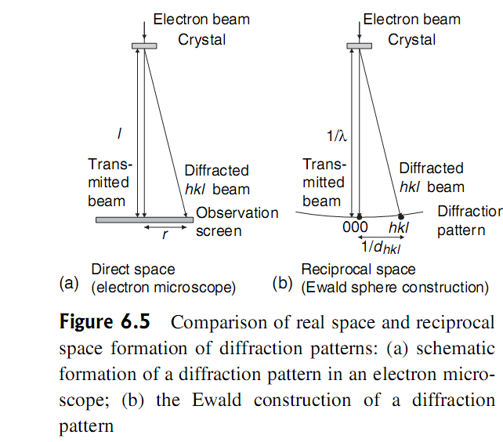
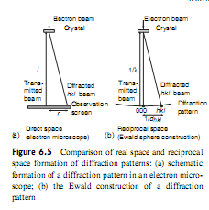

Slide 22
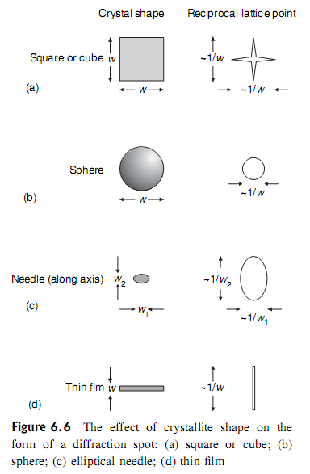

Slide 23
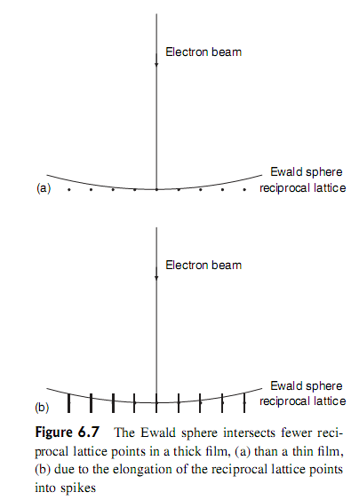

Slide 24
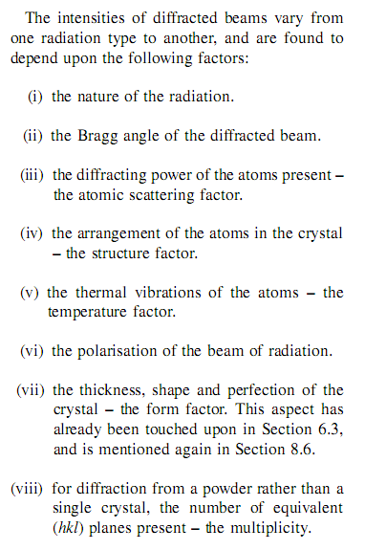

Slide 26
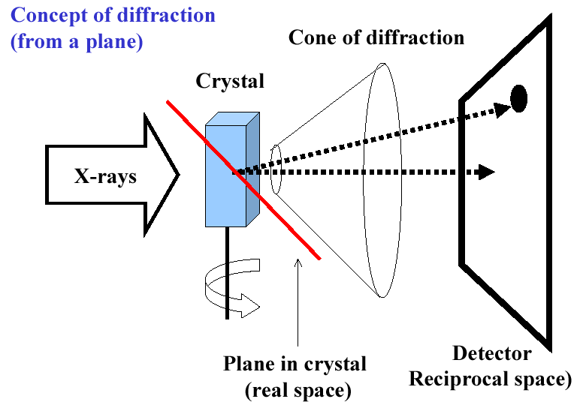
7.3 X-ray diffraction of crystals

Slide 27
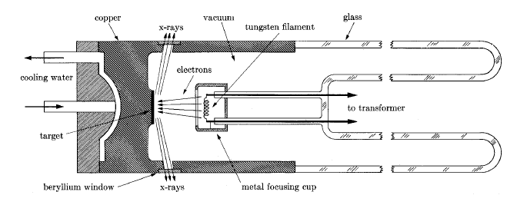
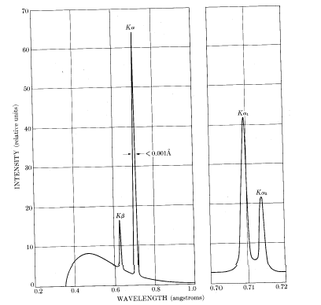
7.3.1 The source and property of X-ray
X-ray tube
the wavelengths of X-ray are in the range
of 100-0.01Å
1-0.01Å: hard x-ray
100～1Å：soft x-ray
2.5-0.5Å: used in crystal structure analysis
1-0.05Å: used in medical perspective, detection of materials wound

Slide 28
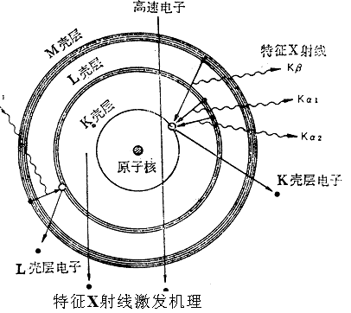
X-rays produced by electronic transition between atomic energy levels
High energy electron beam
A part of the electrons are blocked; their kinetic energies giving rise to “white” x-ray.
M
L radiation
L
K
As for Cu:
K_{α1}=1.540594Å
K_{α2}=1.544422Å
e
1.54056Å
e
I_{Kα1} ≈ 2I_{Kα2}
Notes:
K_{α1}、K_{α2}因其副量子数不同而稍有差异
连续X射线谱
高能电子受靶原子电场减速, 发射连续X射线
特征X射线谱
当具有足够能量的电子(大于或等于壳层电子的结合能)轰击阳极靶时,可能将原子内层的电子逐出,使电子电离而处于激发态,空位将被高能量壳层的电子来填充,能量差则以X射线光子的形式辐射出来,结果得到具有固有能量,固定频率或固定波长的X射线.
如果是K壳层的电子被逐出, 有其它较高能级的外层电子填充而产生的X射线称为K系X射线.由L层电子填充者为K_{α}射线,有M层电子填充的称为K_{β}射线.其它类推. En-E_{k}=hν=hc/λ_{k}
原子间各壳层的能量差随原子序数的增加而增加, 故特征X射线的波长随原子序数的增加而变短.

Slide 29
K_{α1}
K_{α2}
Notice: K_{α2} can not be striped by the monochromator.

Slide 30
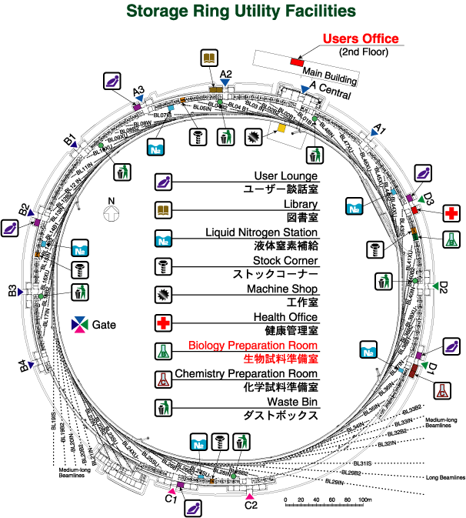
Synchrotron Radiation X ray Source

Slide 31
